Slide 1
November 2015
Sam Simpson
DSA Ireland Conference
Funding the Future
Knowledge, Research and a Self-Sustaining Approach to a Global Challenge

Slide 2
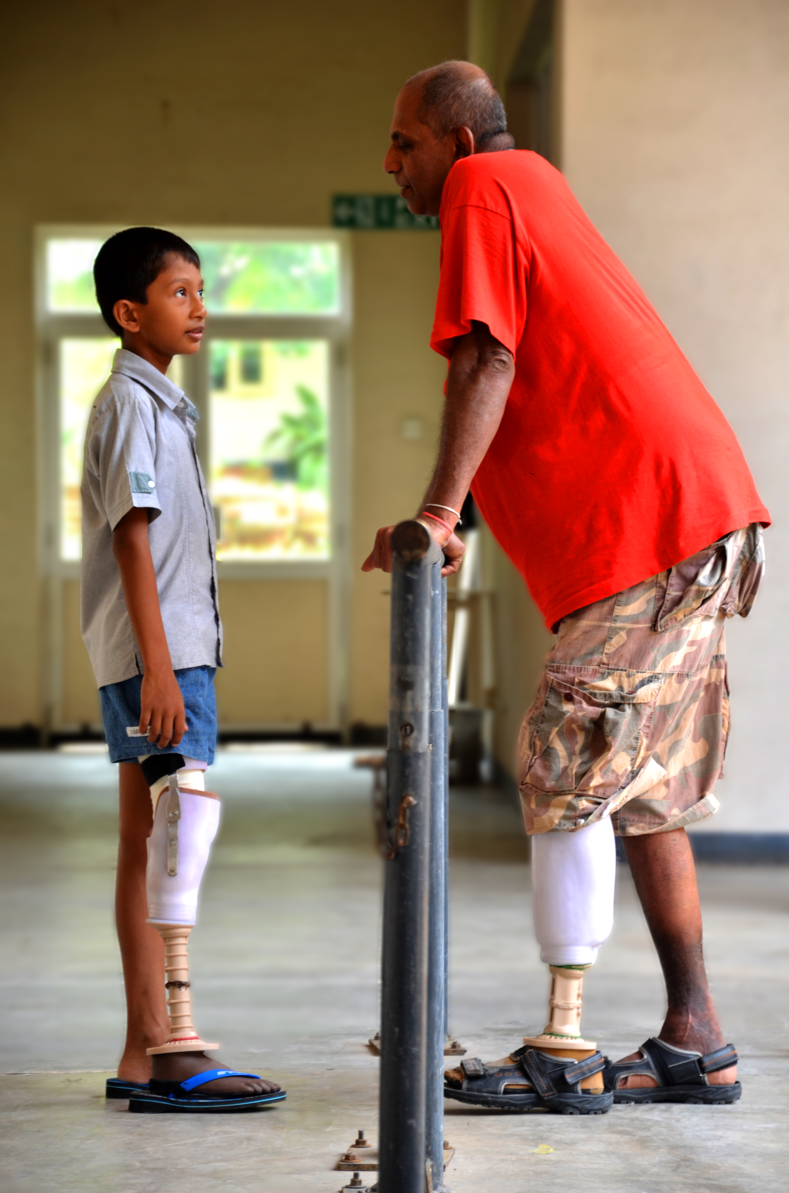
Presentation
Exceed Worldwide
A Global Challenge
The Idea
Research
Advantages
Progress
The Future

Slide 3
Exceed Worldwide – UK Registered Charity
Supports people with disabilities;
Prosthetics & Orthotics (P&O)
Education;
P&O rehabilitation;
Community based rehabilitation.

Slide 4
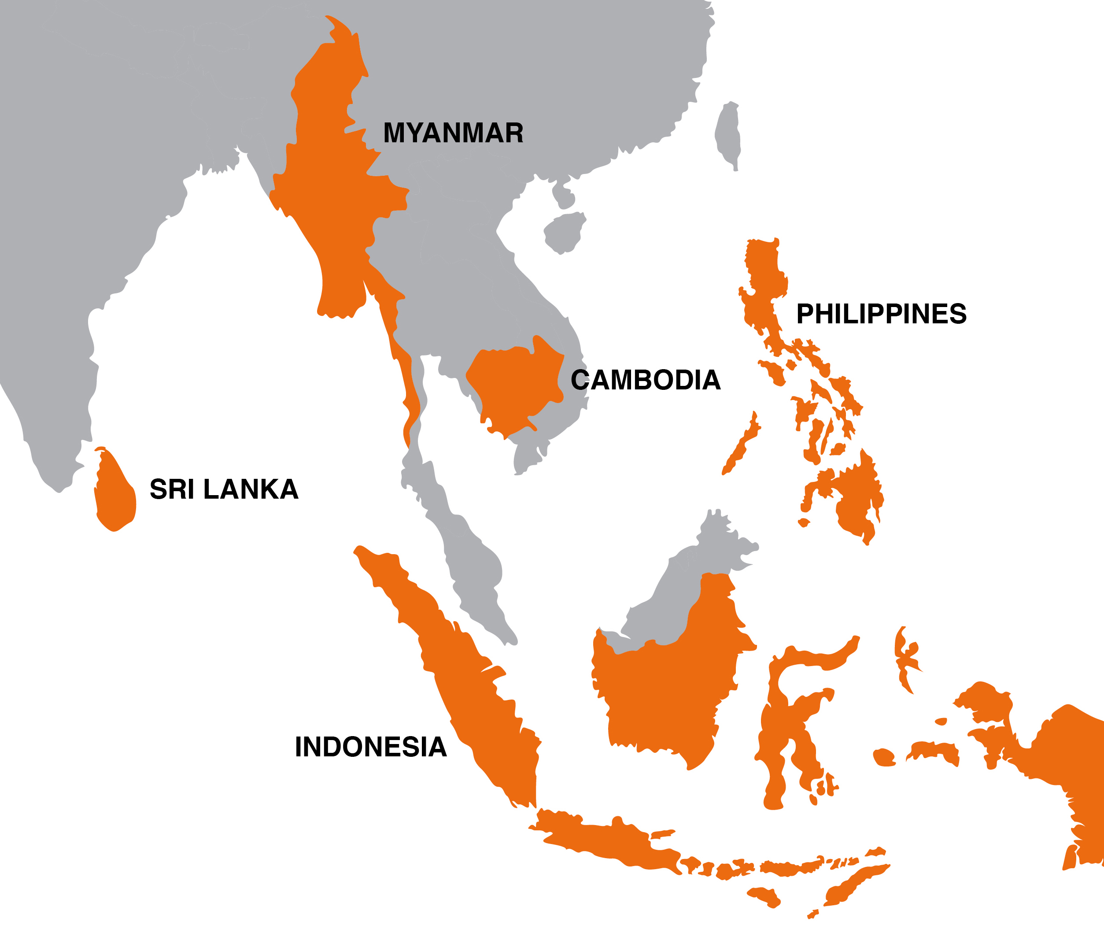
Exceed Worldwide
S and SE Asia
P&O Schools & Clinics
10,000 clients per year
5,500 new devices
CBR
Access to university
Partnership
Evolving – research, funding base
Purpose unchanged
Notes:
CBR – identification, treatment, education, training, business support, advocacy, community relations

Slide 5
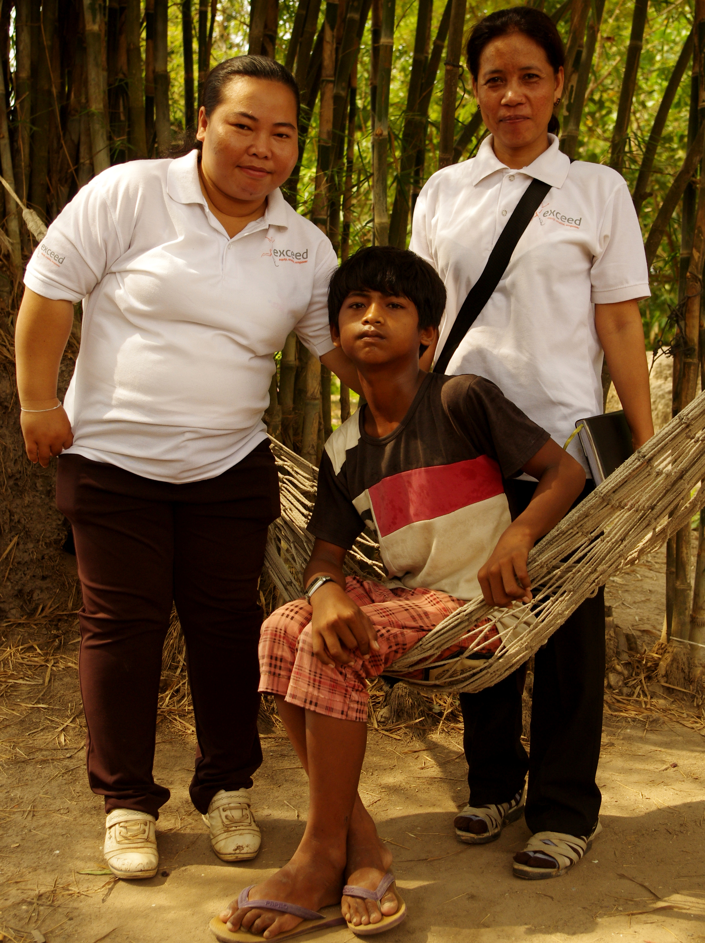
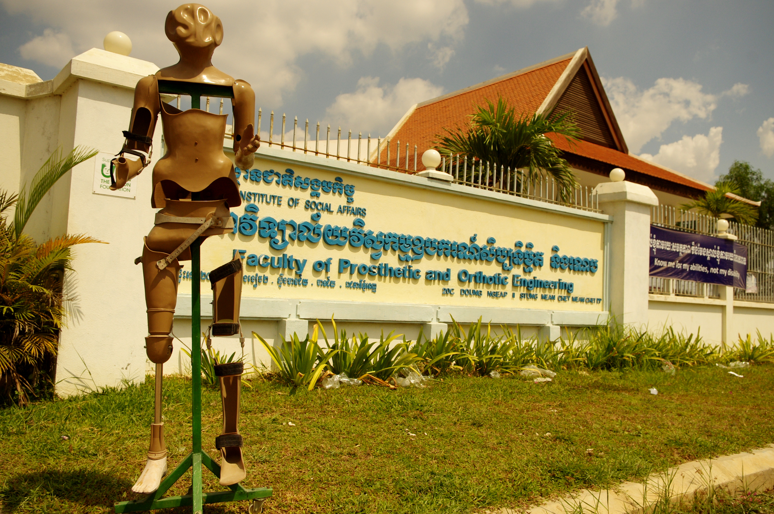
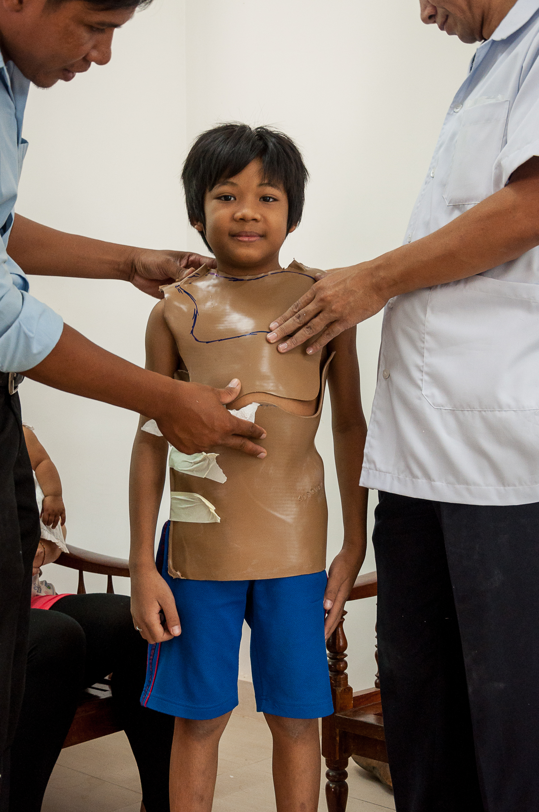
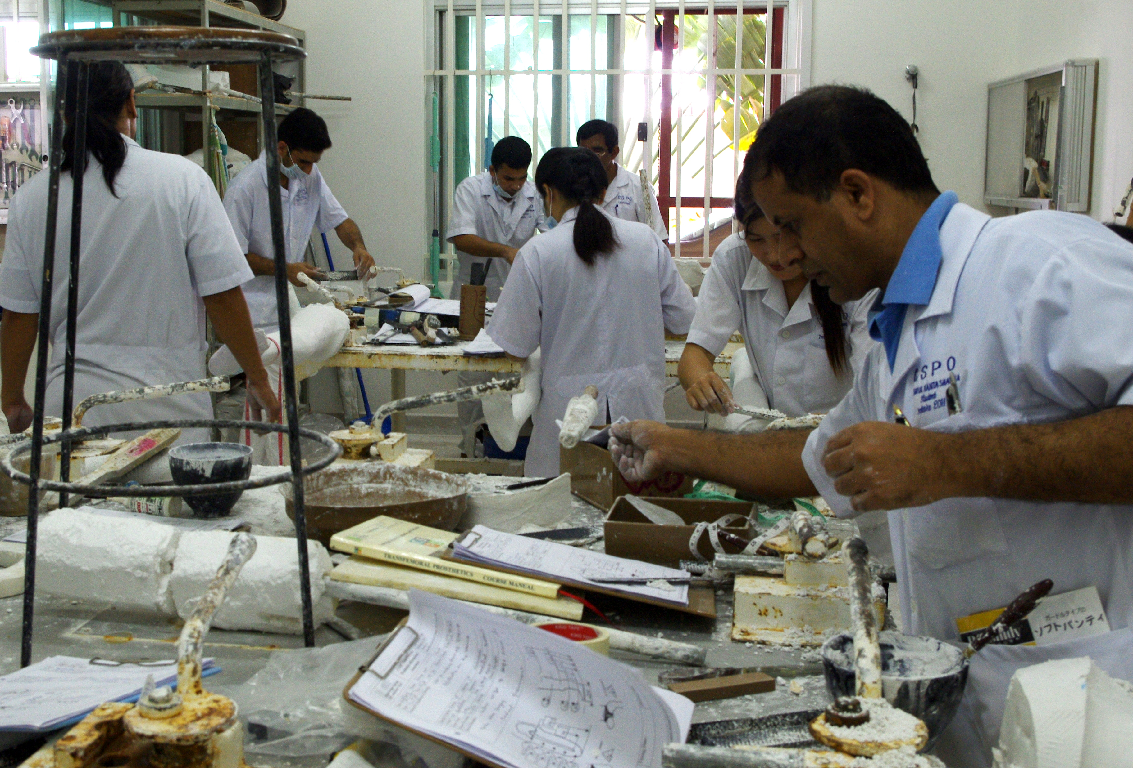
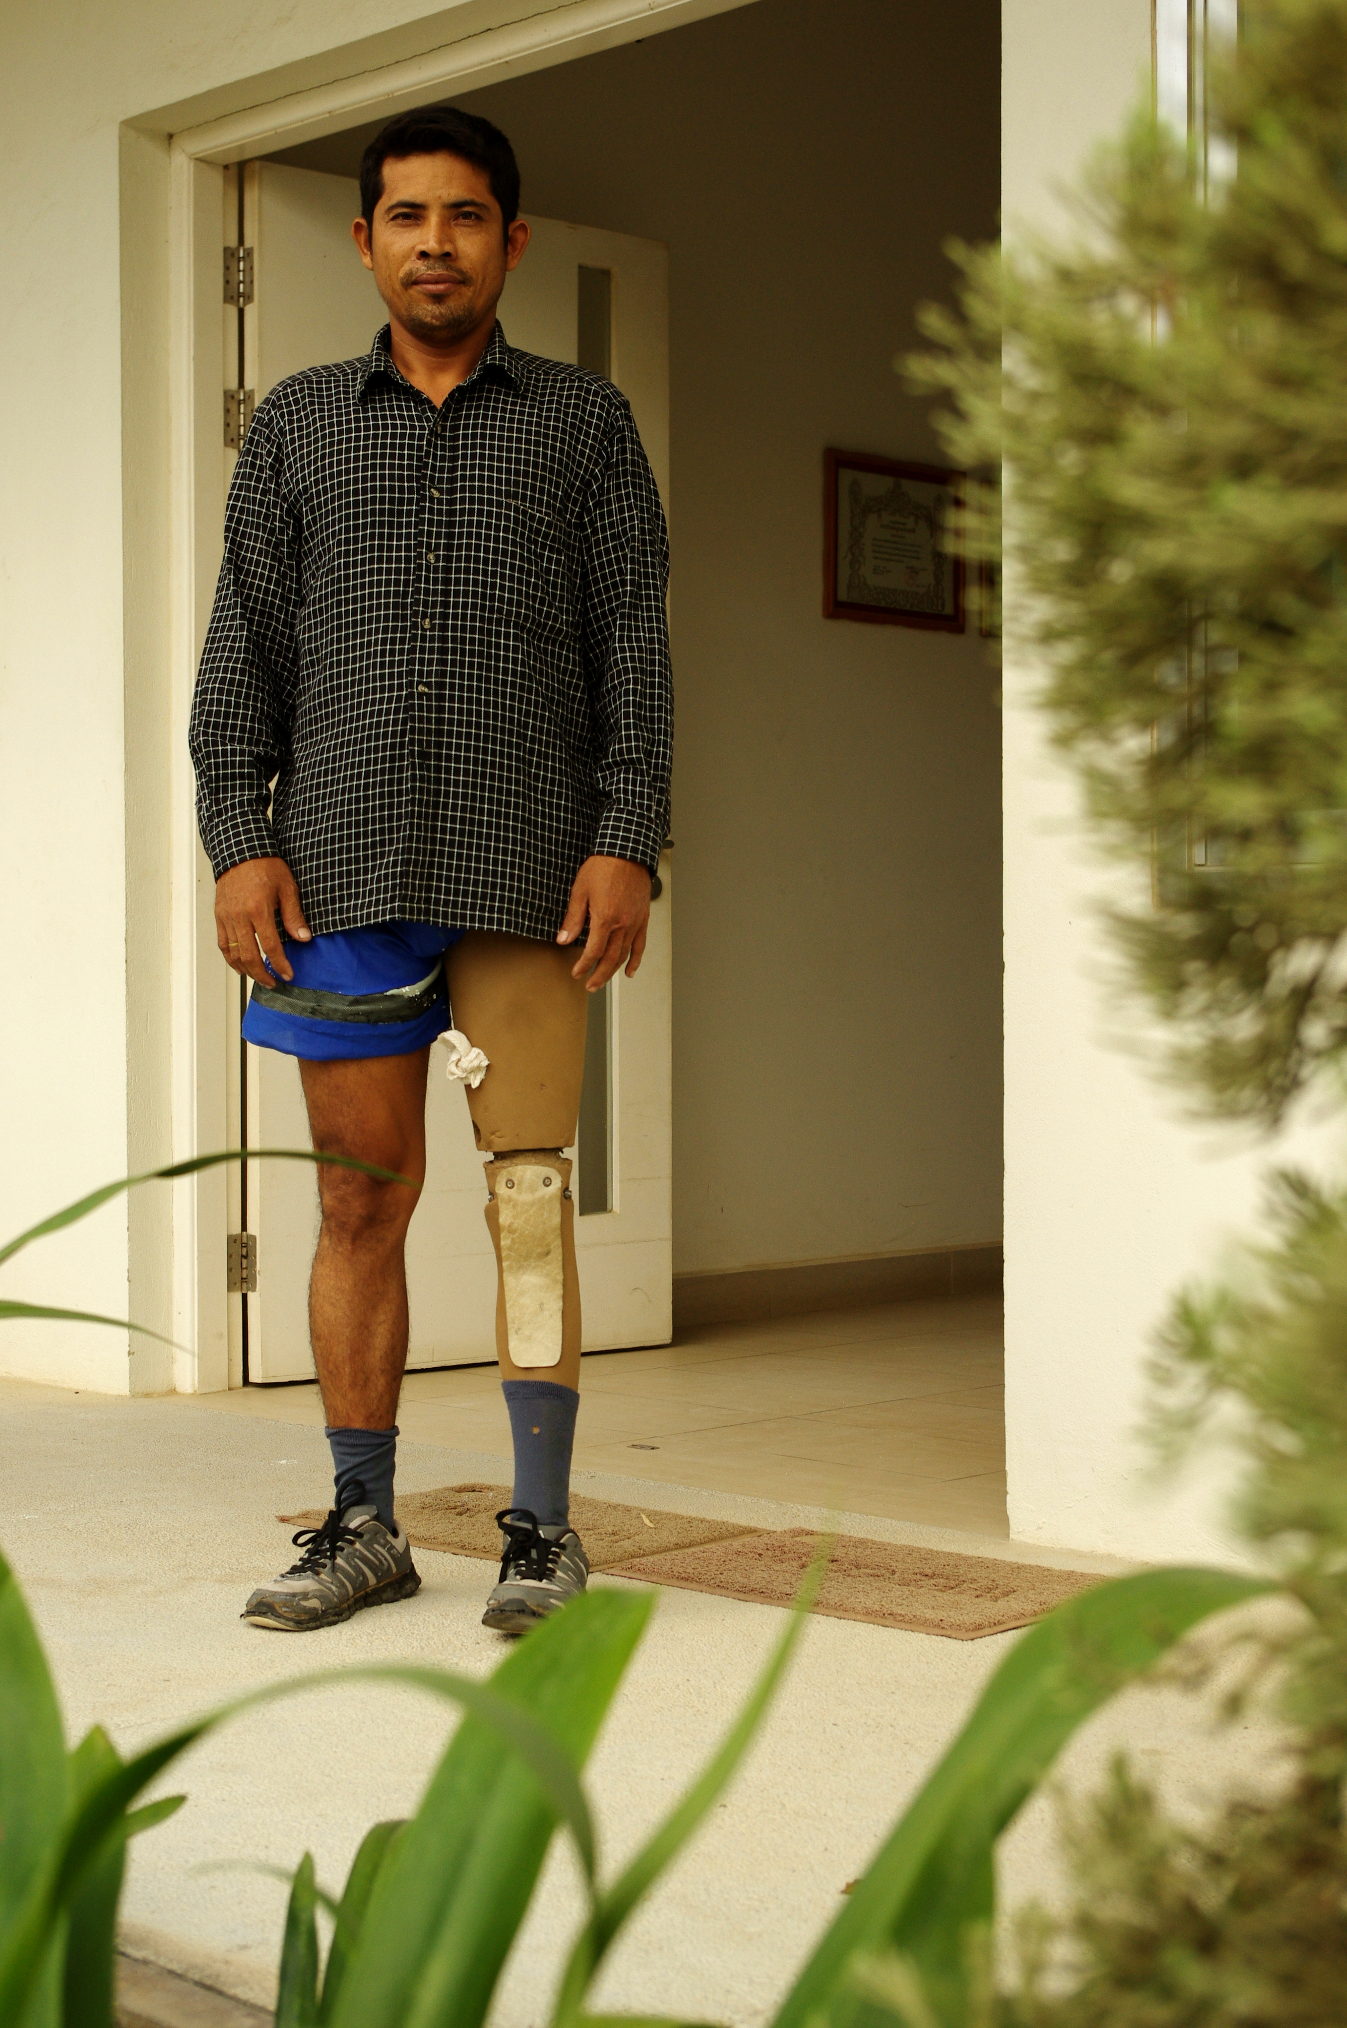
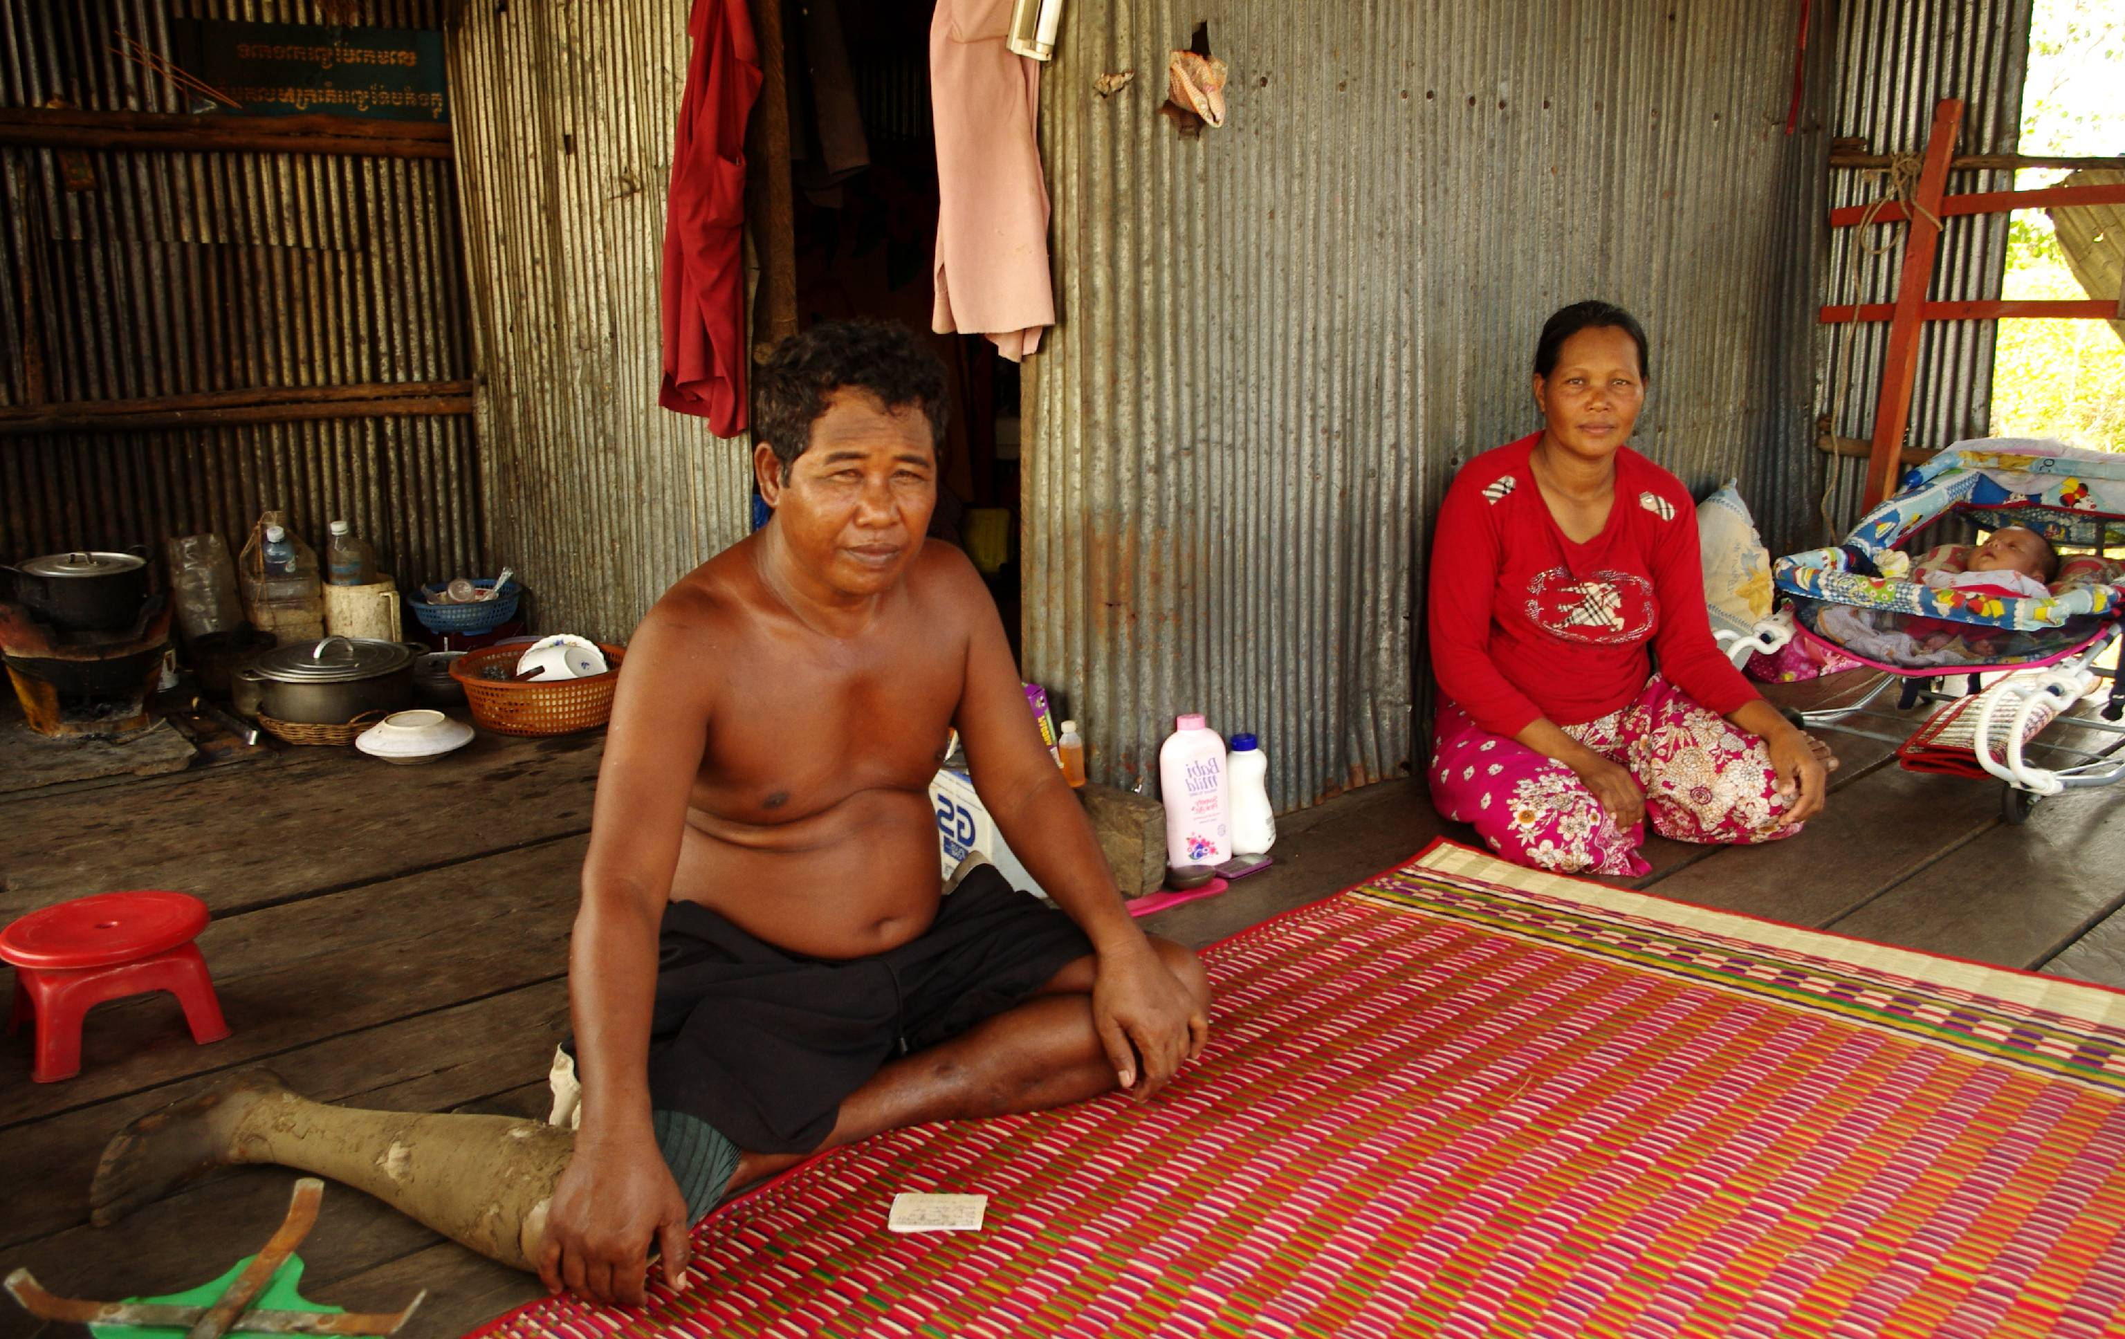
Exceed Worldwide
Notes:
CBR – identification, treatment, education, training, business support, advocacy, community relations

Slide 6
The Global Challenge
80% of those who need P&O services do not have access to them.
Situation will get worse.....
.....unless something is done
But what?
Notes:
Shortage of POs – services not available
Disability not a high priority
Cost of private services
Situation will get worse – ageing populations, lifestyle and non-communicable diseases = much higher levels of impairment and need for P&O services, governments unable or unwilling to address the issue.
Figures for S and SE Asia 2015-25.

Slide 7
The Idea
Social Enterprise
To access the resources of the wealthy in particular developing countries to fund philanthropic P&O services for those least able to pay.

Slide 8
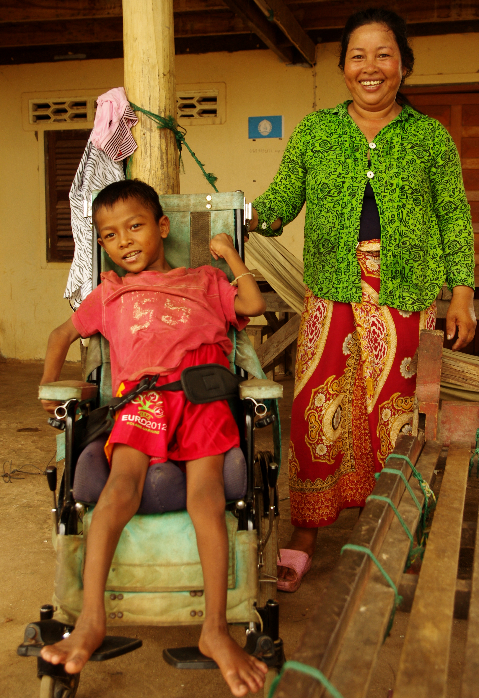
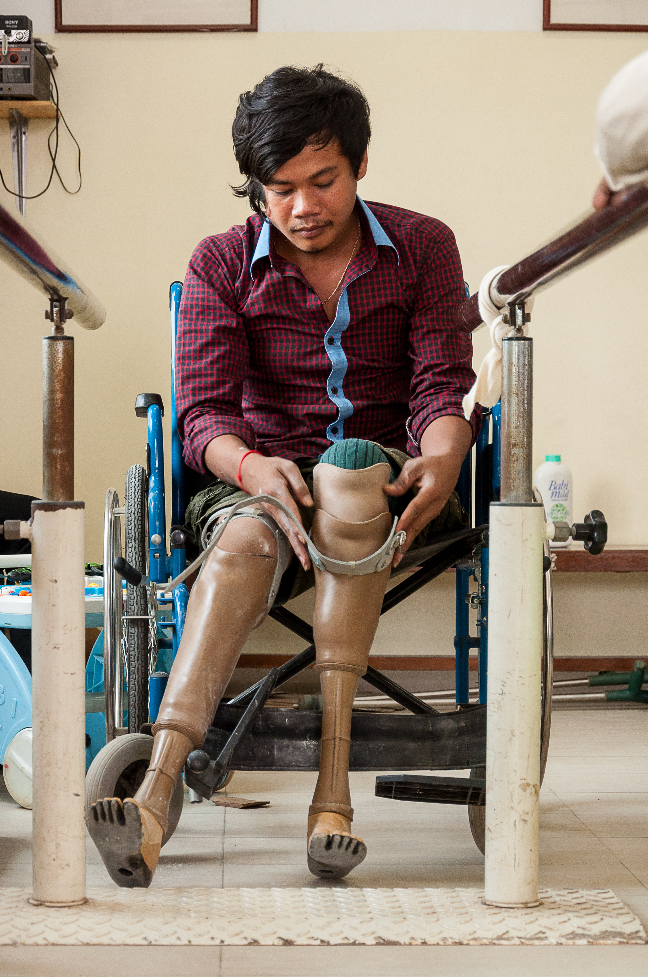
The Idea

Slide 9
Questions
What?
Will it work?
Why?
Should you do it?
Reasons not to?
How?
Notes:
What:
Private P&O clinics
P&O Supply and Distribution
Why:
Charitable services
‘Traditional’ funding harder to obtain
Reliable source of funding
Sustainable services
Product, services, skills
Window of opportunity
Market
Advantages
How:
How to fund?
Structure?
Location?
Initial scale?
Rate of development?
Reasons not to:
Risk to charity
Ability of charity to run a very large business
Unfriendly business environments and related challenges

Slide 10
Research
Desk research
Market intelligence
Primary research
Notes:
Desk Research – drawing upon numerous published sources for statistics, analysis and more qualitative issues like challenges / barriers to establishing a social enterprise – e.g. ADB, World Bank, ASEAN, WHO, UN, ISPO, government statistics, market research reports (e.g. health systems, PMI), US National Library of Medicine, academic papers.
Market Intelligence – qualitative research (e.g. Talking to private sector P&O companies; government agencies [e.g. Public health insurance; employee support] about what’s going on in the market – level of provision, who are the customers; level of demand for private services; barriers / challenges; level of competition; problems potential customers are having.
Field Research – no info about P&O distribution = field / primary research supported by market intelligence – Sri Lanka, 12 buyers, estimated market size, extrapolation for other countries (adjusted for size of distribution area; level of economic development, competition)

Slide 11
Desk Research – socio-economic trends
Population Growth
Economic Growth
Emerging middle class
Lifestyle – disease prevalence
Ageing populations
Private medical sector & PMI
Under-provision of P&O services
Interest from private sector P&O suppliers
Notes:
Middle Class Migration
2009 2020 2030
Number:
% Europe/N America 44 32 21
% Asia Pacific 28 54 66
Purchasing Power:
% Europe/N America 64 46 30
% Asia Pacific 23 42 59
Sri Lanka economic growth (ADB) – GDP forecasts:
2013 2014 2015
7.3% 7.5% 7.5%
SE Asia (OECD) – 2014-18 average 5.4%, least growth in wealthiest countries (Brunei and Singapore – 2%-3% per annum), fastest growth in least developed countries (CMVL) average 6.7%
Diabetes – UK 6% - 36% increase in amputations; Philippines already 16%
Sri Lanka – studies show increasing prevalence of diabetes – e.g.
International Diabetes Federation SE Asia Region (IDF SEA) – Bangladesh, India, Maldives, Mauritius, Nepal, Sri Lanka – currently 75m people with diabetes, projected 123m by 2030 (+64%);
Sri Lanka – 2014 1.1m people have diabetes (8.3% adults),
2. King’s College London – 2012 study – 1 in 5 adults had diabetes or pre-diabetes, over 20% children aged 10 to 14 had 2 or more risk factors for diabetes
3. US National Library of Medicine – stuidy of over 5000 adults ages 18+ - 2005 10% prevalence, predicted 14% prevalence by 2030.
Health:
Overall health expenditures increased two and a half times between 1998 and 2010 – from $US 28 billion to $US 68 billion – 8% growth per year.
Private insurance accounted for 4% of the 2010 figure - $2.7 billion. This will rise to 6% of a $US 173 billion market by 2020 - $US 10.4 billion.
Three major factors are driving this development - steady population growth, steep increases in medical costs, and – most importantly – increases in per capita consumption of healthcare services.
Per capita expenditure on healthcare rose from an average of $US 60 per year in 1998 to $US 115 in 2010 and will increase to $US 264 in 2020.
WHO reports that healthcare currently accounts for 4% of the GDP of ASEAN countries, which is low when compared the OECD average of 9.5%. This is considered to be a sign of the potential of South East Asia, rather than a drawback.
Under Provision of P&O Services:
In 2005, WHO it was reported that there were 24 prosthetic and orthotic schools in developing countries, graduating 400 trainees annually and that worldwide training facilities for prosthetic and orthotic professionals and other providers of essential rehabilitation services were deeply inadequate in relation to need. Estimates in the same report indicated that 30 million people in Africa, Asia, and Latin America require an estimated 180,000 rehabilitation professionals.
This situation has changed little and this puts Exceed, with its experience of establishing P&O schools in less-developed countries WHO and International Society for Prosthetics and Orthotics. Guidelines for Training Personnel in Developing Countries for Prosthetics and Orthotics Services, Geneva, World Health Organization, 2005.
Otto Bock, Blatchford, Ossur, Fillauer

Slide 12
Need for P&O Services
2015 2025
SE Asia, Indian & Sri Lanka 9.8m 13.0m
SE Asia & Sri Lanka 3.4m 4.4m
‘Exceed 4’ Countries 2.0m 2.7m

Slide 13
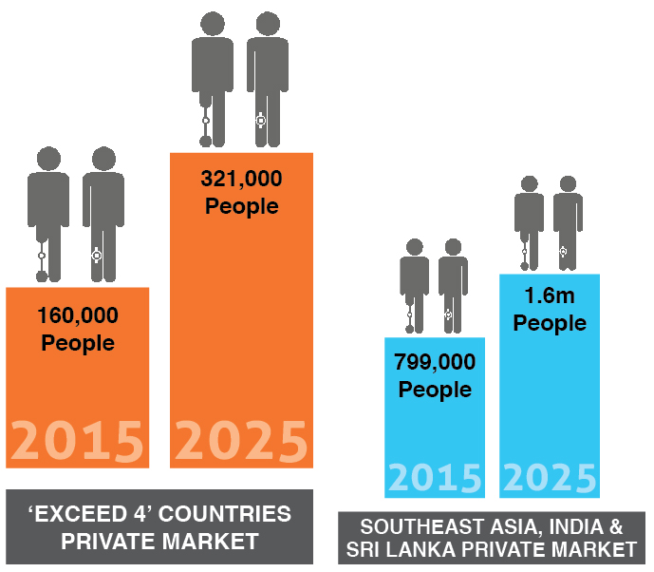
Pay for P&O Services

Slide 14
Value of Private P&O Market
Notes:
Exceed 4 countries - $118m (2015) to $299m (2025)
SE Asia & Sri Lanka - $208m (2015) to $483m (2025)

Slide 15
Market Intelligence
Customers
Barriers / Challenges
Competitor Attitudes
Exceed Advantages
Notes:
Barriers / challenges: unfriendly business environments (time to set up businesses, bureaucracy, import and taxation issues, corruption and cash economies, need for local knowledge and partners, negotiation style and saving face, variations in political, legal, banking and business environments); misinformation and attempted ‘sabotage’; misunderstanding and scepticism in major development agencies; separation of charity and business.
Competitor / Potential Competitor Attitudes – limited number of local competitors who have never been challenged; big companies have targeted wealthy companies – can therefore be partners rather than competitors
Customers – Clinics (referrals from medical professionals; government agencies; private hospitals; other NGOs; self referral); Distribution (government and govt agencies; NGOs; private hospitals; private P&O clinics; Exceed P&O Schools)
Exceed Advantages – experience of region and countries; Exceed reputation; access to workforce and provision of career path; business knowledge and skills; r’ships with major private P&O companies; CEO of ESE (market knowledge and contacts); distribution agreements

Slide 16
Primary Research - Distribution
Survey of purchasing behaviour of 12 main buyers in Sri Lanka
Market Value Sri Lanka
Extrapolation
$30m market in 4 countries
Strong interest in dependable local supply
Exceed advantages
Notes:
Exceed advantages - price

Slide 17
What are we doing?
Network of Private P&O
Clinics in South and
South-East Asia
Distribution /
Manufacturing
facilities
Funding

Slide 18
Structure

Slide 19
2025 – Transformational Change
Outlets Annual Total
Clients Clients
100 Private Clinics 4,800 480,000
Services 12 Private Hospitals 3,000 36,000
9 P&O Schools 2,000 18,000
50 Philanthropic P&O Clinics 4,000 200,000
Total 734,000

Slide 20
Poverty - $1.51 /person/day
2015 2025
Southeast Asia 32% / 185m 16% / 101m
South Asia 55% / 831m 35% / 587m

