Slide 1
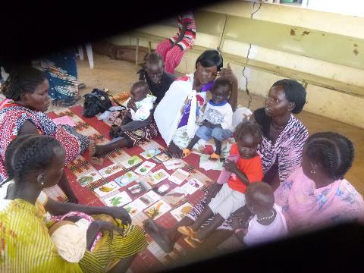
Nutrition Impact & Positive Practices (NIPP) Project – A Community Centred Initiative for Prevention of Malnutrition
Barthorp, H¹ & O’Mahony, S¹
¹GOAL Global, 12 – 13 Cumberland Street, Dun Laoighre, Co. Dublin, Ireland.
Email: hbarthorp@goal.ie and somahony@goal.ie

Slide 2
Presentation Overview
Aim and Objectives of NIPP
Rational for Developing NIPP
Overview of NIPP Implementation Globally
Overview of NIPP Approach
Global NIPP Statistics
Successes in NIPP to Date
Conclusion

Slide 3
Aims and Objectives of NIPP
GOAL: To reduce rates of acute malnutrition (MN) and/or chronic malnutrition in target communities with a focus on women, infants & young children + other at risk groups.
Specific Objectives or Outcomes:
Through positive and sustained behaviour change we aim to:
1. Improve the nutritional status of targeted individuals with confirmed MN
2. Improve families understanding of why MN occurs in high risk individuals & what can be done to prevent future episodes
3. To improve household (HH) diet diversity (and thus nutritional repleteness) of targeted HHs
4. To achieve sustainable improvements in HH care practices (including hygiene-sanitation), feeding practices and health-seeking behaviours for infants, children, pregnant or lactating women (PLW) & the chronically ill (CI), through the promotion of positive behaviour change

Slide 4
Rational for Developing NIPP
It is estimated globally 33 million children suffer from moderate acute malnutrition (MAM, WHZ<-2 and ≥-3) (UNICEF et al 2012) and 171 million children suffer from chronic malnutrition (HAZ <-2) (WHO, 2010)
GOAL designed the Nutrition Impact and Positive Practices (NIPP) project as a gendered, grass-roots approach, directly tackling a package of the underlying behavioural causes of malnutrition, irrespective of the particular manifestations
Although the original stimulus for designing NIPP was to find an alternative to food-based aid programs, the way in which NIPP is designed does not restrict its application to areas affected by acute malnutrition
Designed as a low cost intervention that helps the communities to use locally available resources.

Slide 5
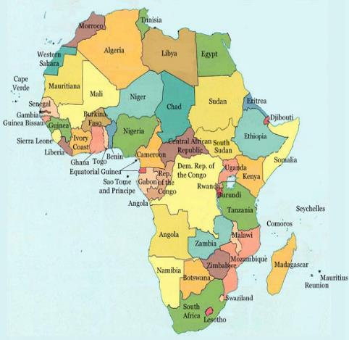
Overview of NIPP Globally
NIPP Globally:
GOAL innovation started in 2012 in South Sudan
Now implemented in 5 countries across Africa
To date has reached over 11,000 direct beneficiaries
NIPP has successfully cured 2148 (81.64% cure rate) children 6 – 59 months of moderate acute malnutrition.

Slide 6
Overview of NIPP Approach
Diagram of Key Components to help illustrate the initiative as a whole
FORMATIVE RESEARCH:
Situational & Barrier Analyses
Designed to Address:
Community based TREATMENT of mild or moderate acute MN (MAM)
Community based PREVENTION of mild or moderate acute MN (MAM)
Potential community based REHABILLITATION & PREVENTION of STUNTING
Potential community based PREVENTION of LBW (due to inter-uterine growth restriction)
WOMENS PEER LED NIPP CIRCLE
COMMUNITY SENSITISATION
CIRCLE
MENS PEER LED NIPP CIRCLE
Incorporate the following initiatives if they are lacking from community HHs:
Fabrication & use of a simple hand-washing point i.e. Tip-Tap with ash or soap
Fabrication of & use of simple latrines using local materials only
Fabrication & use of fuel efficient stoves
Practical demo’s on food processing, preservation & storage techniques.
Practical Behaviour Change Sessions focused on key causes of undernutrition:
To reinforce positive behaviours through practical sessions.
Key Health, WASH, HIV, Nutrition & LLH messages should be discussed & practiced during the sessions
Participatory Cooking Demonstrations:
To help improve nutritional status & care practices
All ingredients to be provided by participants and eaten by children >6mths & PLW / CI as a complementary or supplementary meal
Micro-gardening:
To improve household nutrition security
OVERALL AIM IS: POSITIVE & SUSTAINED BEHAVIOUR CHANGE
Remember it doesn’t matter how many Circles are running or what project coverage you have, if positive and sustained behaviour changes are not being achieved, the project (as it is) is not succeeding & needs reviewing
Notes:
Discuss through key thematic areas in this slide:
Each sessions covers 3 key topics;
1) Behavior Change Communication (for improved awareness and practice where key messages that promote adoption of positive practices are shared through highly interactive, engaging and participatory methods )
2) Micro-gardening
(for improved food security, a seed pack is provided )
3) Cooking Demonstrations
(for improved care practices, recipes based on the 4 star diet are developed using locally available food, ingredients are provide by participants and food eaten by participants).
Incorporate the following initiatives if they are lacking from community HHs:
Fabrication & use of a simple hand-washing point i.e. Tip- Tap with ash or soap and latrines and other hygiene enabling facilities
Fabrication & use of fuel efficient stoves
Practical demo’s on food processing, preservation & storage techniques

Slide 7
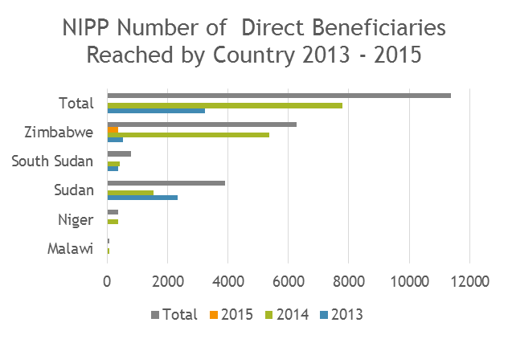
NIPP Outcomes Globally

Slide 8
NIPP Outcomes Globally

Slide 9
NIPP Longitudinal Follow Up

Slide 10
NIPP Longitudinal Follow Up

Slide 11
NIPP Longitudinal Follow Up

Slide 12
Successes in NIPP to Date
NIPP has been nominated for a prestigious award from the UN’s Common Humanitarian Fund in Sudan
Incorporated in the Sudan MoH Guideline for the Management of MAM
Recognised by UNOCHA as an ‘innovative project to tackle malnutrition in South Sudan’
Presented at CORE GROUP Q2 2014
NIPP has been published on in Field Exchange Edn 47 & Nut. Exh
3 Publications in the Sudan Medical Journal.
Featured in the technical resource guide: Enhancing Nutrition and Food Security during the First 1,000 Days through Gender-sensitive Social and Behavior Change
Recently complete qualitative research into programme design.

Slide 13
Conclusion
Countries affected by high rates of malnutrition require alternative or complimentary solutions to therapeutic hand-outs.
A combination of practical, contextually specific nutrition information, accompanied by practical nutrition sensitive activities, can be effective in managing MAM and potentially chronic malnutrition, in areas with underlying basic food security.

Slide 14
Thank you! Questions?

