Slide 1
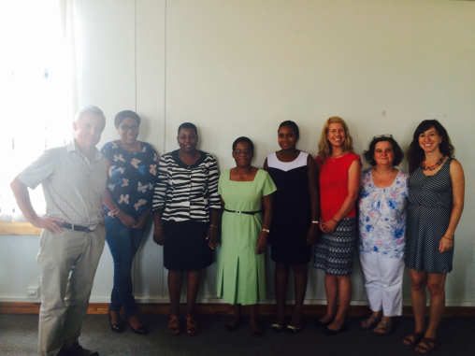
Generating an evidence base for community systems strengthening: the COSYST–MNCH project in Malawi
Anne Matthews DCU; Aisling Walsh, Elaine Byrne RCSI, Daniel Mwale, Tamara Phyriee, Lucinda Manda-Taylor, Victor Mwpasa, College of Medicine Malawi; Jennifer Weiss, Concern Worldwide, Malawi; Ros Tamming, Concern Worldwide, Ireland; Lisa Donaldson DCU, Ruairi Brugha,RCSI.
Community Systems Strengthening for Equitable Maternal, Newborn and Child Health (COSYST-MNCH www.cosystmnch.org) is funded by Irish Aid through the Higher Education Authority (2012-2015).
Notes:
Own picture

Slide 2
What is COSYST-MNCH?
Community Systems Strengthening for Equitable Maternal, Newborn and Child Health
Goal: to achieve a better understanding of community factors underpinning MNCH service utilisation in Malawi
2 interlinked components:
Research case studies where NGO partners are implementing projects – test a CSS Analytic Framework
Masters in Community Systems Health Research undertaken by partner NGO development workers, who are currently undertaking dissertations related to community systems
Notes:
Shutterstock image

Slide 3
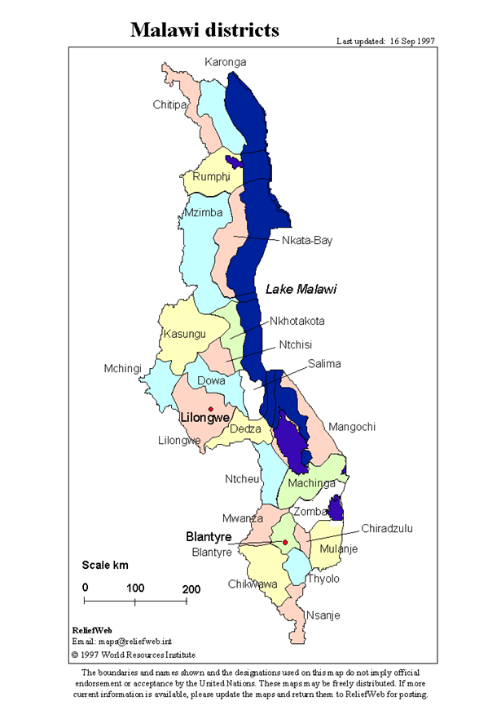
Research component
Aim: To identify obstacles and enabling factors within community systems which influence MNCH service utilisation in Malawi within the first 1,000 days of life, in order to generate strategies for strengthening community systems.

Slide 4
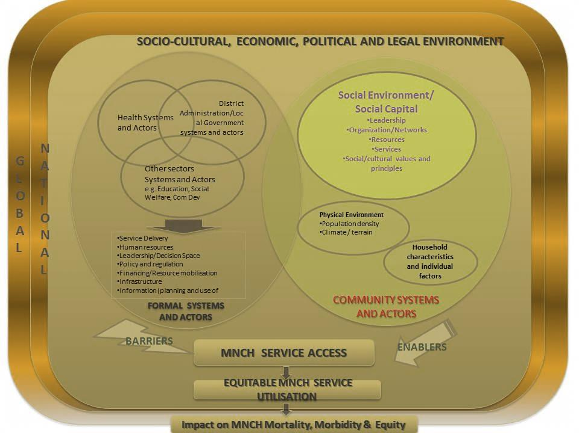
COSYST MNCH Community Systems Analytical Framework

Slide 5
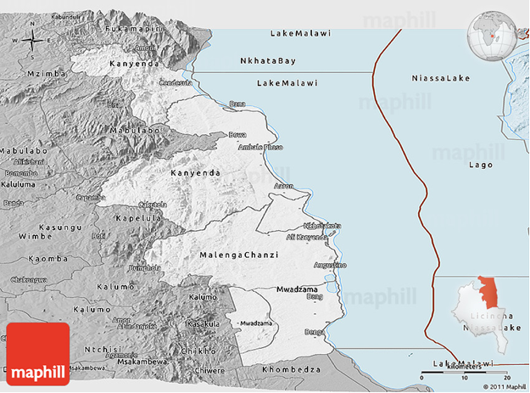
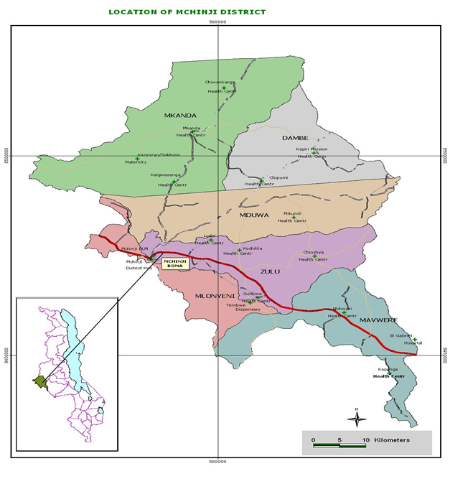
Project Districts
Nkhotakota district has 421 villages governed by 82 Group Village Headmen (GVH), under six Traditional Authorities (TAs), including , Malengachanzi (19 VDCs) & Mwadzama (A & B, 17 VDCs); 70% Chewa, fishing. District: 2 hospitals, 23 health facilities.
Mchinji district 7 TAs with 3 Sub-TAs, including Mkanda and Mduwa; Chewa; 1 hospital, and 20 facilities & 7 private facilities
Notes:
These are your own maps?

Slide 6
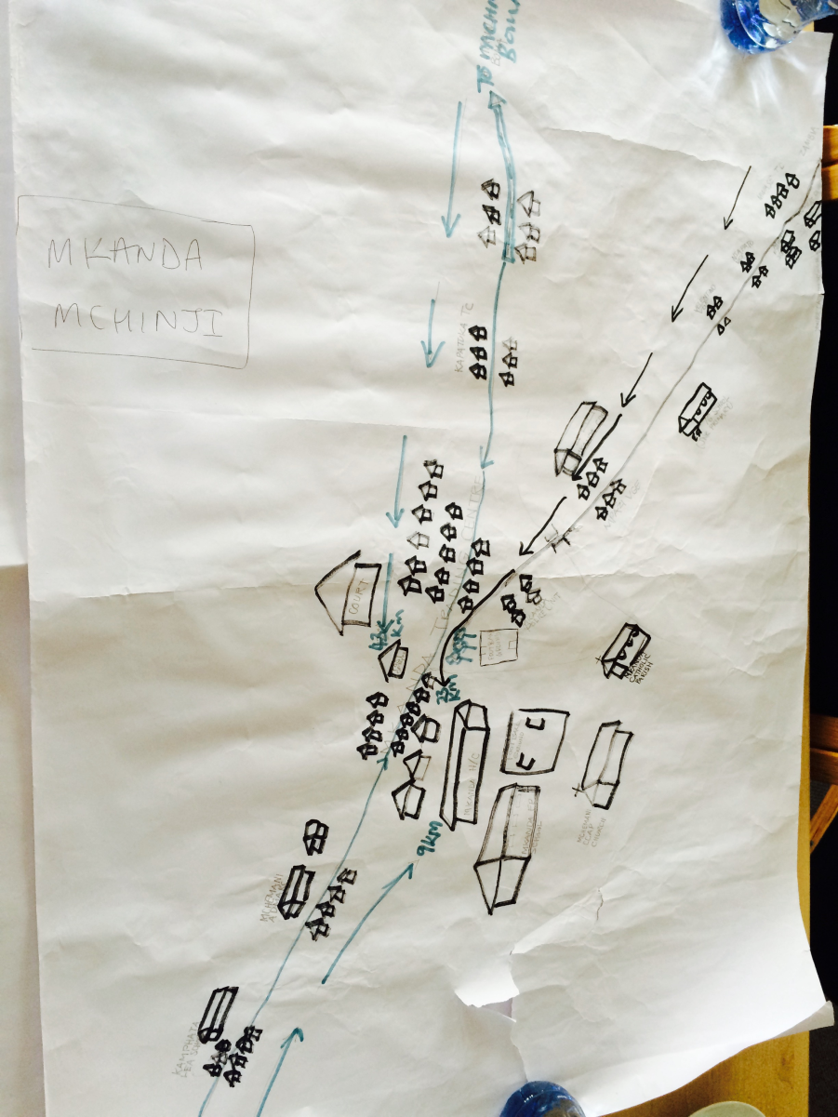
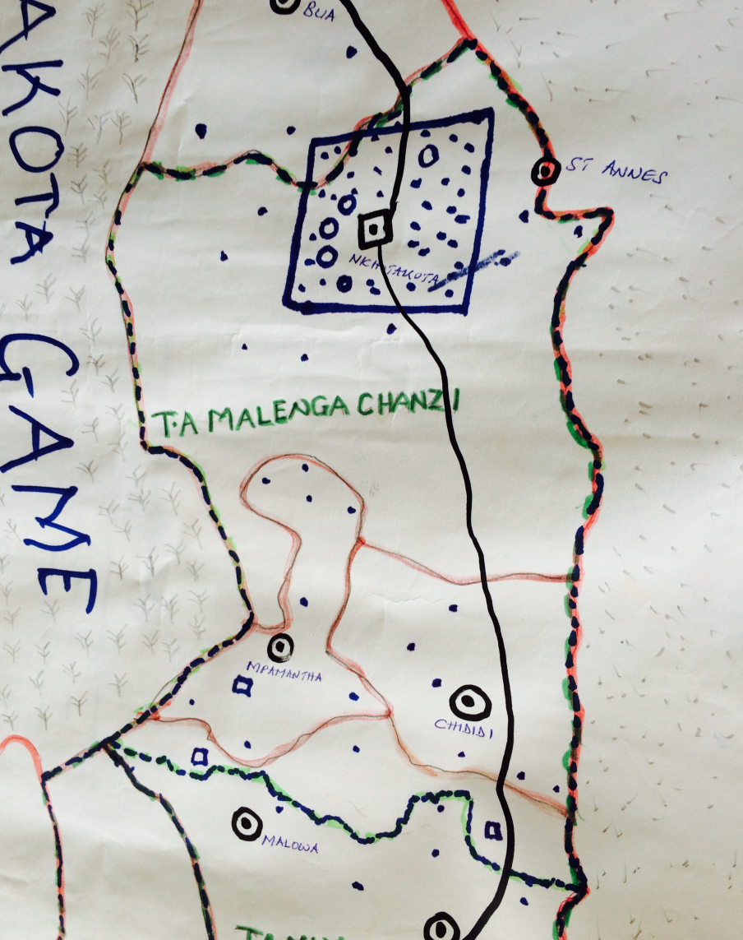
Community maps by TA
Mkanda TA, Mchinji
Nkhotakota

Slide 7
Methods
Mixed Methods Case Studies
Mchinji
Nkhotakota
Qualitative Data
80 in depth interviews
20 Focus Group Discussions, with female and male community members
Quantitative Data
Service Utilisation Data from District Health Offices- for key MNCH indicators
with traditional birth attendants, community health workers, traditional and religious leaders, NGOs representatives and health workers
Where NGO partners had existing projects
Thematic analysis ongoing drawing on CSS framework

Slide 8
Data collection
 | Mchinji | Nkhotakota
Traditional Leaders (IDIs) | 8 | 8
Religious Leaders (IDs) | 7 | 7
Government Officials (IDs) | 3 | 5
Senior NGO officials (IDIs) | 6 | 6
Nurses (IDIs) | 3 | 3
Medical Assistants (IDIs) | 2 | 2
Health Surveillance Assistants (IDIs) | 4 | 10
Traditional Birth Attendants (IDIs) | 3 | 3
Caregiver-Husbands (FGDs) | 2 | 3
Caregiver-Grandmothers + Mother in-law (FGDs) | 2 | 1
MNCH users (pregnant women + women with under-5 children) | 4 | 3
MNCH non-users (pregnant women + women with under-5 children) | 2 | 3
TOTAL (IDIs + FGDs) | 46 | 54

Slide 9
Coding framework
 | Theme |  | Code
A | Leadership | A1 | Traditional leadership
 |  | A2 | Religious leadership
B | Organisations/networks (governance and power) | B1 | NGO
 |  | B2 | CBO
 |  | B3 | VHC/VDC
 |  | B4 | Support groups/youth groups/volunteers
 |  | B5 | Informal community support (individual/HH)
C | Human resources (formal) | C1 | Nurse
 |  | C2 | HSA/CHW
 |  | C3 | Doctor
 |  | C4 | Medical Assistant
D | Human resources (informal) | D1 | TBA
 |  | D2 | Traditional healer
E | Financial resources Services | E | Financial resources
F |  | F1 | Maternity
 |  | F2 | Newborn and child
 |  | F3 | Nutrition
G | Cultural beliefs and practices | G | Cultural beliefs and practices
H | Physical environment | H | Physical environment
I | Household characteristics | I1 | Financial constraints
 |  | I2 | Male involvement
J | Individual characteristics | J | Individual characteristics
K | Knowledge and practices | K | Knowledge and practices

Slide 10
Focus for this presentation
Community Leadership
Cooperation of those involved in health work
Cross-cutting considerations
Notes:
Shutterstock images & own picture & morguefile
Community leadership
especially traditional leaders
Cooperation of those involved in health work:
Non-governmental and community-based organisations and networks
Linkages between formal and informal health workers
Cross-cutting considerations
household and individual characteristics and physical and financial constraints

Slide 11
Community leadership
Traditional leaders, especially the village chief:
Acts as a role model
Goes to health facility himself
“I have to start with visiting the health centre; people will follow” Village headman Mchinji.
Enforces laws (local by-laws) and national policy
Antenatal care, delivery and postnatal care at facility; not to give birth in village with TBA (sanctions)
Uses influence- to promote male involvement in antenatal care, delivery and postnatal care, HIV testing uptake

Slide 12
Cooperation for improved health
Formal Human Resources for Health (HRH): Nurses, doctors, HSAs expected to provide services across maternity, newborn, child & reproductive health, nutrition
Health Surveillance Assistant (HSA) plays central community role, as ‘owner of community area’, trusted, close, familiar to communities
Informal HRH: TBAs, Traditional healers- role to encourage formal healthcare use
Range of community-based structures: committees, groups, volunteers- all support, sometimes unclear who/how works
Some religious groups support healthcare, some contradict
NGOs provide resources, pilot MNCH strategies, aligned with district priorities; many external funders

Slide 13
Reciprocal roles
“We work hand in hand with HSAs”
Community Counsellor, NGO, Mchinji
“For those of us who are static working at this [named] facility we rely on our friends who work in the field. Their major role is to look for risky groups to refer them to us for treatment and management; and if we fail, we send them for further management at the district hospital. The main difference is that we are based at the health facility while our friends are based in the field. We work with our clients here at the facility while they work with their clients in the field”.
Nurse, […] facility, Mchinji
“MaiMwana [NGO] and health workers are the same because they teach us everything which is important to the life of a person”.
FGD participant, Mchinji

Slide 14
Barriers despite cooperation
Effective referral between community and facilities is hampered
by lack of transport, fuel, distance to facilities, lack of health service staff, lack of materials and drugs at facilities and some cultural practices
Negative experiences of formal health workers at facilities
What will improve this:
Addressing the difficulties women face: New programme incentivises women to attend for antenatal care, give birth at facility and have postnatal care (supported by Results Based Financing programme) by covering costs of some transport and materials necessary for birth and newborn
Staffing, drugs and materials at facilities are inadequate- need support and investment, quality improvement- some initiatives underway

Slide 15
Conclusions
Conclusion
The community systems factors that contribute towards increased uptake of MNCH services are traditional leadership from chiefs, religious leadership, community-based organisation activity and the pivotal role of community-based health workers (Health Surveillance Assistants).
Socio-economic circumstances of households & communities, health systems factors (such as limited services and human resource capacity) cultural beliefs and practices, impact on service utilisation.

Slide 16
Conclusion
Current analysis is by Traditional Authority and district for case studies
The findings of this study highlight the value of examining community systems factors as well as health systems and socio-cultural systems and draws these together in a framework for use by government agencies, NGOs and other stakeholders.

Slide 17
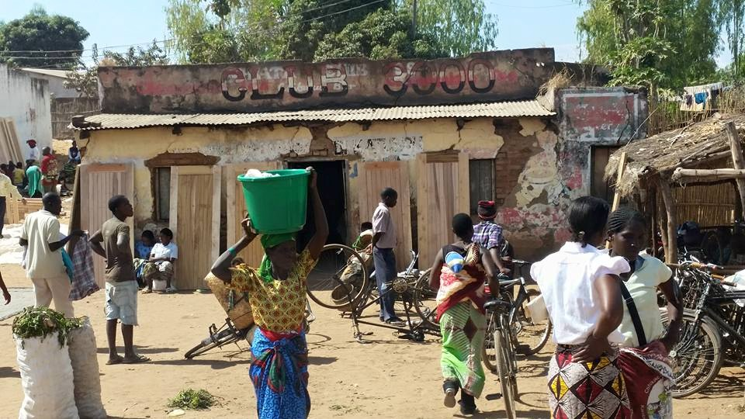
Closing words: community ownership
“I can say that in this community when it comes to playing a role in decision making, it is the community which plays a bigger role and are usually in the forefront. Other organisations just facilitate, perhaps provide information but as a community we then lead and can even proceed even when the organisation withdraws”.
HSA, Nkhotakota
Notes:
Own picture

Slide 18
Thanks to the research team and all participants

