Slide 1
Evidence based research in action: Exploring social accountability and improving intervention outcomes through field based research collaboration
Presentation by Pieternella Pieterse and Alix Tiernan
Research conducted with support from
Joseph Ayamga, Christian Aid Sierra Leone staff,
and Christian Aid Ireland staff.

Slide 2
What is Social Accountability?
Houtzager and Joshi define social accountability as:
“the ongoing and collective efforts to hold public
officials to account for the provision of public goods
which are existing state obligations” (2008, p. 3)
Research question:
Why and when do social accountability interventions aimed at improving public service delivery, succeed or fail?
What effects do social accountability interventions have on frontline staff in healthcare facilities?
How can social accountability methodologies be improved?

Slide 3
What was CAI motivation for collaboration?
To obtain information that could lead to in-depth policy guidance on accountability interventions in Sierra Leone’s health sector, which could also be more broadly applicable to accountability interventions in other sectors and other countries.
To continue to build relations with the academic sector in Ireland and promote cross-learning and possibly influence future research directions for mutual benefit

Slide 4
Two CAI partner-implemented programmes under study:
Quality Circle/monitoring through community groups implemented by NMJD
Participatory Monitoring & Evaluation with MDG awards implemented by SEND
The research was also complemented by an assessment of two further, World Bank funded, SA interventions, which provided an opportunity to verify and triangulate some of the findings:
Community monitoring intervention with score cards
Non-financial awards

Slide 5
Study encompassed four SA methods-key differences:
World Bank RCT | NMJD (Christian Aid Partner) | SEND (Christian Aid Partner) | World Bank RCT
Community monitoring intervention with score cards | Mixed methods intervention including quality service circle | Participatory Monitoring & Evaluation, incl. MDG awards | Non-financial awards
Community scores health services it received; plan to improve status quo gets drawn up during community-health worker interface meeting, in which parties commit to change behaviour. Progress is reviewed in subsequent meetings. | Community based monitoring team is central to monitoring ‘commitments to change’ that are agreed in community -health worker ‘quality circle’ interface meeting, in which healthcare status (based on small citizen survey) is discussed. | Health workers, health authorities, NGO staff jointly draw up monitoring check list for clinics. Clinics compete to win motorbike and cash prize in annual ‘best performing clinic competition’, based on check list scores. | External agency conducts clinic + household survey to assess clinic performance. NGO staff informs health workers of performance ‘score’ and encourages them to improve work practice to win non-financial award for most improved clinic.
Citizen engagement at heart of the intervention | Some citizen engagement | Minor citizen engagement | No citizen engagement

Slide 6
Methodology:
Comparative case studies of 4 interventions and control group
Qualitative data gathering: interviews and focus group discussions
Data analysis using NVIVO10
3 field visits to Sierra Leone (Sept 2012-May 2014)
35 clinic visits
35 health workers interviews
35 focus group discussions with health centre users
48 additional interviews/key informant interviews
Analytical framework tested efficacy of 4 key SA components:
Access to information
Citizen engagement
Political and power awareness of SA project design
Staff motivation

Slide 7
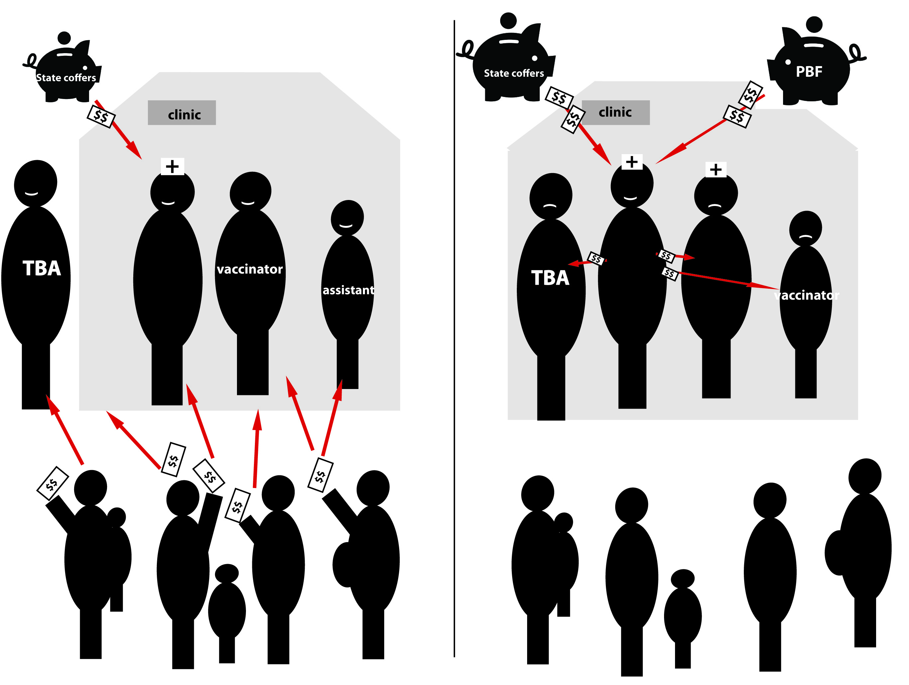
Structural barrier: Sierra Leone’s health financing
Free healthcare
Pre-2010
System:
Notes:
When the free healthcare was introduced, all income was taken away from the clinic, and only the salaried health worker remains paid. In many clinics, the paid health worker has retained a lot of the previous staff because she cannot run the clinic. Traditional Birth Attendants, who were previously delivering as much as 70% of all babies in Sierra Leone, are now encouraged to work with the clinics to bring the pregnant women from their villages to deliver at the health facility. To encourage them, many are given a ‘job’ in the health centre, helping out with ante-natal care and growth monitoring of children under 5. So the current picture is as the cartoon on the right: One health worker in the clinic gets paid, often a second trained health worker is just out of training, so she is already on job placement, but may not get paid for up to 8-9 months. Others, such as the TBAs and vaccinator, are simply ‘helping out’.
There is a Performance Based Finance system, a World Bank funded salary top-up programme designed to give some extra motivation to the health workers, and that contains a small fund for ‘volunteers’ who help in the clinics, but this is no more than 10US$ per quarter, so not a living wage for most of these other staff members.

Slide 8
Outcome: Focus group discussions in which the problem of “charges
levied for free healthcare” was discussed – by type of accountability
intervention.

Slide 9
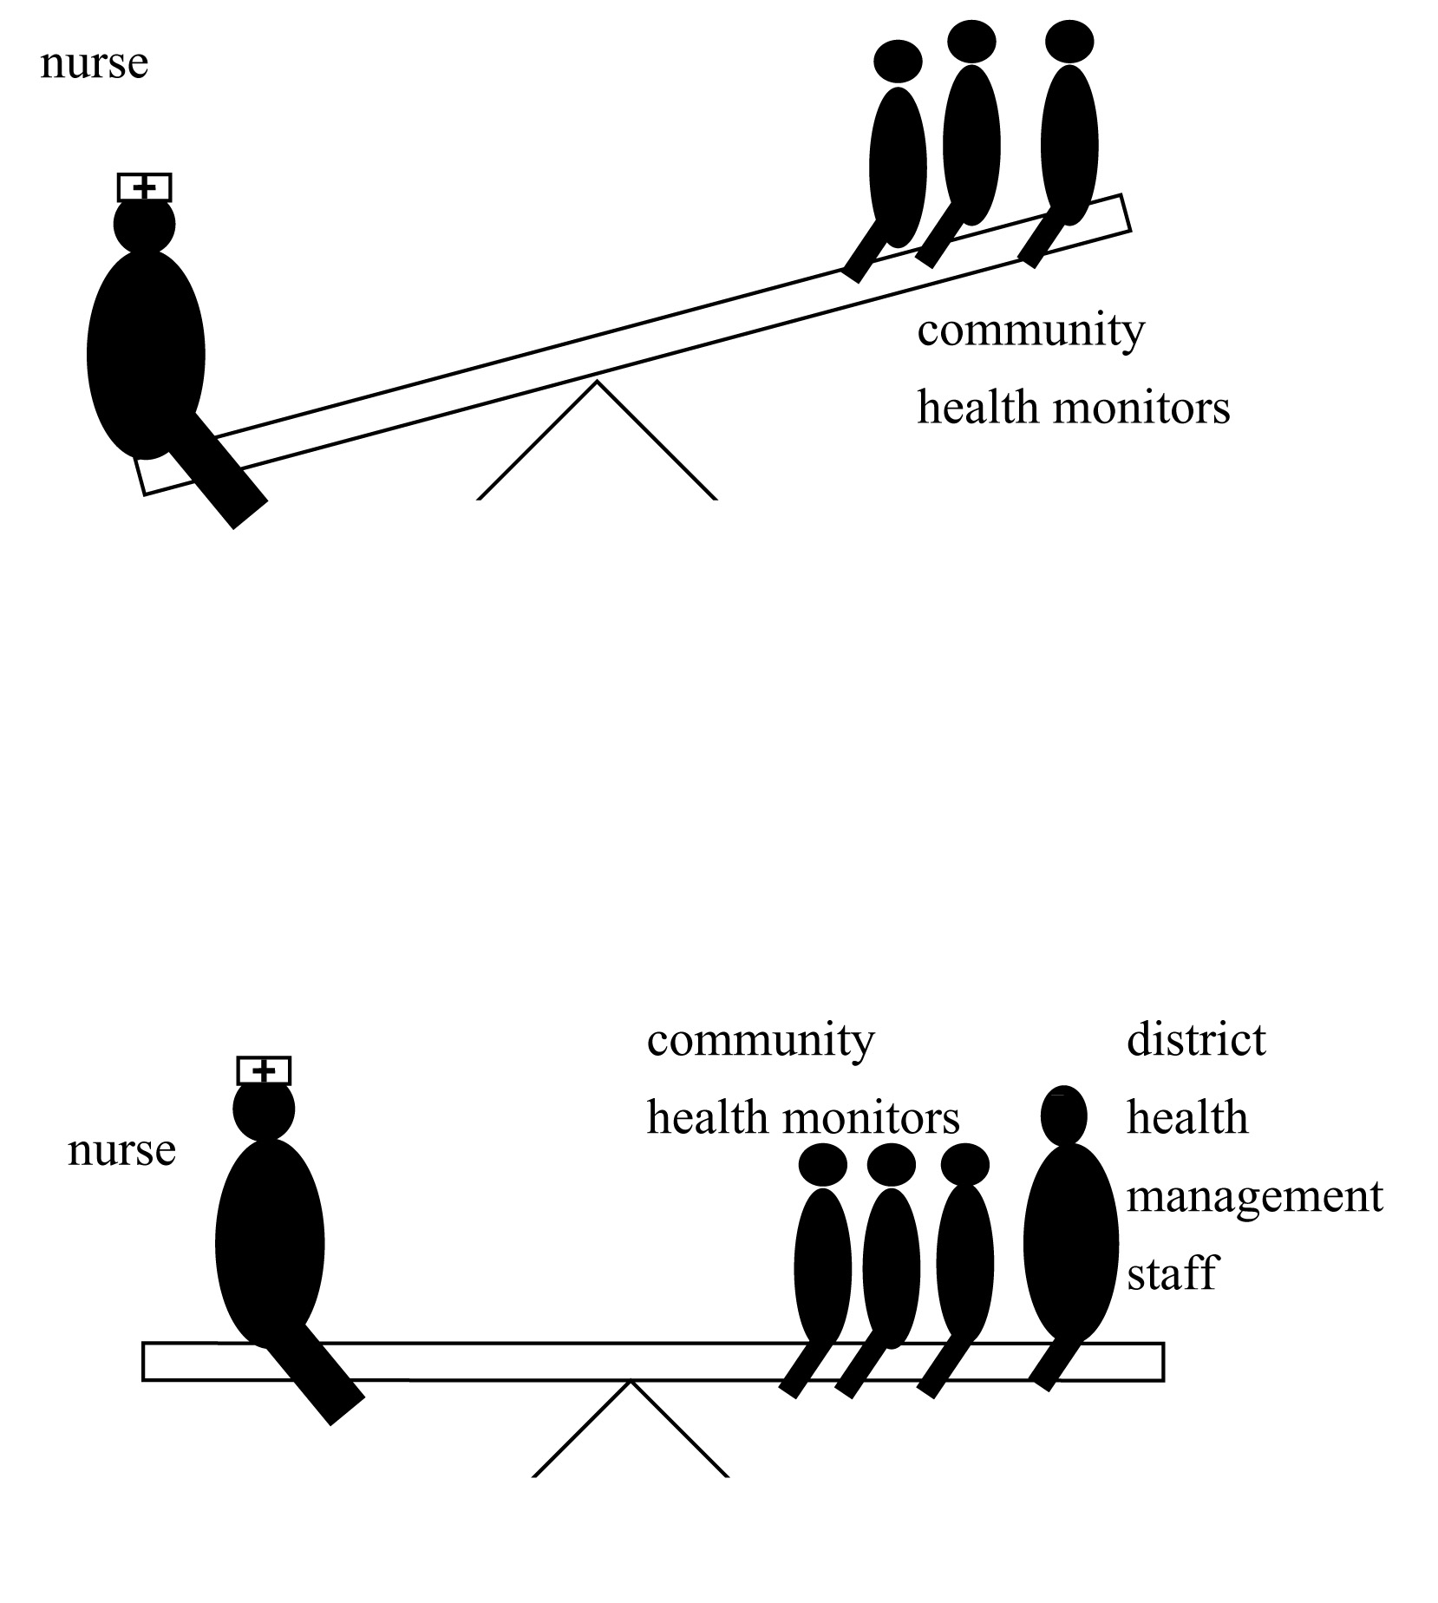
Power imbalance during community dialogue
Facilitating NGOs/CSOs need to be power aware during accountability interventions.
Bringing in district health management staff (who have the mandate to carry out oversight) can help to make the voices of the community or community-based monitoring groups heard.

Slide 10
Key findings:
Research findings revealed how high levels of corruption and post-conflict environment influences which SA components work best, but also design of the project and quality of the implementation
SEND project most effective in reducing illegal payments for healthcare and overall most effective in improving healthcare delivery.
Factors leading to effective SA outcomes (eg. SEND approach)
Offering strong incentives to change
Awards for best performing clinic motived all healthcare staff
PM&E implemented professionally, staff knew project well
Intervention had strong links with authorities, media
Power and political awareness was prioritised in project design
Staff motivation – even non-financial award inspired change!

Slide 11
Factors that did not seem to result in effective SA outcomes
Access to information proved to be ineffective if citizens do not feel empowered to use the information to hold health workers accountable
Citizen engagement/level of participation was equally ineffective for same reason
Why was NMJD’s SA intervention less successful?
External factors were not taken into account adequately in project design, eg. power relations, other actors, and political economy
Research uncovered that implementation of programme was undermined by NMJD staff lack of training.

Slide 12
How did the research help to address weaknesses in NMJD approach?
The intervention provided great insights into community dynamics and power imbalances between citizens and service providers
The research visit report was used as midterm review and identified some opportunities of improving programme actions to learn from initial research findings
NMJD took on board a number of suggested changes and the final programme evaluation has found evidence of improved programme outcomes (see next slide)

Slide 13
NMJD took on board a number of suggested changes:
NMJD staff received additional M&E training, communities are now being visited regularly, and animators are now based in the communities
CHMVGs are now analysing data collected and the health workers are engaged on the results. CHMVG leadership issues have been resolved, in part through re-recruitment
NMJD has now focused its work on Quality Service Circles and accountability and dialogue fora with the District Council and the DHMT (other areas have been dropped).
Improved programme outcomes as identified in the recent programme evaluation (July 2015):
Increased level of challenge by communities towards duty bearers, esp. regarding delivery of services, with examples of response by service providers
The District Council is following up on concerns raised by citizens through the Quality Service Circles, including addressing gaps in information flows to DHMTs

Slide 14
Lessons from research collaboration
Both researcher and CAI stood to gain from the collaboration:
Access to the CAI programmes enabled research to take place
Research engagement with NMJD led to improvement of their programme
Relationship strengthened between academia and CAI (also through additional initiatives, eg. on land rights and transitional justice)
Factors that ensured that these gains were achieved:
Researcher had experience working in challenging development contexts, which often posed logistical problems to be solved
Flexibility and generosity on the part of both researcher and host organisation (CAI and partner agencies) to adapt to time and resource limitations
Measured consideration of when it was ethically appropriate to influence future development outcomes, rather than remaining impartial as a researcher

