Slide 1
Understanding how HIV prevention programmes influence women's vulnerability in Malawi
Dr Fiona O’Reilly: Kerena Consulting & UL, Dublin
Lifah Sanudi: REACH Trust, Malawi
Dr Nata Duvvury: NUIG
Dr Stacey Scriver: NUIG
Nicola Ndovi: Trócaire, Malawi
Deirdre Ni Cheallaigh: Trócaire, Ireland

Slide 2
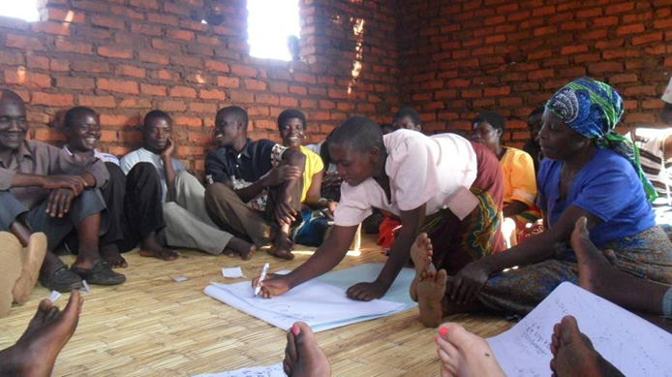
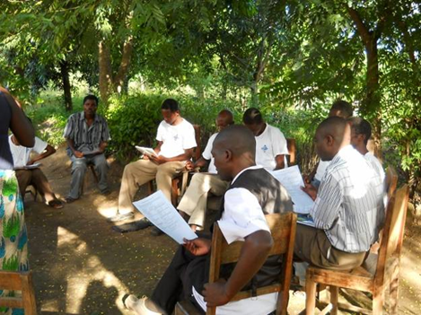
Programme Strategies
STAR Circles *
Engaging Men
Work with Traditional and Religious Leaders
Village Savings and Lending Schemes
*Societies Tackling Aids through Rights

Slide 3
Research Aim
To determine the impact of the Gender and HIV programme in the target areas and to understand how different programme approaches influence vulnerability to HIV for women and girls.
Notes:
Idea behind research
Improve the quality of Trócaire programming in Malawi
Contribute learning to international best practice for wider dissemination and policy influence
Bring together local research expertise with research expertise in Ireland

Slide 4
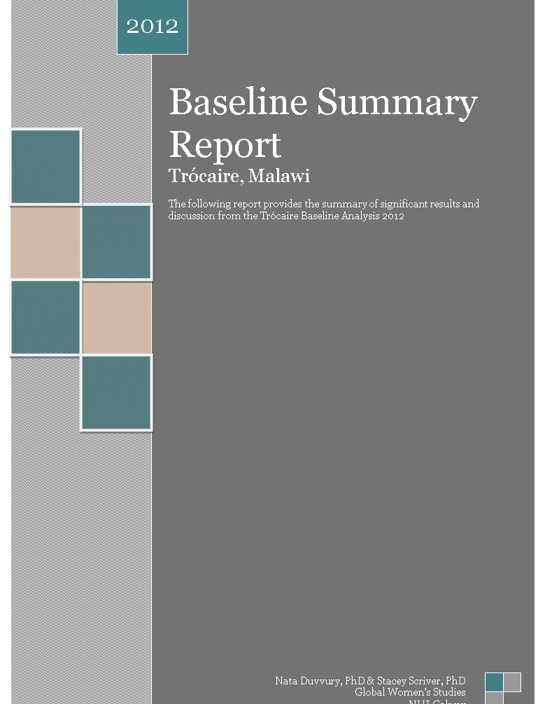
Design, methods & response
A quantitative baseline and end line
  796 (503 F 293 M)
A qualitative component in three rounds throughout the course of the programme .. So far..
  30 FGDs & 42 FGDs
  237 & 332 individuals
  8 in depth case studies followed up
Ethical approval
  National Malawi Commission of Science and Technology

Slide 5
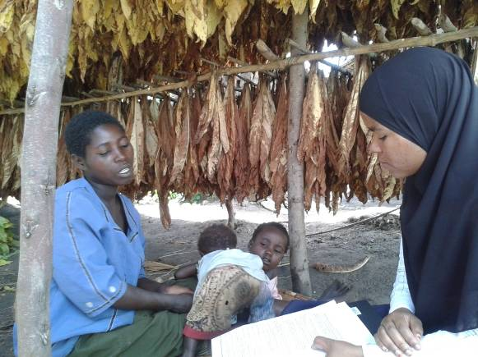
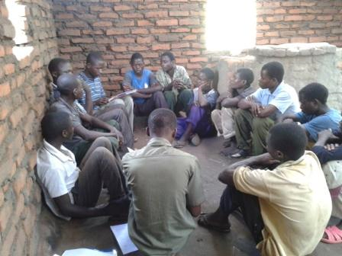
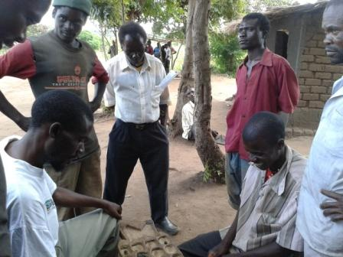
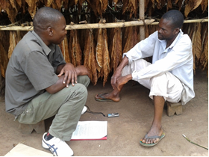

Slide 6
Time line
End line
Survey 2015
Scoping exercise
2010
Baseline
Survey Sept 2011
On-going programme monitoring
Best Practice Programmes
Qualitative study All sites site
MARCH 2013
Qualitative study
All sites
MARCH 2014
Qualitative study all site
2015
Qualitative study 1 site

Slide 7
Some results
Cultural practices changing
Discrimination & Stigma reduced
Women’s role in decision-making increased
VSLs reducing vulnerability
Unintended changes
Improved spousal relationships
Notes:
Patriarchy is a social system in which the role of the male as the primary authority figure is central to social organization, and where fathers hold authority over women, children, and property. It implies the institutions of male rule and privilege, and is dependent on female subordination

Slide 8
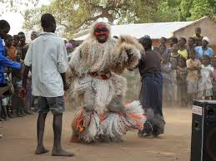
Cultural practices
Notes:
Cultural ceremonies and rituals were common in all villages, including initiations, ceremonial dances and rituals around births and deaths. Rituals involving sex were reported, some of which carry risk of HIV transmission. For example, the use of fisi (a man who is engaged for sex to help a childless couple). Cultural practices and rituals have been adapted over time to reduce risk of HIV transmission. Religious teachings have worked against practices that promote the spread of HIV and the programme’s engagement with religious leaders is supporting this.

Slide 9
Gender norms and equality
  Hegemonic patriarchal power evident.
  Male authority as head of family or ‘chairman’ was largely unchallenged.
Programme influenced change in gender norms
sharing the work burden.
Women involved household decision making
Less consensus on control of women’s behaviour
Still clear distinctions between ‘women’s roles’ and ‘men’s roles’.
“The men are also responsible for buying the clothes because if she can decide for herself she may come up with the miniskirts.”
Notes:
There were set views held by many men in all sites on woman’s subordinate position within the relationship in terms of doing what the man says.

Slide 10
Round 2
Round 1
Today both sides contribute in decision making to say let us do it this way. But previously a man was the one who had more authority in decision making’ (Males, non-participants, Salima).
On financial matters, my husband opposes my input and tells me that it is his role then I just accept his decisions and I perform domestic chores, he tells me what to do
(Woman non participant Dowa)

Slide 11

Stigma and discrimination
“Not anymore”
HIV is common and treatable
Discriminated in terms of relationships
Public disclosure not common
Notes:
Participants reported that stigma around HIV had reduced. Fear of disclosure suggested that stigma nevertheless persisted. Stigma effected men and women differently. While women were tested for HIV in pregnancy, men’s status more easily remained undisclosed. In most aspects of life, people said they did not discriminate but when it came to sexual relationships, marriage and pregnancy, women were treated differently because of their status. Women who had disclosed a HIV positive result risked abandonment and rejection by their partners.

Slide 12


Gender Identities, risk and vulnerability
Rooted in tradition and culture,- hard working family provider & protector, strong sex drive, children
  Faithfulness beginning to replace multiple partners as an attractive characteristic
  Abstinence not expected
Attractive, hardworking, reserved respectful polite.
  Change is suggested with the introduction of sexual ‘openness’.
Notes:
Masculinity was associated with being hard working, having a strong sex drive and being able to produce children. Faithfulness was seen as an attractive quality however men were not expected to be able to practice abstinence undermining expectations of faithfulness. The male identity appeared to be taken as fixed and instead it was the women’s sexual behaviour that more often presented as the target for change. Positive impact on the nature of couples’ relationships were reported

Slide 13
Openness
  Changes in the nature of couples’ relationships
    Facilitate faithful intimate relationships where the male identity is not lost.
    Reported to lead to more harmonious relationships.
    Welcomed by all participants
  Caution
    …strongly associated with women being sexually available to their husbands to prevent infidelity
  Question
    Are cultural and societal changes immune to societal influences that favour men?

Slide 14
Faithfulness & openness
“What was happening before was that after selling the rice men were leaving their wives for the girls at Mwansambo turn off this was happening because our women were sleeping with clothes on, as per cultural values, but after being trained about openness they are now sleeping naked and men are happy about that and the money that they are earning are budgeted well together with their wives.” Round 2
Once we trust and being faithful to each other no one will go out and have sex with any other person. Being open to each other people discuss issues of sexual activities freely without fear and if they are not satisfied when having sex they are able to communicate to each other and resolve the matter (Male Chief Ntcheu, )
There are some women who deny having sex with their husbands. This causes some men to go out and have sex with other women. (Male Chief Ntcheu)

Slide 15

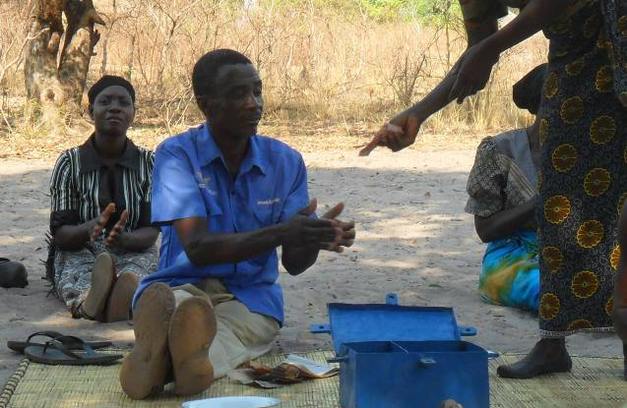
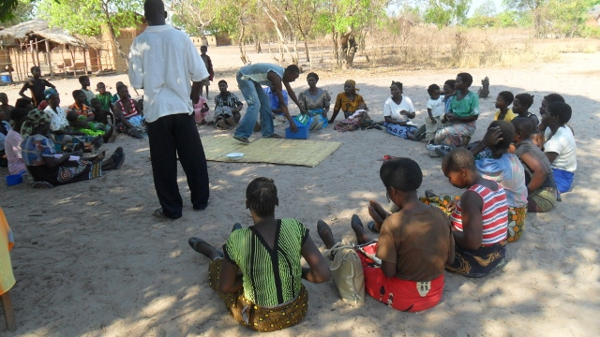
Economic factors
lack of power and control over resources
Poverty gave rise to some women engaging in transactional sex
‘Bank Mkhonde’ is like a husband of many unmarried women in this village. Many of these people they have found a way of accessing loans for doing businesses to sustain their lives’ (Male, non-participant, Nkhotakota)
Notes:
Women’s lack of power and control over resources emerged disas an underlying vulnerability factor. Poverty gave rise to some women engaging in transactional sex, particularly when household supplies were low. For men, disposable income meant that they could experience different sexual relationships and they had the power to determine whether or not condoms were used. Change was emerging as a result of village savings and loan schemes which were very popular and were credited with reducing risk taking behaviour of women.

Slide 16
Lessons learnt from research process
The value of mixed methods
  How change has been contributed to
Reinterpretation of some findings on
  Violence
  Knowledge
  Stigma
The un-deniability of context
  The potential programme vs research conflict
  No intervention exists in a vacuum and is likely to be influenced by the power dynamics existing in a culture which are themselves the target of that intervention
The importance of capacity to
  Identification and understanding of unforeseen consequences

Slide 17
Conclusion
Cultural practices changed or stopped to reduce risk and vulnerability
Though gender norms have seen some change gender equity is still a long way off
Signs of a gender inequity reflect a patriarchal society that perpetuate relationships of male dominance and female subordination
Deep and lasting positive change in women’s vulnerability to HIV requires continued efforts in developing understanding and practice of equality in all spheres of life and societal structures
Notes:
Eg – signs
seclusion and wife’s absence causes husband’s infidelity
Women must be available for sex regardless of own wants
Men are the heads of the households and have decision making authority, and
The fact that Women are economically dependent on me

Slide 18
Conclusion
Combining qualitative and quantitative methods allows measurement of programme impact with a deep understanding of the actual changes in people lives and how these came about

