Slide 1
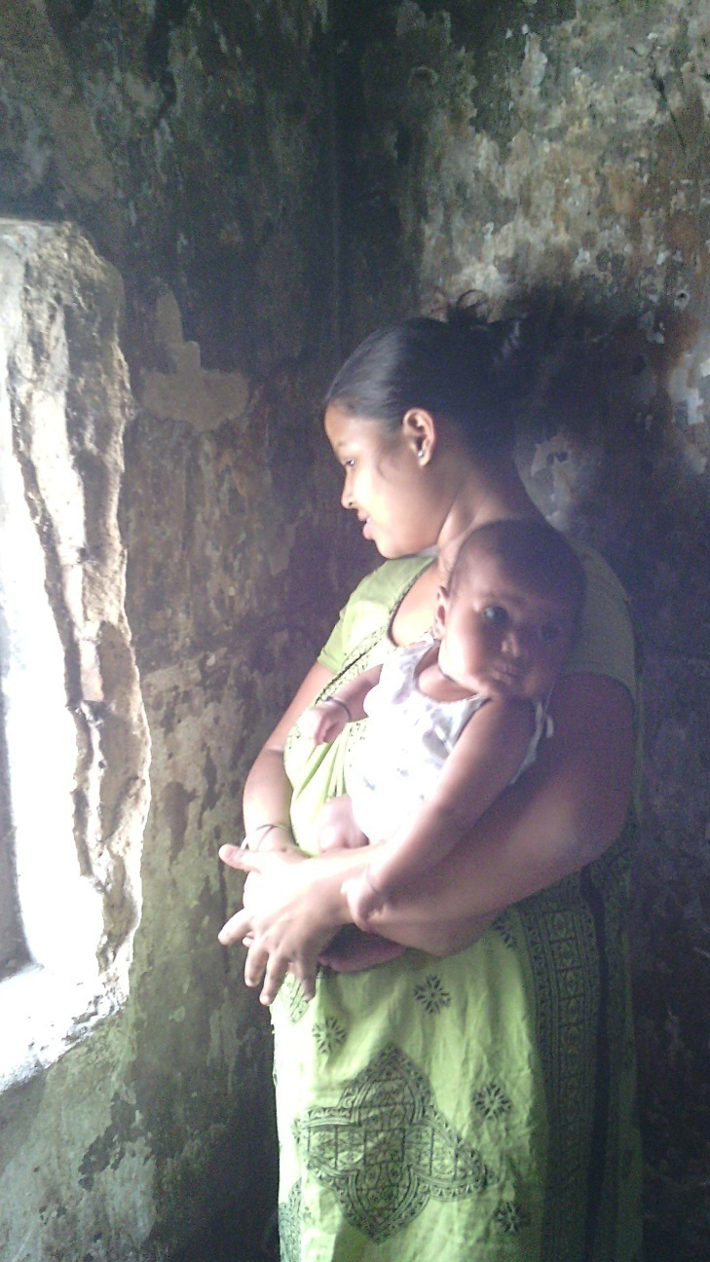
“ When sex workers are also mothers”

Slide 2
Do we recognise rights to motherhood for a woman involved in sex-trade?

Slide 3
Objective of the Study
To understand MCH issues related to the women involved in sex trade.
To identify care and protection facilities available for babies born to women involved in sex trade.
To understand situation of rights and entitlements for children born to sex workers.
Exploring a broad outline for creating services and protection mechanism under the current RMNCH+A,ICDS and ICPS schemes to ensure rights of sex workers for a safe motherhood and entitlements of children of sex workers.

Slide 4
Profile of Respondents
172 sex workers having children below 5 years were studied
Majority of sex workers were in reproductive age group of 21-30 years
Majority of sex workers were illiterate or semi literate .
Most of the respondents who had ever married reported marrying before 18 years of age (44%).

Slide 5
Area Profile
Poor sanitation and hygiene facilities in area
Rooms are over crowded and poorly ventilated
Diseases and Infections are common; during rains cases of malaria & dengue are common due to water logging in various parts of area
Low access to individual toilets and toilet ratio of 40:1 in brothels with common toilets for whole floor

Slide 6
Reproductive Health
Knowledge about STI and HIV were significantly high.
Menstruation perceived as a major issue due to poor personal hygiene, low usage of sanitary napkins.
Period days are lean in terms of sex trade as clients tends to avoid such sex workers.
Cases of menophilia( People who prefer sex with menstruating female) were reported

Slide 7
Contraceptive Usage

Slide 8
Getting Pregnant…
75% had been pregnant since their introduction to the sex industry.( GOAL PAR, 2010)
Pregnancy is perceived as occupational hazards and big burden due to financial constraints
Wish to have their own child with the hope of a better future
Multiple abortions reported amongst sex workers
Preference given to private health facilities (54%) for getting abortion due to privacy issues
Reproductive Health Behaviour
26% of Sex Workers had abortions

Slide 9
Sexual Activity during Pregnancy
Participation in sex trade during pregnancy is common among sex workers owing to financial circumstances
Safe sexual practices during pregnancy is another major concern as indicated by non-usage of condoms in third trimester of pregnancy
Sex workers reported to have clients suffering from maiesiophilia (erotic attraction to pregnancy)

Slide 10
ANC Check Up
Base = 172

Slide 11
Place of Delivery

Slide 12
Results of Pregnancy
Results of Last Pregnancy
 | Total
 | 172
Live Birth | 96%
Still Birth | 1%
Abortion | 3%

Slide 13
Exclusive Breastfeeding

Slide 14
Immunisation

Slide 15
Initiatives of GOAL….
GOAL initiated projects in two small red-light areas in 2013.
Engaged with Sex workers, live in partners, brothel owners and Government Authorities for upholding rights of children in the red-light areas.
Conducted evidence based advocacy and awareness raising.
Collectivisation of sex workers and their children.
Focused on Maternal Child Health supports to secure the right to survival and national identify of children of sex-workers.
GOAL deployed community health workers,
Established referral linkages with Government health facilities to enhance MCH services for these red-light area populations.

Slide 16
Initiatives of GOAL….
GOAL is also providing integrated solutions to Children in Red-light Areas.
GOAL is upholding rights of children through promotion of child safety net within the red-light areas through securing children’s access to Government supported child care services, birth registration, pre-primary education, formal education.
Conducting community based rescue and reintegration activities to prevent entry of children into the sex trade.

Slide 17
Our Achievements
100% of participants accessed 4 Antenatal Checkups from Government Health Facilities.
87% of pregnant participants accessed institutional deliveries in Government Run Hospitals near the red-light areas.
Rest of the sex workers have moved to their native places during the third trimester.
Birth registration of 100% new born babies were initiated and 68% have obtained birth Registration from Municipal Authorities.

Slide 18
Our Achievements
53% of the children within the 0-6 years of age are receiving pre-primary education and nutrition support ( ICDS) facilities within red-light areas.
GOAL is advocating for shifting of timings of ICDS centres during the evening hours so that it serve the purpose of crèche for the children 0-6 years.
43% of 6-18 years children enrolled and are continuing in formal schools.
GOAL is continuing community based monitoring, rescue and restoration protocols and established close coordination within justice system to promote a safe environment for children in red-light areas and prevented entry of minors in sex trade in two red-light areas.

Slide 19
Lessons learned:
This small initiative revealed the wide spectrum of Reproductive, Mother and Child Health care needs of sex-workers.
The findings demonstrate that deployment of targeted community based supports, persistent engagement with Government Health authorities were effective to secure Mother and Child Health Services for Sex workers in two red-light areas.
Replication of programme in more red lights areas is required to understand the replicability of the initiatives.
Policy level commitment is required to achieve sustainable and replicable effects of the initiatives and GOAL is working towards securing policy commitment.

Slide 20
Conclusion
Sex Workers Rights to Safe Motherhood needs to be recognized and Respected by Civil Society Organisations as well as by Government Authorities.
More focus needs to be given to understand reproductive, maternal and child care needs of needs of sex workers.
Strengthened systemic support is required to ensure equal access to health and support services.
Strengthened systemic support is required to secure children’s Rights to Birth Registration, child care and protection services within red-light areas.
GOAL initiated the Mother and Child Health component within red-light areas but strengthened Civil Society Involvement is required to secure rights of sex workers in India and in the entire region of Southeast Asia.

Slide 21
THANK YOU

