Slide 1


Measuring the effectiveness of Community-based Management of Acute Malnutrition (CMAM)
DSA Ireland Conference, 2015
Transformative Change?
The Role of Evidence-Based Research and Impact in Global Development
Lovely Amin, CMN Coverage Adviser, Concern Worldwide 19.11.15

Slide 2
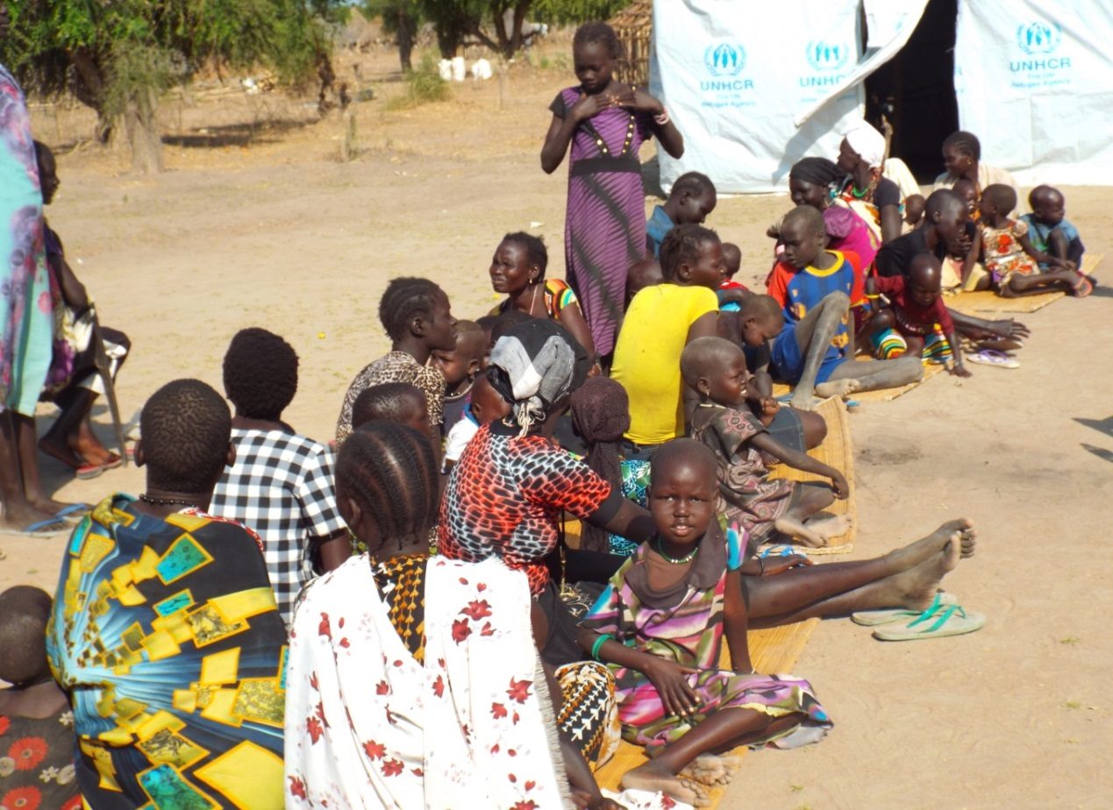
Issues: Malnutrition – CMAM – Coverage
What is the Coverage Monitoring Network?
What is coverage? Why are Coverage Assessments important?
Lessons Learned - Coverage Assessments leading to Change and Improvement
Next Steps
Notes:
Source: http://www.coverage-monitoring.org/training-centre/

Slide 3
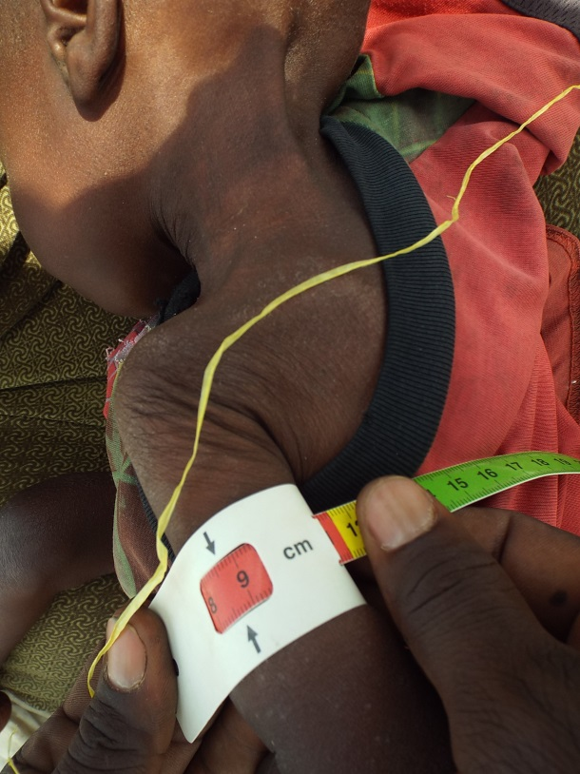
Malnutrition
Under-nutrition
A consequence of
a deficiency
in the body due to
insufficient food
intake or illness
Over-nutrition
A consequence of
consuming too
many calories or too
much energy
i.e. obesity
Both increase risk of illness and death
Notes:
Estimated number of children at any given time are severely wasted (SAM) 17 million, moderately wasted (MAM) 34 million. Case-load reached by prog. SAM 2.6 million (<15%) MAM 4.6 million (<13.5%).
Source: World Health Organization. Global database on Child Growth and Malnutrition. 2012 Joint child malnutrition estimates – levels and trends. UNICEF-WHO-The World Bank project. Geneva: World Health Organization; 2012 (http://www.who.int/nutgrowthdb/estimates2012/en/, accessed 8 October 2014).

Slide 4
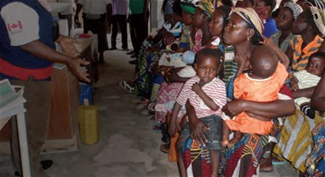
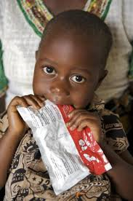
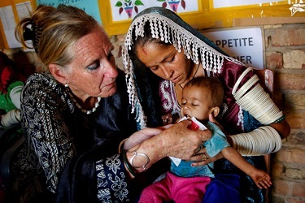
Community based Management of Acute Malnutrition (CMAM)
A community-based approach to treating Severe Acute Malnutrition (SAM)
  Most children with SAM without medical complications can be treated as outpatients at accessible, decentralised sites
  Children with SAM and medical complications are treated as inpatients
  Community outreach is conducted to encourage community involvement and early detection and referral of cases to health centres

Slide 5

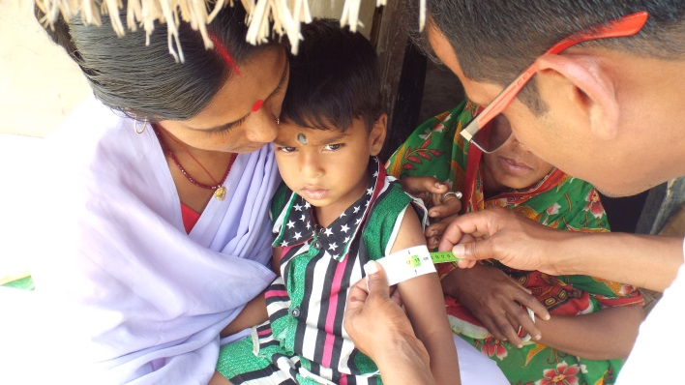
COVERAGE
What is the CMN?
The CMN (Coverage Monitoring Network) is a consortium of NGOs established in 2012 including Action Against Hunger (lead agency), Concern Worldwide, Helen Keller International and International Medical Corps
The main focus of the initiative is “Improving nutrition programmes’ coverage by supporting the identification and responses to barriers to access”
The project is funded by ECHO and OFDA/USAID

Slide 6
COVERAGE
What is coverage?
Coverage is commonly defined as the proportion of all people needing or eligible to receive a service who actually receive that service
In CMAM services, it is considered a vital indicator of programme success and impact.
Combined with cure rate, it can measure a programme’s met need or effectiveness.

Slide 7
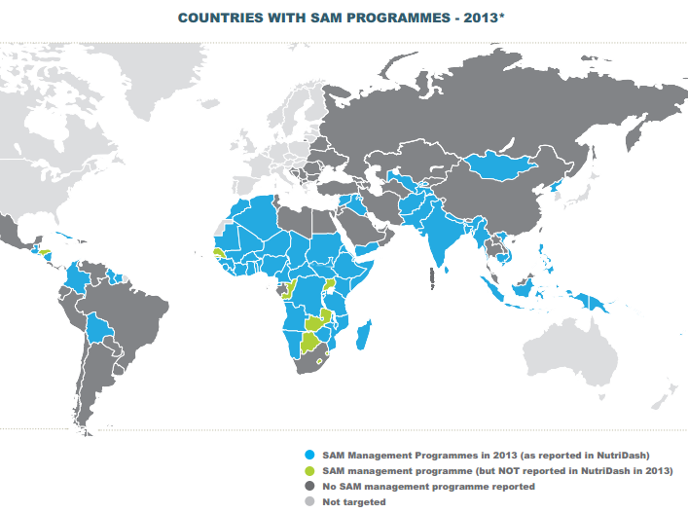
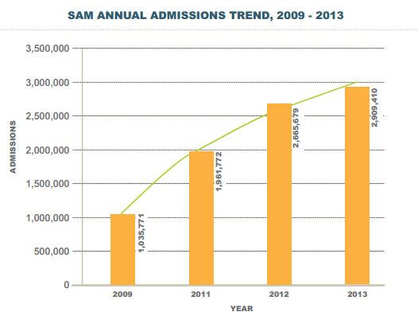
Why measure coverage?
COVERAGE
Estimated number of children at any given time:
SAM: 17 million
Moderately/MAM: 34 million
Approximate Case-load reached by CMAM programmes:
SAM 2.6 million (<15%)
MAM 4.6 million (<13.5%)

Slide 8
Assessment results lead to action for changes at programme level
COVERAGE
Coverage assessments (SQUEAC and Community Assessments)
Enable programmes to understand WHAT coverage of the programme is and WHY it is low (or high)
The programme staff then decide…
HOW to address challenges:
Joint Action Plan to
Improve service delivery
Improve community engagement and uptake

Slide 9
Assessment results lead to action at global level
COVERAGE
Number of assessments conducted by country:
Notes:
The CMN systematises and analyses information provided by 268 SQUEAC assessments conducted since 2010 (not including SLEACs and Community Assessments). Overall, the CMN works with data covering CMAM programmes in 30 countries.

Slide 10
Some evidence exists…
COVERAGE
Changes to coverage in health districts:
Notes:
Evolution of Coverage
The CMN encourages CMAM programmes to track coverage periodically. It has recently developed guidelines for follow-up assessments, which are a simpler version of the full assessments conducted as a baseline. The graph below shows coverage evolution for 33 CMAM programmes that have conducted two or more coverage assessments. The most recent coverage estimate is represented by circles, whose colour indicates either an increase or a decrease in the rate of coverage across time.

Slide 11
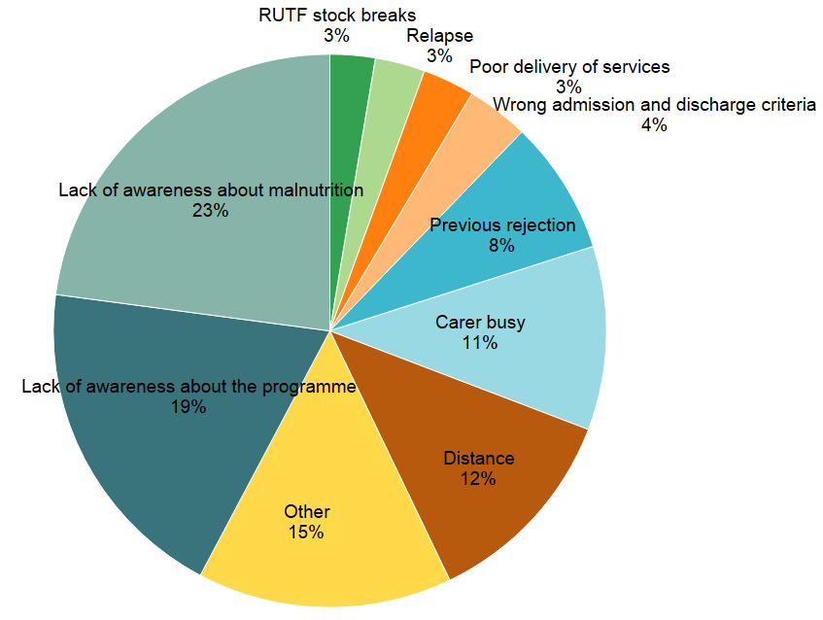
Barriers to Access persist
COVERAGE
Notes:
N=365 Country =12 , SEQUEAC=?

Slide 12
Global level results influence CMAM programming and practice
COVERAGE
CMN is working to gather evidence of the impact of programme level action plans on the coverage of CMAM responses
This will be used to develop guidance for programmes and to influence donors and stakeholders at national level
Lessons Learned
Indirect programme coverage estimation providing unreliable rates when compared with actual coverage rates, - often lower.
Coverage Estimation is still donor driven (a method to measure programme performance). The benefit of coverage assessments is not yet fully appreciated by the programmes.
It is difficult to follow the trends on changes in coverage due to the small number of programmes conducting assessments on a regular basis.

Slide 13
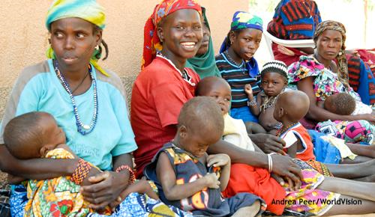
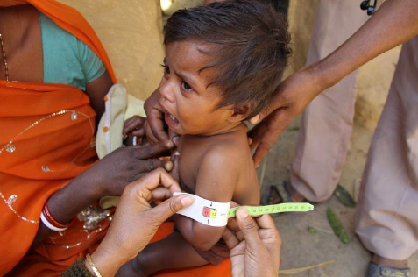
Next Steps
Advocate with donors and Ministries of Health (MoH) to integrate Coverage assessments into regular M&E systems
MoH to be country leads on Coverage assessments and on consolidating data and learnings
To attain highest number of children accessing the services – reduce barriers by implementing Joint Action Plans.
Thank you. Questions please?

