Slide 1


Research for Results
Introduction: Choosing the right methodology
    Carol Newman
    Associate Professor, Department of Economics, Trinity College Dublin (cnewman@tcd.ie)
    Trinity International Development Initiative (www.tce.ie/tidi)
    Trinity Impact Evaluation Unit (www.tcd.ie/economics/time)

Slide 2
Why is research important for development practice?
Overseas Development Assistance from DAC countries was $135bn in 2014
William Easterly, 2005 “Spending $2.3 trillion ... in aid over the past five decades has left the most aid-intensive regions, like Africa, wallowing in continued stagnation; it’s fair to say this approach has not been a great success.”
Jeffrey Sachs, 2009 “Without foreign aid, Rwanda’s path breaking public health successes and strong current economic growth would collapse.”
Nancy Qian, 2014 “The empirical literature on the impact of foreign aid is perhaps one of the most controversial ones in development and growth economics. ... [But] a large number of studies have emerged to dispute the positive effects of foreign aid.”
In general, there is a lot of disagreement in the economics profession on the effectiveness of ODA…….

Slide 3
Why is research important for development practice?
What economists do (generally) agree on is that…..
Resources are scarce and so development programmes need to be as effective as possible
Aid and investments should be targeted towards the areas where they are needed most and should be used in such a way that they have the greatest impact
It is important to learn from our current actions in order to improve future programmes and future aid effectiveness
To do this we need to know not just whether or not programmes work
Important to know how outcomes are obtained (mechanisms) and how they vary across time and space (context)

Slide 4
What evidence we use to inform policy and aid programs is crucially important
Big methodological advances over the last few decades has meant that we have the ability to provide rigorous evidence of what works in different contexts
Key to this is a mixed methods approach which combines strengths of quantitative and qualitative approaches
  Qualitative evidence to identify the problem and propose possible ways to address the problem
  Quantitative approaches to learn which (if any) of the proposed approaches are effective, to be able to accurately measure impact, identify channels of causation and understand heterogeneous effects
  Use of qualitative approaches to monitor the implementation of the programme.
  Follow up with qualitative approaches to better understand mechanisms and reasons for heterogeneous effects

Slide 5
Methodological approaches
Qualitative Methods
Quantitative Methods
- Focus groups
- Participation
- Observation
- Open ended interviews
- Textual analysis
Randomized Controlled Trials
Quasi-experimental designs
Natural experiments
Matching
Regression discontinuity
Instrumental variables
Non-experimental approaches
Observational data
Counterfactual?

Slide 6
Randomized controlled trials
RCTs are a very effective tool for impact evaluation and in particular in understanding whether programmes work and why
Growth in popularity over the last two decades due to the problem of drawing causal inferences when using observational data to evaluate programmes, i.e. there is no counterfactual
We can’t compare the same individual over time, i.e. before/after a program is implemented
Using an RCT we can obtain the average impact of a program or policy on a group of individuals by comparing them to a group of individuals who were not exposed to the program but are the same in every other way providing us with a counterfactual
This is possible by randomizing participants into treatment and control groups
With RCTs the treatments can be tailored to the question and in an ideal world will be informed by qualitative research on local context

Slide 7
Trinity Impact Evaluation Unit
TIME’s vision is to provide strong evidence of what works, so that better investments that have real impact on the development process can be made.
TIME brings together researchers from different disciplines, development practitioners, and policy makers in a collective effort to estimate and understand the impact of development aid and investments.
TIME can help to uncover the mechanisms that are at work in order to inform the design of better programmes in the future.
TIME strives to identify the casual effect of interventions, thereby providing credible evidence on what really works.

Slide 8
Trinity Impact Evaluation Unit
Projects:
Digitising Savings Groups: Impact Evaluation of Savings Group e-Recording Technology in Western Kenya.
Migration, Remittances, and Information
NOURISH: Nutrition and Treatment Outcome. Development of a Ugandan-Irish HIV/Nutrition Research Cluster.
Powering Education: the impact of solar lamps on educational attainment in rural Kenya.
Repayment flexibility, contract choice and investment decisions among Indian microfinance borrowers.
So fresh and so clean: urban community engagement to keep streets trash-free and improve the sustainability of drainage infrastructure in Senegal.
Flexible Loans and Locked Savings for Female Market Vendors in India

Slide 9
Example: Combatting malaria
According to the WHO malaria caused almost 1 million deaths in 2008, mostly among African children
Sleeping under an insecticide treated bed-net can help save many of these lives
For $10 you can deliver a net to a family and teach them how to use it
If half of the population sleeps under a bed night then the other half are much less likely to get it
Is there a case for giving bed nets for free to poor families?
Source: Banerjee and Duflo, 2003

Slide 10

Economic arguments FOR subsidizing bed nets
Externality associated with bed nets (others are less likely to get malaria if I sleep under a bed net). This implies that private incentives are not aligned with social benefits and a subsidy should be used.
Information failures may mean that families do not understand the benefits of using the bed nets until they actually have one. Providing them for free might kick-start them into buying/using more bed nets

Slide 11
Economic arguments AGAINST subsidizing bed nets
Psychological sunk cost – how much you pay gives you a sense of the value of the good
Selection effect – wasteful if you give the nets to families who will not use them
Entitlement effects – if you give things away for free people expect to get them for free in the future

Slide 12
Should bed nets be distributed for free?
To understand this we need to answer three questions:
If people have to pay full price for a bed net will they prefer to go without?
If bed nets are given for free will people use them or will they be wasted?
If they are given a bed net for free will they be willing to pay for one in the future or will they expect to get it for free in the future?

Slide 13
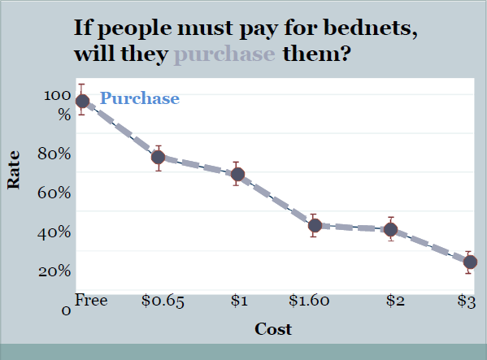
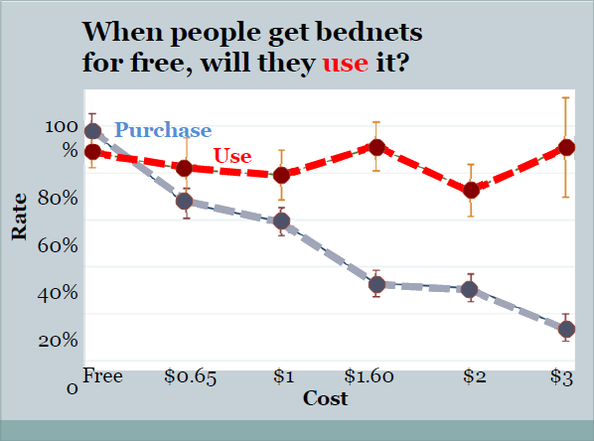
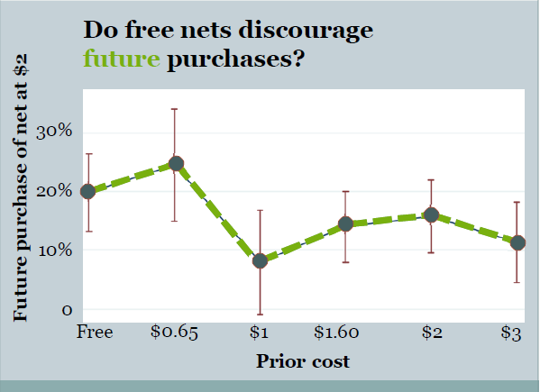
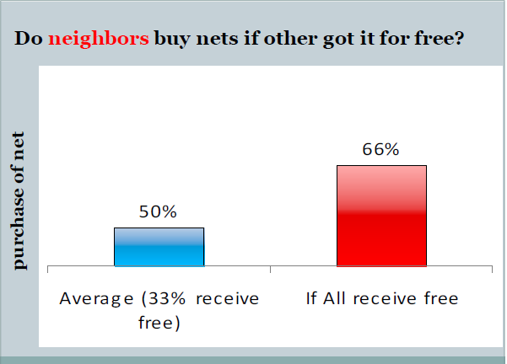
Results of an experiment by Pascaline Dupas in Uganda
Should bed nets be distributed for free?
Results from this experiment suggest
YES

Slide 14
Quasi-experimental designs
Natural experiment:
Observational study in which the treatment and control groups are not determined by researchers
They are determined by nature or factors outside of the researchers' control such as government policy
Still follow the primary principles of an experimental study and are most effective when there are clearly defined treatment and control groups: one clearly defined population that is exposed to a program and another that is as similar as possible in every other way other than program exposure
Observed changes in outcomes can reasonably be attributed to a causal impact of the program rather than just a correlation
Can never be fully sure of causality – unlike in case of RCTs
Econometric methods such as difference-in-differences, instrumental variables estimations and panel data techniques can help to tell a convincing story.
Relevant for program evaluation where a program is piloted in one district that is chosen at random (or in a somewhat random way)

Slide 15
Quasi-experimental designs
Natural experiment:
Example:
Duflo, E. (2003) ‘Grandmothers and granddaughters: old age pension and intra-household allocations in South Africa.’ World Bank Economic Review, 101(7), 3078-3108
How does the gender of the recipient affect the impact of a cash transfer?
In the early 1990s the benefits and coverage of the South African Social Pension System were expanded to the black population. This is a quasi-experiment or natural experiment
The shock was not expected at the time the household was formed
All women over the age of 60 and all men over the age of 65 were entitled to benefits, subject to means test
Compare the weight for height/height for age of children in households with
  no member eligible for the pension;
  an eligible man;
  an eligible woman
Identification assumption: there is no systematic difference in nutrition between eligible and non-eligible households with an elderly member
Notes:
Pensions received by women had a larger effect on child nutrition
The same resources are spent differently whether received by a woman or by a man
Policy implication is that targeting resources at women may be more effective in improving child nutrition

Slide 16
Quasi-experimental designs
Matching:
Using statistical methods to find a control group. For example, propensity score matching
The approach estimates the effect of a treatment by accounting for the factors that predict receiving the treatment.
The aim is to reduce the bias in trying to estimate the impact of the treatment from simply comparing outcomes between those that receive the treatment and those that do not
Matching attempts to mimic randomization by creating a sample of units that received the treatment that is comparable on all observed covariates to a sample of units that did not receive the treatment.
Main drawback is that subjects can only be matched on observables
Bias due to unobservables cannot be ruled out
It is often the unobservable confounders that we worry more about!

Slide 17
Quasi-experimental designs
Matching
Example:
Jalan, J. and Ravallion, M. (2003) ‘Estimating the benefit incidence of an antipoverty program by propensity-score matching.’ Journal of Business and Economic Statistics, 21(1), pp.19-30.
Estimate the distribution of net income gains from an Argentinean workfare program
Form a comparison group from observed characteristics
Also allow for heterogeneous impacts
Find that the average direct gain participants is half the gross wage
Over half of the beneficiaries are in the poorest decile nationally, and 80% are in the poorest quintile
Notes:
We study the Trabajar Program, an antipoverty program of the Government of Argentina, supported by a World Bank loan and technical assistance.
The program provided short-term work at relatively low wages, the program aimed to self-select unemployed workers from poor families.
A number of features of this setting lend themselves to PSM methods. As is common in a crisis, other evaluation methods requiring randomization or a baseline (preintervention) survey were not feasible. However, it was possible to do a postintervention survey in which the same questionnaire was administered to both the participants and the nonparticipants, and in a setting in which it was plausible that both groups came from the same economic environment. The Trabajar participant could be identified in the larger survey.
- Propensity-score matching methods of evaluation combine a single cross-sectional survey of program participants with a comparable larger cross-sectional survey from which a comparison group is chosen
- detailed cross-sectional data on both participants and nonparticipants, these methods can allow an assessment of behavioral responses without preintervention baseline data or randomization
- The accuracy of this method will depend on how well one can assure that treatment and comparison groups come from the same economic environment and were given the same sur-vey instrument. The method cannot rule out the possibility of selection bias due to unobserved differences between participants and even a well-matched comparison group

Slide 18
Quasi-experimental designs
Regression discontinuity:
Exploit discontinuity around a threshold or cut-off above or below which an intervention is assigned to examine the impact of a programme
By comparing observations lying closely on either side of the threshold, it is possible to estimate the local average treatment effect
Only possible to use this approach in cases where there is an identifiable threshold

Slide 19
Quasi-experimental designs
Regression discontinuity
Example:
Meng, L. (2013) ‘Evaluating China’s poverty alleviation program: A regression discontinuity approach.’ Journal of Public Economics, 101, pp.1-11.
Evaluate the impact of the second wave of China’s poverty alleviation program (8-7 Plan) on rural income growth
Program participation was largely determined by whether a county's pre-program income fell below a given poverty line
They compare the counties just below the dividing line to the counties just above it
They find that the 8-7 Plan resulted in an approximately 38-percent increase in rural income for counties that were treated between 1994 and 2000
Our empirical results also suggest the important role of initial endowments in the path toward economic development
Notes:
the program aimed to promote local economic development through targeted public investments in the form of subsidized credits, earmarked budgetary grants, and “Food-for-Work” proje
In a bid to lift majority of the remaining 80 million poor from poverty by 2000, the program covered 592 counties, or 28% of all county-level administrative units in China.

Slide 20
When can using quantitative methods be challenging?
There are many different types of development assistance
Some programs are very clearly defined and so are open to the use of experimental methods.
Quasi-experimental methods can also be used but also only in certain contexts
Many projects have multiple components and involve many actors (donors, NGOs, national agencies, ministries)
They are often broad in scope with no clear idea of full set of intended outcomes or impacts from the outset – this makes it difficult to use RCTs and other types of statistically rigorous methodologies
They could however be used for components of those programs e.g. PROGEP Senegal project
Quantitative evaluations should be built in from the outset to allow for the best possible design of the analysis. It becomes a lot more difficult (but not impossible!) ex-post

Slide 21
How can qualitative and quantitative methods be combined to enrich our analysis?
Reference: Bamberger, M., Rao, V. and Woolcock, M. (2010) ‘Using mixed methods in monitoring and evaluation.’ World Bank Policy Research Working Paper number 5245
Qualitative methods are very informative in the pre-design stage.
They can be used to help define the research question and set out the main hypotheses
They can also be used to help design or tailor the interventions
They can be used to pre-test the design so that it is relevant for the context and the key stakeholders.
They can inform the data collection process for the quantitative analysis and help in the design of the survey instruments.
For example: TIME/Plan Ireland research collaboration on gender disparity in disability in Togo
.

Slide 22
How can qualitative and quantitative methods be combined to enrich our analysis?
Mixed methods can strengthen the validity and operational utility of rigorous statistical designs
Limiting the analysis to pre and post surveys misses out on the process of project implementation
If you find no statistically significant differences between treatment and control is this due to design failure (program not effective in this context) or implementation failure (was not possible to implement the program)?
Participant observation, key informant interviews and focus groups can help to assess the process of project implementation.
You can also see whether what the beneficiaries are experiencing is in line with the theory or a prior expectations at an early stage.
Quantitative mid-line evaluations can also help in this regard.
Important that the integrity of the research design is preserved.
Do onto control groups as you do onto treatment groups!

Slide 23
How can qualitative and quantitative methods be combined to enrich our analysis?
Combining qualitative data with quantitative data can add depth to statistical indicators.
For example, through case studies or in-depth interviews the meaning of quantitative indicators can be established.
Quantitative data is difficult to collect in certain settings, such as in cases of domestic violence, or in trying to interview hard to reach groups – sex worker, homeless, etc. There are mixed methods technique that can help to address this.
Qualitative methods can help to shed line on heterogeneous effects that the quantitative analysis may not be able to pick up

Slide 24
How can qualitative and quantitative methods be combined to enrich our analysis?
Mixed methods can also help to improve the uptake of the results of quantitative designs.
They can help understand the extent to which a program will be scalable and will work for the range of stakeholders involved.
Mixed methods approaches can help in the communication of results.
Different audiences will respond differently to different styles of presentation. Academic audiences in economics will want to see the quantitative evidence, policy makers might respond better to case studies, videos or photographs, etc.

Slide 25
How we use evidence is crucial
Our research will tell us what works and why in a particular context
BUT…
…. it is only one piece of evidence, one observation
To truly inform policy and development aid agendas we need to consider all of the (good) evidence that is available
Too often policy makers and donors will use the one piece of evidence that tells them what they want to hear
This will not help us use development aid more effectively and advance the international development agenda
Notes:
(all of the research papers and journal articles)
(or worse, they will fund research that proves they are right – policy based evidence making.
Drawing policy conclusions from bad research is bad, drawing policy conclusions from one study is also bad)

Slide 26
Conclusions
International development is highly complex
To make sure aid is put to its most effective use and that it reaches those most in need we need rigorous evidence
Through rigorous impact evaluation we can uncover what works and why
We as researchers need to:
engage in multi-disciplinary research, work together with development practitioners and policy-makers in providing a rigorous evidence base
provide lots of rigorous evidence, from lots of different contexts and settings
base policy recommendations on a synthesis of findings that address the realities and complexities of different contexts

Slide 27

Thank you!
Carol Newman
Associate Professor, Department of Economics and Trinity Impact Evaluation Unit Trinity College Dublin
Chair of Trinity International Development Initiative
Contact: cnewman@tcd.ie
Web: www.carolnewman.ie
:@Carol_Newman

