Slide 1
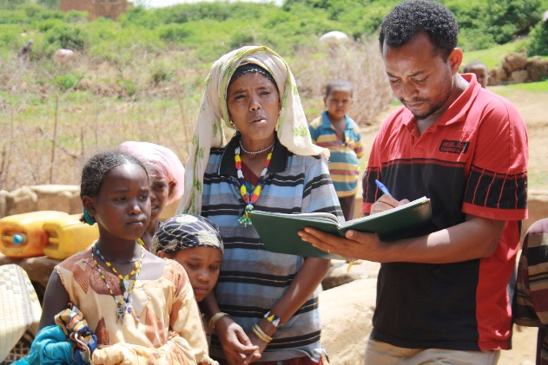
DSAI Conference 2015
Critical Reflections on the AgriDiet Project
Edward Lahiff
Nick Chisholm
Nora O’Brien
Tom O’Connor
and
Stephen Thornhill
all of University College Cork
With acknowledgments to the entire AgriDiet Team

Slide 2
AgriDiet Overall Goal, Partners and Approach
“To contribute to poverty reduction through the identification of policies and interventions that can make a positive impact on the nutritional status of vulnerable rural households”.
3-year research project (2012 – 2015) in Ethiopia and Tanzania: funded by Irish Aid and HEA under the Programme of Strategic Cooperation
8 research partners (5 from Global South): University College Cork is the lead institution with Ethiopian Development Research Institute, Mekelle & Haramaya Universities (Ethiopia), Sokoine and St Augustine’s Universities (Tanzania), Institute of Development Studies (UK) and University College Dublin
Multi-faceted (agri-food systems, food security, health and nutrition experts and researchers) and multi-level (micro-meso-macro) approach
Observational research – aims to advance understanding of agriculture-nutrition linkages through in-depth analyses: no direct interventions

Slide 3
Research Questions
1. How does the wider economic and policy environment impact on food systems and nutrition?
2. In what ways do current agricultural and food systems impact on nutritional status, particularly of young women and children?
3. What existing agricultural initiatives are likely to have positive impacts on nutritional status and have potential for wider application?
Proved to be very topical issues

Slide 4
A concept frame linked to work packages

Slide 5
AgriDiet Work Packages
WP1 – Global review of ag-nutrition linkages (state of art)
WP2 – Country policy reviews and recommendations
WP3 – Concept frame and methodology guidelines
WP4 – Meso-research of agri-food systems and institutions
WP5 – Household agri-nutrition linkages (PhD research)
WP6 – Review of pro-nutrition agri-interventions
WP7 – Stakeholder platforms (national and local)
WP8 – Knowledge mobilisation
WP9 – Project management

Slide 6
Multi-disciplinary Approach
Powerful tool for addressing complex ‘real world’ questions
Introduces new critical perspectives and mutual learning within teams
More comprehensive fieldwork
But also presents new challenges and complexities
Tendency to break down at critical junctures – e.g. data analysis, PhD submissions and examinations, and publications.

Slide 7
Cross-sectional Observations
Research centred on one year’s data:
cross-sectional (as opposed to time series);
observational research (as opposed to experimental) – no direct intervention
Policy-makers often expect “action research” trialling an intervention; links to evaluation studies
AgriDiet makes a distinctive contribution by collecting data twice within the one agricultural year – high season and low season.
Provides valuable insights into seasonality, and a fuller picture for one complete year, but not variation between years

Slide 8
Large, multi-country team
Adds complexity at every stage, and requires compromise – perhaps beyond what is useful
Collaboration with Irish partners (UCD) was very positive – different strengths and POV
Focus on one southern country may be preferable to two
Two-country focus brings additional perspectives and potential for comparative perspective, but not fully realised
Policy contexts are so different that cross-country analysis has not really been attempted.
Different conditions and personalities meant that the country studies sometimes went in different directions –trying to meet needs of multiple partners.

Slide 9
Focus on doctoral research
Provides a strong core to the project, and lasting impact, but sits uneasily with the highly diverse objectives of the project
PhD studies bring their own challenges - effectively individual and discipline-specific projects; 3 years is too short given the inevitable delays in start-up; students only registered in month 6 of 36.
Dangers of over-loading PhD students with responsibility for data collection for the entire project team, acting as translators/guides for visiting researchers, drawn into unscheduled tasks.
Recruitment of PHD students from within partner institutions was shaped by local institutional requirements, but probably better than open recruitment; meant that the students had a ready-made institutional based, and local support, but meant they couldn’t disengage entirely from prior responsibilities. Basing students full-time in Ireland would not be a solution.

Slide 10
North-South Cooperation
Strongly emphasised, but not straightforward
Brought unique access to the field, and policy actors
Different institutional arrangements lead to a lot of admin – need for full-time project manager
Nothing could start until first funding was transferred, and this could not happen until (lengthy) contracts were in place
Issues around finishing of work and ultimate responsibility for quality of output, publications etc.
For some (Irish) researchers, this became their main research activity for the period; for African partners, it was a relatively minor part amongst many research projects, often with much bigger budgets and more established - multi-faceted - partnerships.

Slide 11
Research versus capacity building
Inevitable trade-offs: considerable investment in capacity building activities (esp. with PhD students), with long-term benefits (i.e. beyond the project timeframe)
PhD students are the most obvious success; other achievements were in the areas of joint design, joint fieldwork, joint outputs, policy engagements
Fostered some new intra-country collaborations
PhD studies tend to run-on beyond the project timeframe: e.g. final write-up and submission, viva voce exam, revisions, which may not have budget attached

Slide 12
Policy Engagement and Dissemination
Greatly boosted by having dedicated work package and specialists, separate from other research
Valuable insights gained by holding stakeholder workshops at national and sub-national levels
Dedicated website (and web manager) and publication specialists helped integrate the team and smoothed the publication process (taking pressure off researchers)
Linked us to other current research initiatives – but not in a position to accept offers of further collaboration
May not have met the needs of policy makers, who would prefer some more sustained engagement and flow of findings from the outset

Slide 13
Findings (so far) 1
Global review highlighted the pathways by which agriculture can improve nutrition but evidence of linkages is weak and research gaps were identified including the full pathway of the supply chain
Methodologies and metrics are another weakness identified and results from the household survey using diversity, perception and anthropometric indicators are being analysed for variances
Under-nutrition remains a major development challenge, particularly seasonally in rural areas, as shown in PhD analysis so far (eg Nutrition journal paper on seasonal variation in under nutrition and anaemia of lactating mothers in rural Ethiopia, better outcomes for HHs with off-farm income in Tanzania)
Chronic micronutrient deficiency higher than expected (particularly zinc at 70% in Ethiopia – 96% in lowland zone mothers)
Policy reviews recommend promoting micronutrient rich crops and animal products, better coordination between ag and health extension and more involvement of the Ministry of Agriculture in national nutrition plans.

Slide 14
Findings (so far) 2
Policy reviews also call for a more gendered approach - improving women’s control over HH income, better nutrition education and developing a food basket for different eco-zones, as well as better processing and storage of fruit and veg
The stakeholder workshops highlighted the importance of improving cross-sectoral coordination at local level and a research brief was produced with recommendations to develop more dynamic structures, more resources for capacity-building and clearer guideline0s for extension collaboration
The meso-research included recommendations to improve post-harvest handling of groundnuts in Ethiopia due to aflatoxin problems. In Tanzania, low prices and poor productivity of staple crops grown were linked to low intake of more micronutrient rich foods, such as meat and veg.
The review of ag-interventions concluded that those interventions that addressed multiple pathways (income, diet diversity, women’s empowerment, sanitation, etc) appeared to have the greatest potential, but empirical evidence remains weak

Slide 15
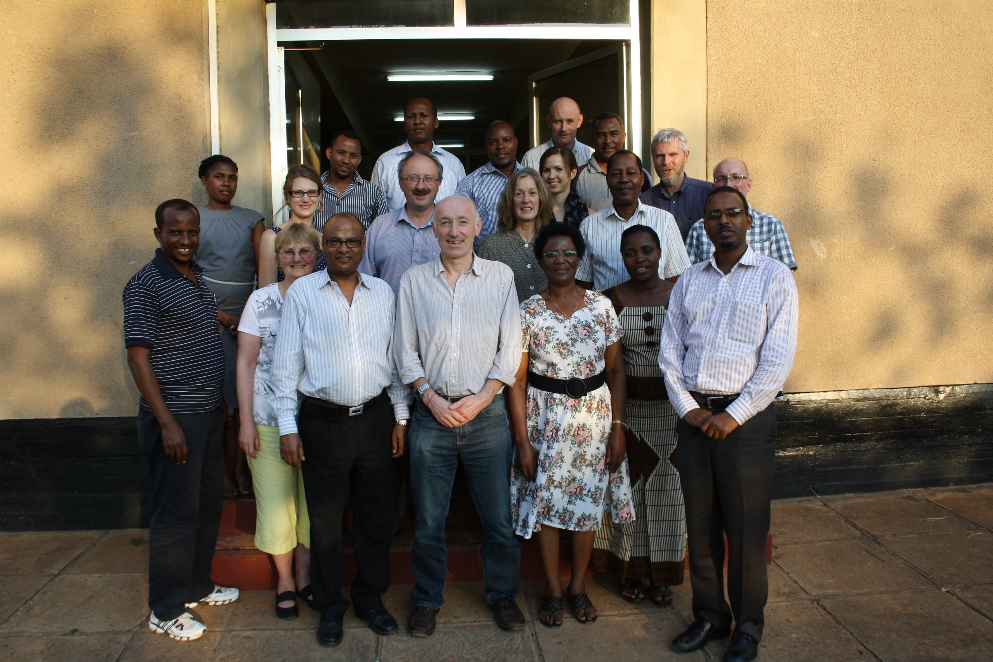
Thank You

