Slide 1
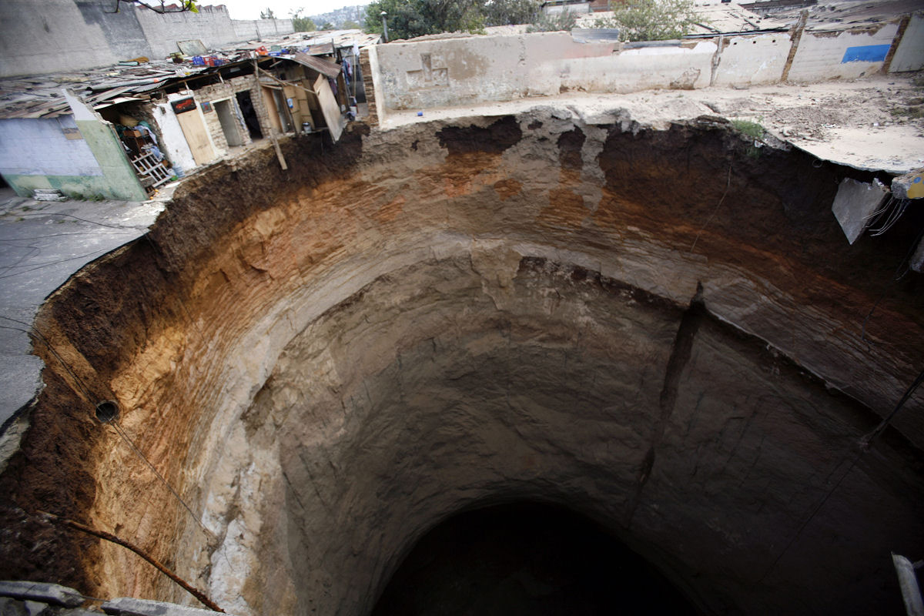





Equality challenges
Maynooth University
Social Sciences Institute (MUSSI)
Challenges to Gender Equality, Public Health and Human Rights in the Trump Era:
Critical issues for development
Su-ming Khoo
National University of Ireland, Galway
suming.khoo@nuigalway.ie
@sumingkhoo

Slide 2
The Trump Effect and the Sinkhole
INEQUALITY is the biggest challenge
Just 8 men own same wealth as half the world (Oxfam 2017)
“mild tweaking is not going to work” (Stiglitz)
  https://www.facebook.com/evonomics/videos/1853336234937157/
Neoliberal-neoconservative contradictions- Universalism and racism-sexism are not opposites, but a symbiotic pair – ideological zig-zag (Wallerstein 2005)
‘Anti genderism’ (Poland, Russia); ‘anti-political correctness’ (alt-right) are rhetorically pro-freedom, anti-elitist and anti-global, but substantively misogynist, white racist, xenophobic and Islamophobic
Neoconservatives are activists motivated by perceived threats to privileges which are seen as property rights (Dietrich 2011)
“Depravation is the cleverest strategy of deprivation” (Bauman & Mazzeo 2012, 31)
Conservative media as institutional and organizational nexus, transforming audiences into activists and a reliable voting base. Embrace of ‘totems of bigotry crosses over into real poison’ (Hemmer 2016)
90% of 10,000 US K-12 educators surveyed in November 2016 reported negative effects of Trump presidential election. Most believe it will have a long-lasting impact. 80% reported heightened anxiety and concern (SPLC 2016)

Slide 3
Eroding, not expanding floor of development / rights
An increasingly unstable world: economic crisis, social injustice, over-consumption, waste
Calls for development ethics that questions the market-driven paradigm, moves closer to rights
Public health goods have been eroded as collective health has become commodified and conflicted (Khoo 2015)
“neoliberal globalization has produced a global health crisis” (Global Health Watch 2015)
Formal democracy as the route to expanding rights is severely in question

Slide 4
Source: Global Health Watch 2015

Slide 5
Public Health
Reduce morbidity and mortality
the organised efforts of society in preserving and enhancing all that makes life worth living
for everyone and to give every individual and community
reasons to value their existence and contribution
(Hanlon et al 2011)
Ethical principles of Public Health
beneficence
Non-maleficence
Justice
Autonomy
Society’s interest in assuring conditions in which people can be healthy (Koplan & Fleming 2000)
Identify and minimise burdens
Fair procedures for dealing with burdens
Reliable scientific evidence
“The missing element is a thorough analysis of the role of misogyny”

Slide 6
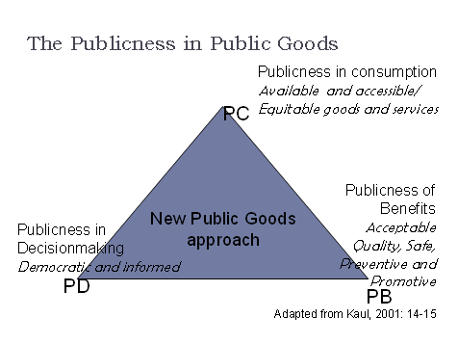
Public Goods
Public health emphasises collective goods requiring public protection.
Public health ethos requires more than individual responsibility
Necessary levels of trust and quality depend on collective attributes of the health system
(Khoo 2015)

Slide 7
‘Public’ redefined by data platform capitalism
Since 2010, Robert Mercer has donated $45m to reshape beliefs through Republican political campaigns and $50m to rightwing, ultra-conservative nonprofits.
J Albright’s map shows rightwing sites reinforcing domination via YouTube and Google
Illiberal freedom - “unwavering commitment to neutralising leftwing bias in the news, media and popular culture
Mercer funded Breitbart, the biggest political site on Twitter and Facebook
Cambridge Analytica: from covert military “psyops” to “election management strategies”, messaging and information operations
Specific companies eg SCL engineer political outcomes for profit as well as ideology using “the manipulation, and then resolution, of fear,”

Slide 8
‘Development’ as Global Future Public Health
How can we find a way to think and act effectively in potentially overwhelming circumstances? (Hanlon et al 2011)
Current public health isn’t sustainable - present methods and mindsets have diminishing returns and adverse effects.
Need multi-disciplinary, global, transformational, emergent approach to identify current values, goods and skills and what is needed for the future
Extend ethics and rights to institutions, and internationally
Broaden ‘human rights’ to include solidarity, needs, duties, future
Immediate social action, policies to prevent rollbacks, social stabilization
Medium term policies must include tax, regulation, public services
Longer term mindset change must prioritize sustainability, justice

Slide 9
Human Rights
The only approach combining equality with obligation to not discriminate
an internationally agreed set of standards to guide and assess the conduct of governments across a wide range of sectors and has a direct, close bearing on medicine, public health, and the strengthening of health systems (Backman et al 2008, 2047)
1993 Vienna Conference “Women’s Rights are Human Rights”
1994 Cairo ICPD “notable shift from control of women’s fertility to reproductive health and rights placing women (and men) at the centre as decision-makers over their own lives.
Beijing 1995 reaffirmed and extended Cairo vision (Yamin 2013, 279)
But also saw the rise of ‘relativist’ challenges to HR universality
  Conflicts between ‘culture’ and ‘women’s rights’ (Tripp 2010)
  “fundamentalist ecumenism” the challenge for feminists (Vuola 2002)
One of the most universal human values is health . Health transcends all our cultural, geographic and political barriers to provide a fundamental basis for human dignity (Lorntz et al 2008,1 65)
Recognized global, regional and national treaties and constitutions underpins rationale for the post-2015 development agenda
Health and SDG - A green economy that maximizes benefits, through coherent policies across sectors, with health and human well-being as the bottom line.

Slide 10
Non-discrimination = Genuinely equal treatment
It is prohibited to deny women access to healthcare, including reproductive healthcare, because they are women. This is understood to mean that the state cannot deny health services that only women need, such as services related to pregnancy, pregnancy related complications, and post abortion care. It is also forbidden to discriminate against women due to their marital status or for any other reason, such as HIV status or pregnancy. (NHRI Handbook p78)
The biological differences between men and women call for different sets of goods and services in order for women to be genuinely treated equally with respect to access to healthcare. To treat men and women in a uniform manner would itself constitute substantive discrimination (Yamin 2013, 278)
Women's rights - including SRHR- are intrinsically linked to equality at intrastate level and at the inter-state level

Slide 11

Domination and injustice - encapsulation
Public health and development programmes have accommodated social contracts of domination and injustice.
Dominated persons had no rights, were dispossessed and their needs subject to moral judgement as ‘others’.
Christian Democracy
Marriage-based heterosexual family
Unpaid, reproductive and caring work
‘Protecting’ women and children
Public Health
“Development”?
Colonialism and imperialism
Civilizing mission
Sectarianism, racism,
ethnocentrism

Slide 12
Trumpian domination
Disorganises dissent by multiple attacks on progressive forces including women's and feminist orgs
Targeting SRHE attacks the traditionally marginalised – esp. poor non-white women.
in effect condemns them to cycles of violence, pregnancy, poverty, ill-health that, perhaps, also justify their treatment as underserving and other
Shoring up the inherent inequalities produced by neoliberalism but which are also required for its success - making the working poor more vulnerable , reduce their entitlements and provide greater tax rebates to the wealthy
Neoliberalism is complemented by neoconservative 'morality' that defines others to exclude and justifies removing their rights (unacceptable women, POC, the poor, immigrants)

Slide 13
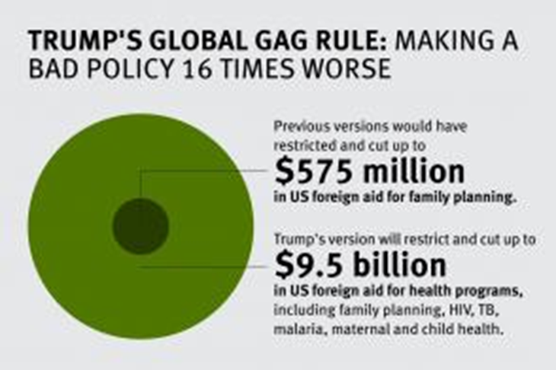
Global roll-back on SRHR
US largest global health donor
“President Trump’s expanded Global Gag Rule is anti-woman, anti-family, anti-health, and anti-free speech and threatens to roll back hard-fought health gains around the world”.
“Donors should protect the investments they have been making in global health by pledging new funds to help fill the gap.”
https://www.hrw.org/news/2017/02/28/governments-step-reproductive-rights
Netherlands, Belgium, Denmark, and Sweden: “She Decides” funding initiative will support organizations affected by US restrictions and cuts.

Slide 14
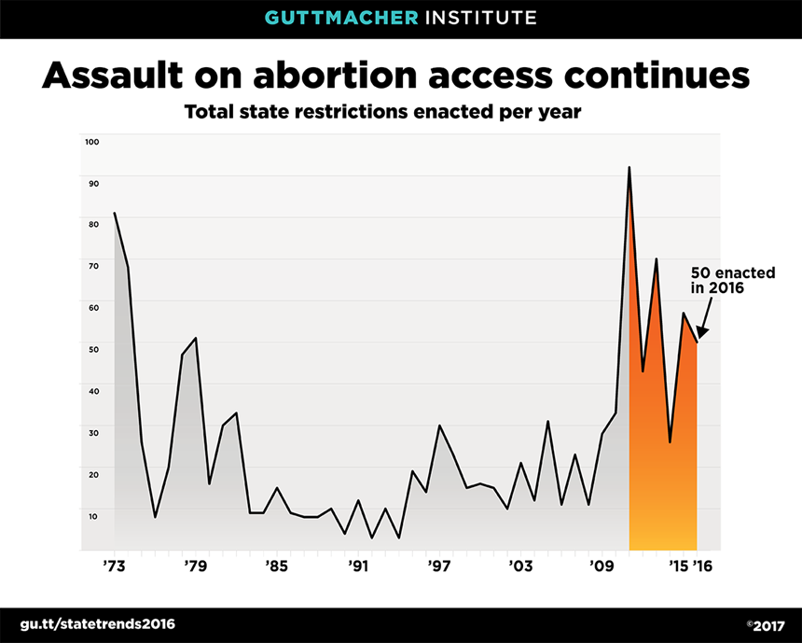
Domestic rollbacks
Rise/ platforming of traditional + alt-right interests
Blocking/defunding/legislative pushback on abortion and SRHR
Planned de-funding of DV organisations
a specifically antifeminist and gendered mobilization with women’s health bodies as ‘collateral damage’
Whole Woman’s Health v. Hellerstedt 2016 Court’s ruling upheld need to consider scientific evidence, not just lawmakers’ beliefs, in evaluating the constitutionality of abortion restrictions.
Assault on science will have negative effects

Slide 15
Being political
Being political requires both a space of political freedom and equality
and the existence of a ‘common world’ of humanity, a shared, public world (Arendt, 1978)

Slide 16
Public health as a model
The public health model is a concept with currency in many disciplines, including health, education and welfare (welfare and child protection) (Hunter 2011)
Public health’s preventative and social model must mobilize against deleterious trends
VAW and SRHR are not optional: 36% of women affected = a public health problem of epidemic proportions (WHO 2013)
Primary / universal interventions are strategies that target whole communities or populations in order to build public resources and attend to the social factors that contribute to illness and social problems
PH interventions focus on changing cultural and societal norms, policy or legal reforms, and at alleviating social inequalities (WHO, 2006)

Slide 17
References
Adut, Ari (2012) A Theory of the Public Sphere. Sociological Theory 30 (4), 238-22
Albright J (2016) Data is the Real Post-Truth, So Here’s the Truth About Post-#Election2016 Propaganda Nov 27, 2016 https://medium.com/@d1gi/data-is-the-real-post-truth-so-heres-the-truth-about-post-election2016-propaganda-2bff5ae1dd7#.pnkvknm8b
Arendt, Hannah (1978) The Life of the Mind, New York: Harcourt, Brace & Jovanovich
Backman G et al Health systems and the right to health: an assessment of 194 countries Lancet 2008; 372: 2047–85
Bauman, Z with Mazzeo R (2012) On Education: Conversations with Ricardo Mazzeo. Cambridge: Polity
Benatar, S. R.; Gill, S. Bakker, I. (2013) “Global health and Global economic crises “in Grodin, Michael A.; Tarantola, Daniel; Annas, George J.; Gruskin, Sofia (eds) (2013) Health and Human Rights in a Changing World. New York: Routledge, pp. 487-500
Billingsley, Amy (2015) Hope in a Vice: Carole Pateman, Judith Butler, and Suspicious Hope, Hypatia 30, 3: 597-612
Cadwalladr, C. (2017) Robert Mercer: the big data billionaire waging war on mainstream media, Observer 26 February 2017
Dietrich, David R (2011) Rebellious Conservatives: Social Movements in Defense of Privilege
Doyal, Lesley (2002) ‘Putting gender into health and globalization debates: new perspectives and old challenges’, Third World Quarterly 23(2): pp. 233–250
Global Health Watch 2015 Report
Griffis, C (2014) The Heart of the Battle Is Within:” Politically and Socially Rightist and Conservative Women and the Equal Rights Amendment
Hanlon, P.; Carlisle, S.; Hannah, M.; Lyon, A.; Reilly, D. (2011) Learning our way into the future public health: a proposition. Journal of Public Health. 33, 3, 335–342
Hemmer, N. (2016) Messengers of the Right: Conservative Media and the Transformation of American Politics, University of Pennsylvania Press
Hunter, C. (2011). Defining the public health model for the child welfare services context. National Child Protection Clearinghouse Resource Sheet. Melbourne: Australian Institute of Family Studies. aifs.gov.au/nch/pubs/sheets/rs11
Ingram (2016) What a Map of the Fake-News Ecosystem Says About the Problem http://fortune.com/2016/11/28/map-fake-news/
Khoo (2015) Solidarity, equity and rights-based approaches to health provision. Commonwealth Health Partnerships 2015, 128-30
Koplan, J.P.; Fleming, D.W. (2000) Current and Future Public Health challenges JAMA 284, 13 1696-8
London, L. Schneider, H. (2012) “Globalisation and health inequalities: Can a human rights paradigm create space for civil society action?’, Social Science & Medicine 74: pp. 6-13
Mirugi-Mukundi, G (2015) ‘A human rights based approach to realising access to sexual and reproductive health rights in sub-Saharan Africa’, in Durojaye, E (ed.), Litigating the Right to Health in Africa: Challenges and Prospects, Farnham, Ashgate, 43-69
Nash, E. et al (2017) Policy Trends in the States: 2016, Guttmacher Institute https://www.guttmacher.org/article/2017/01/policy-trends-states-2016
Oxfam (2017) Just 8 men own same wealth as half the world https://www.oxfam.org/en/pressroom/pressreleases/2017-01-16/just-8-men-own-same-wealth-half-world
Starrs, E.M. (2017) The Trump global gag rule: an attack on US family planning and global health aid, The Lancet 389, 485-6
SPLC (2016) The Trump Effect: The Impact of The 2016 Presidential Election on Our Nation's Schools https://www.splcenter.org/20161128/trump-effect-impact-2016-presidential-election-our-nations-schools
TNI (2017) Manufactured Consent Power, Media and Thinktanks 25 January 2017 –Infograph https://www.tni.org/en/publication/manufactured-consent
United Nations (2014) Reproductive Rights Are Human Rights: A Handbook for National Human Rights Institutions HR/PUB/14/6
West, Cornel. 2008. Hope on a tightrope: Words and wisdom. New York: Smiley Books
Yamin, A (2013) ‘Women’s health and human rights: struggles to engender social transformation’, in Zuniga, J, Marks, S, and Gostin, L (eds), Advancing the Human Right to Health, 275-290

