Slide 1
Water and Sustainable Development
Prof. Fiona Regan
A DSA IRELAND/TIDI/3U
Global Health Workshop
September 22nd 2015
Printing House, Trinity College Dublin

Slide 2
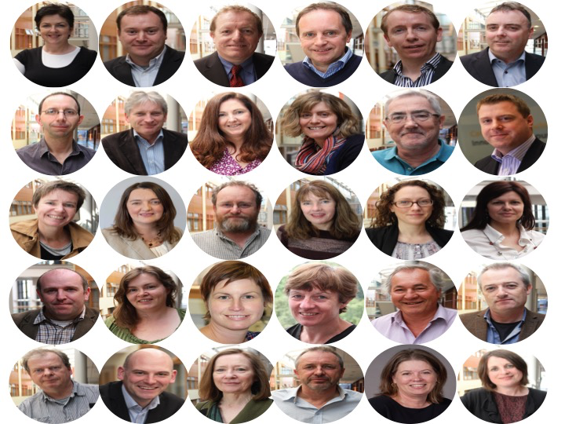
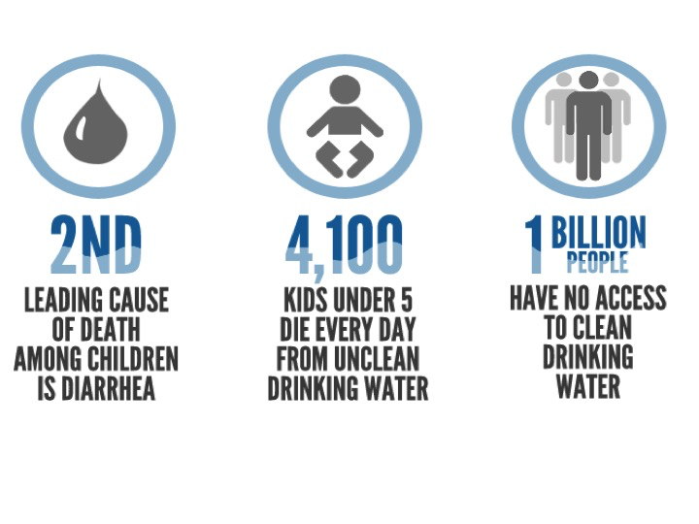
Elevator Pitch
What is it
Why are we doing it
What are the outcomes
What is the Impact

Slide 3
Mission
The DCU Water Institute translates research into solutions for global water problems
Vision
By 2020, the DCU Water Institute will be Ireland’s centre of excellence for the development of technical solutions for water management and sustainable water supply, and for contributions to water policy developments.

Slide 4
Who is interested in what the Water Institute has to offer?
Quadruple Helix of Stakeholders

Slide 5
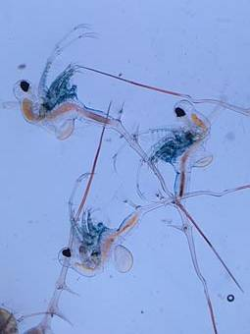
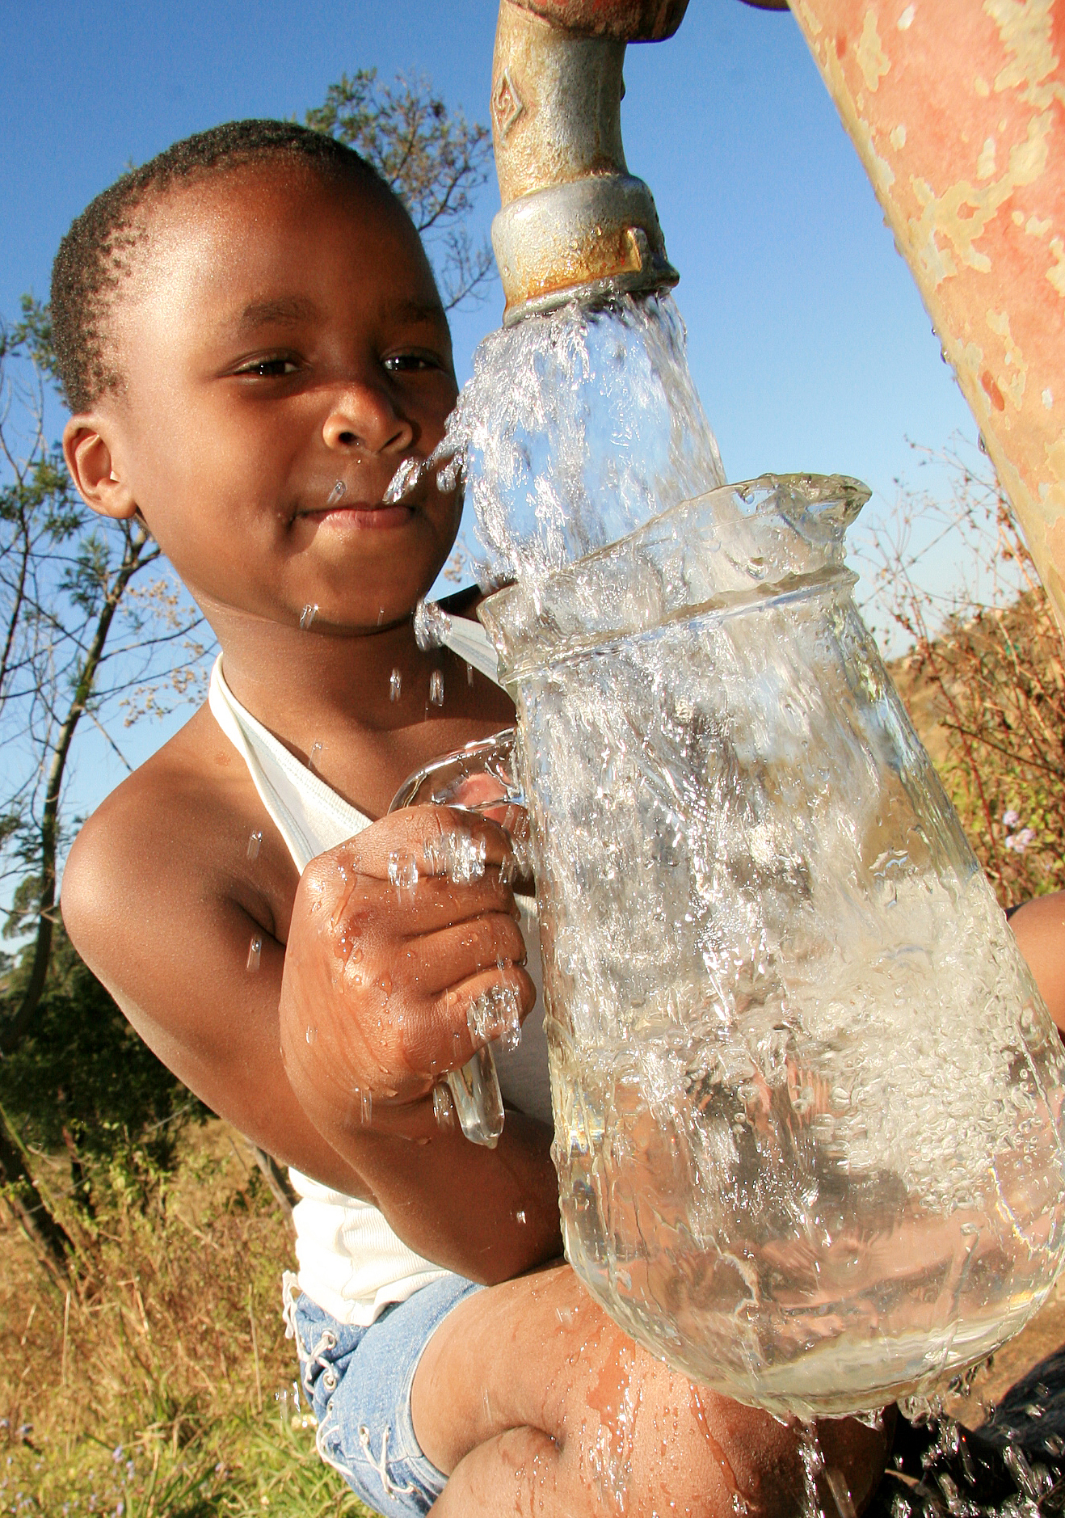
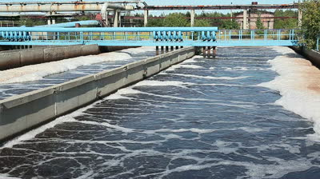
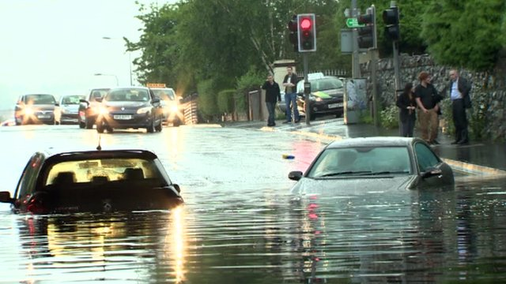
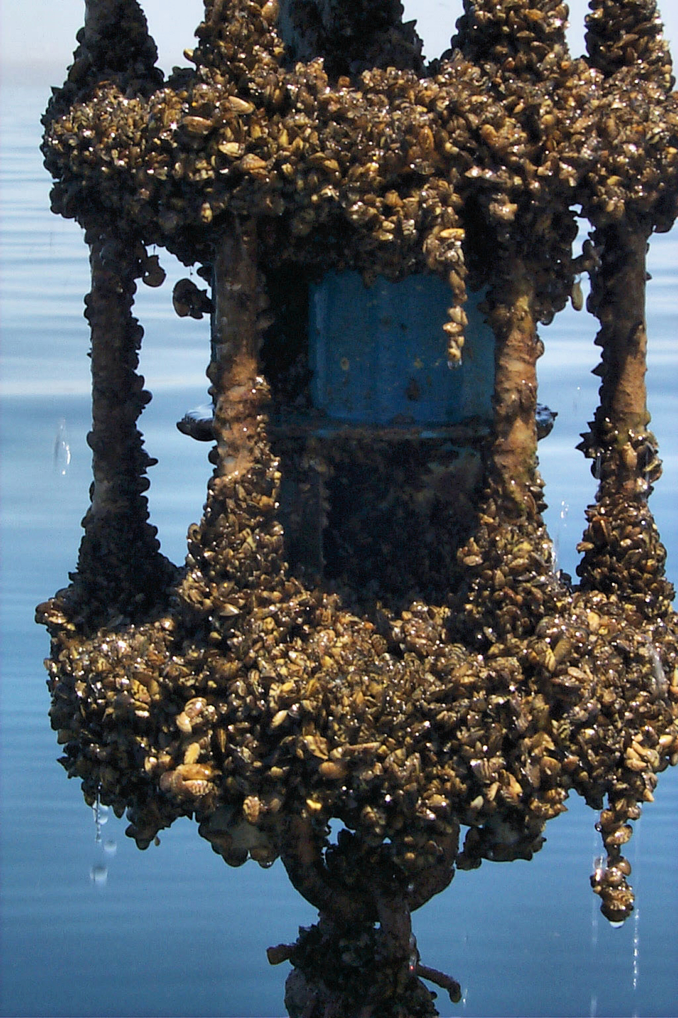
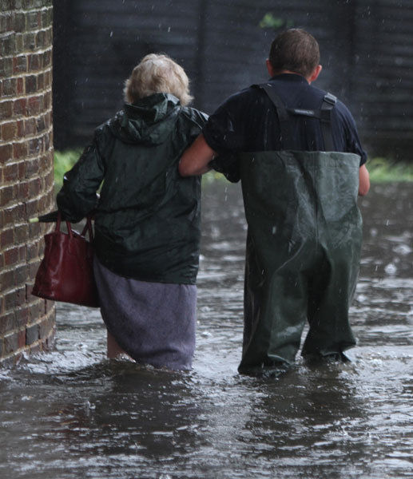
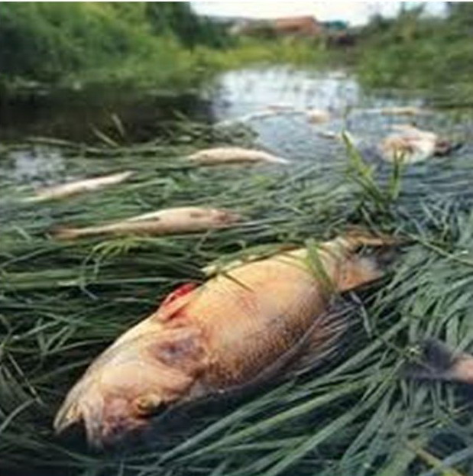
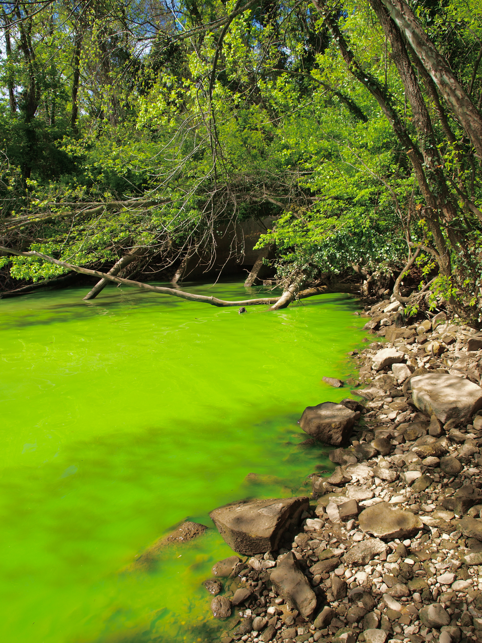
What is the offering of the WI? The WI working in partnership helps to provide solutions to global water problems:
Support and solutions to achieve environmental compliance
Prevention of transfer of invasive species from ballast water or large vessel transport
Solutions to enable availability of clean drinking and bathing water
Technology to improve the efficiency of membrane filtration technology and energy efficiency in water treatment plants
Decision support systems to address water shortages and flooding
Solutions to allow long term deployment of devices in water (i.e sea water )
Solutions for environmental water pollution and environmental monitoring of ecosystems
Find alternative uses for agricultural waste (i.e. nitrates, phosphates)

Slide 6
Who is interested?
Environmental compliance:
EPA, MI
Transfer of invasive species:
Agencies
Industry (aquaculture)
Solutions for clean water:
Public
Agencies
Membrane filtration technology and water treatment:
Industry
Decision support systems:
Industry (Data analysis)
OPW, EPA, MI
Long term deployment:
Aquaculture industry
Ocean energy industry
Sensor developers etc.
Solutions for environmental water pollution:
Public
Agencies
Agricultural waste:
Industry (Dairy and Beef)
Aquaculture
Agency

Slide 7
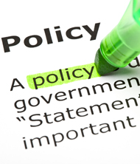
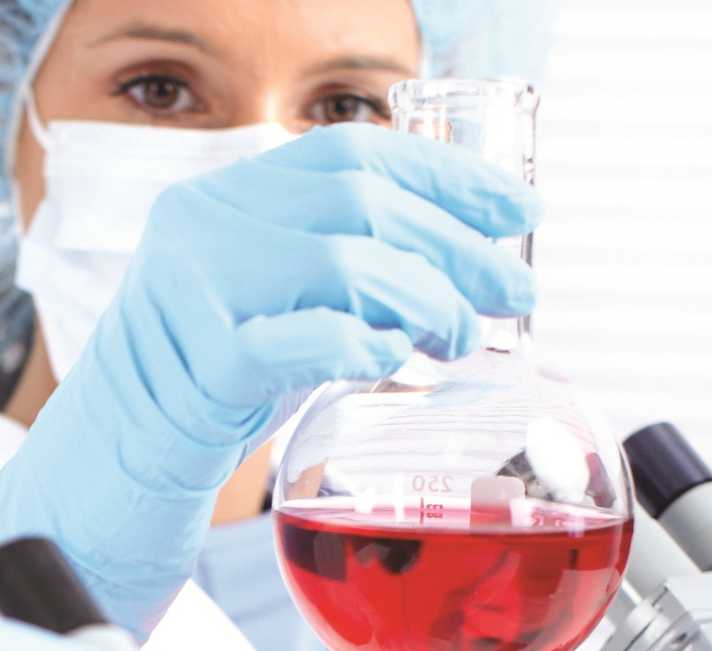
And also…
An body of experts to contribute with information for government policy development
A pipeline of suitable qualified post-graduate professionals to address the needs of the water industry
A expert forum to bring water news to the public

Slide 8
Scientific and technical competencies at the WI
Asso
Associated Technology Platforms
Core Water Science, Technology, and engineering expertise

Slide 9
SCIENTIFIC AND TECHNICAL COMPETENCIES AT THE WI
Engineering
Dr. Yan Delaure,
Dr. Brian Corcoran
Complex
Multi-flow
characterisation
Data
Analytics
& Image
processing
Data Analytics
Prof. Noel O’Connor,
Prof. Alan Smeaton
Asso
Water Science
Bio-technology
Environmental Science
Science Policy
Energy Efficiency
Nano-water
technologies
Nanowater Treatment
Dr. Kieran Nolan,
Prof. Tia Keyes
Autonomous
sensor
technology &
Sensor
networks
Environmental Sensing
Prof.Fiona Regan,
Prof. Dermot Diamond
Separations Science
Prof. Apryll Stalcup,
Prof. Dermot Brabazon
Membrane Technology
Dr. Jenny Lawler,
Dr. Greg Foley
Advanced
Analytical
Separations
Membrane
technology

Slide 10
Current Position
30 P.I’s cross faculty, multidiscipline.
National and International Partners with focused objectives and specialist expertise
Over €10.6 million water-related funding to date
Agency and Industry Engagement with SME and MNC
Graduate Programme development for capacity building
Five thematic areas: Water and health Risks and security Marine Agriculture Energy

Slide 11
Existing research under WI thematic areas
Energy
Water & Health
Risks & Security
Marine
Sustainable Agriculture
EPA - Increasing Resource Efficiency in WWTP’s
EPA - Optimal design and operation of small-scale WWTP’s
SFI TIDA – Nanoporous Thin Films, Solar
SCIENCE WITHOUT BORDERS – Photodisinfection
CEMS:
Cost Effective Manufacturing of Microfluidic Chips
EPA - Passive Sampling in new and emerging chemicals
SFI – Photocatalysts to remove pharmaceuticals from industrial ww streams
IRC – Biosensing for e-coli monitoring of bathing waters
FP7 – MariaBox – Biosensors
FP7 – NAPES – Environmental Sensing
FP7 - Aquawarn – Early Warning
FP7 – COMMONSENSE – sensors for insitu monitoring
FIRM - Marine Mining for marine materials
BEAUFORT AWARDS:
Marine & Environmental Sensors
EI – IP
self cleaning coatings
SmartBay Galway
SmartBay Dublin
FH2020
Agri Strategy
Naughton Fellowship on nutrient monitoring
EPA-COSAINT led by Teagsac
Industry Projects in development:
ABP-IP
Agilent
Thermo
Notes:
E

Slide 12
Developing Partnerships for Research

Slide 13
Collaborative International Projects – a snapshot
Project 1: MICROCYSTIN DETERMINATION IN RESERVOIRS AND LAKES USING SENSING TECHNOLOGY
Ireland, Mexico, Indiana
(Linked with NUTRIENT SENSING IN FRESHWATER ECOSYSTEMS)
Project 2: ENDOCRINE DISRUPTING CHEMICALS IN SURFACE WATERS
Ireland, Nevada, Mexico
Project 3: ALGAL TOXIN DETERMINATION IN THE MARINE ENVIRONMENT
Cyprus, Spain, UK, Italy, Ireland
Project 4: PRIORITY POLLUTANT MONITORING IN IRELAND
EPA, DCU, MI and UKEA
Project 5: WATER IS LIFE
NUIM, DKIT, DCU, RCSI, Irish Aid, Uganda

Slide 14
WI partnerships delivering solutions
Project 1: Flood management using information technology
DCC, Intel, NUIM, TCD, DCU, Kingspan, public

Slide 15
Partnerships delivering solutions
Project 2: Resource efficiency in Waste water treatment
EPA, Dublin Councils, Irish Water, NUIG, DCU

Slide 16
Funding Sources:
J

Slide 17
Contact Details:
J
Jane Wall
Project Development
DCU Water Institute
Dublin 9
Tel: 00-353- 1-7008614
Email: jane.wall@dcu.ie
Fiona Regan
Director
DCU Water Institute
Dublin 9
Tel: 00-353-1-7005765
Email: fiona.regan@dcu.ie

