Slide 1
Gender and health in developing countries
Gender
Equity
Health

Slide 2
Gender and health in developing countries
Gender
Equity
Health

Slide 3
Gender and health in developing countries
Gender
Equity
Health

Slide 4
Gender and health in developing countries
Health
Access to resources and opportunities
Decision making in the household
Health seeking behaviour
Access to health information
Harmful traditional practices
Harmful social expectations

Slide 5
Gender and health in developing countries
Health
Access to resources and opportunities
Decision making in the household
Health seeking behaviour
Access to health information
Harmful traditional practices
Harmful social expectations

Slide 6
Gender and health in developing countries
Health
Access to resources and opportunities
Decision making in the household
Health seeking behaviour
Access to health information
Harmful traditional practices
Harmful social expectations

Slide 7
Gender and health in developing countries
Health
Access to resources and opportunities
Decision making in the household
Health seeking behaviour
Access to health information
Harmful traditional practices
Harmful social expectations

Slide 8
Gender and health in developing countries
Health
Access to resources and opportunities
Decision making in the household
Health seeking behaviour
Access to health information
Harmful traditional practices
Harmful social expectations

Slide 9
Gender and health in developing countries
Health
Access to resources and opportunities
Decision making in the household
Health seeking behaviour
Access to health information
Harmful traditional practices
Harmful social expectations

Slide 10
Gender and health in developing countries
Enacted by Reagan
Rescinded by Clinton
Enacted by Bush
Rescinded by Obama
Enacted by Trump
Global Gag Rule
Block of US federal funding for NGOs that provide abortion services, counselling or referrals, or advocate to decriminalise abortion services

Slide 11
Gender and health in developing countries
Enacted by Reagan
Rescinded by Clinton
Enacted by Bush
Rescinded by Obama
Enacted by Trump
Global Gag Rule
Block of US federal funding for NGOs that provide abortion services, counselling or referrals, or advocate to decriminalise abortion services

Slide 12
Gender and health in developing countries
Enacted by Reagan
Rescinded by Clinton
Enacted by Bush
Rescinded by Obama
Enacted by Trump
Global Gag Rule
Block of US federal funding for NGOs that provide abortion services, counselling or referrals, or advocate to decriminalise abortion services

Slide 13
Gender and health in developing countries
Enacted by Reagan
Rescinded by Clinton
Enacted by Bush
Rescinded by Obama
Enacted by Trump
Global Gag Rule
Block of US federal funding for NGOs that provide abortion services, counselling or referrals, or advocate to decriminalise abortion services

Slide 14
Gender and health in developing countries
Enacted by Reagan
Rescinded by Clinton
Enacted by Bush
Rescinded by Obama
Enacted by Trump
Global Gag Rule
Block of US federal funding for NGOs that provide abortion services, counselling or referrals, or advocate to decriminalise abortion services

Slide 15
Gender and health in developing countries
Enacted by Reagan
Rescinded by Clinton
Enacted by Bush
Rescinded by Obama
Enacted by Trump
Global Gag Rule
Block of US federal funding for NGOs that provide abortion services, counselling or referrals, or advocate to decriminalise abortion services

Slide 16
Gender and health in developing countries
Decrease supply of condoms and other contraceptives
Increase in unplanned pregnancies
Increase in number of abortions
Increase in maternal deaths

Slide 17
Gender and health in developing countries
Decrease supply of condoms and other contraceptives
Increase in unplanned pregnancies
Increase in number of abortions
Increase in maternal deaths
6.5 million

Slide 18
Gender and health in developing countries
Decrease supply of condoms and other contraceptives
Increase in unplanned pregnancies
Increase in number of abortions
Increase in maternal deaths
6.5 million
2.1 million

Slide 19
Gender and health in developing countries
Decrease supply of condoms and other contraceptives
Increase in unplanned pregnancies
Increase in number of abortions
Increase in maternal deaths
6.5 million
2.1 million
21,700

Slide 20

Gender and health in developing countries

Slide 21
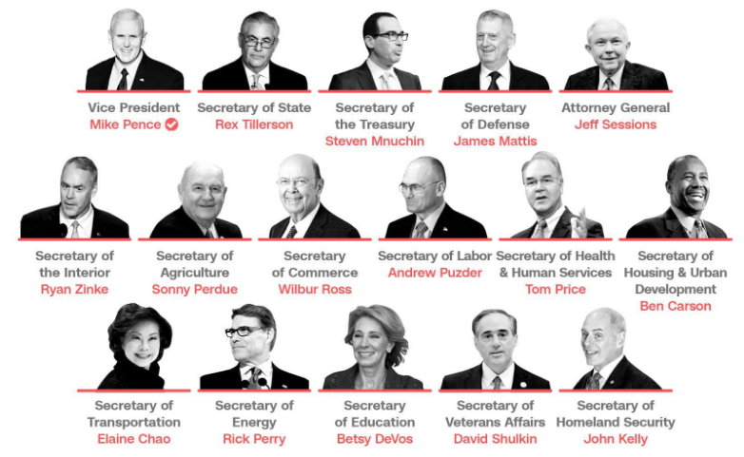
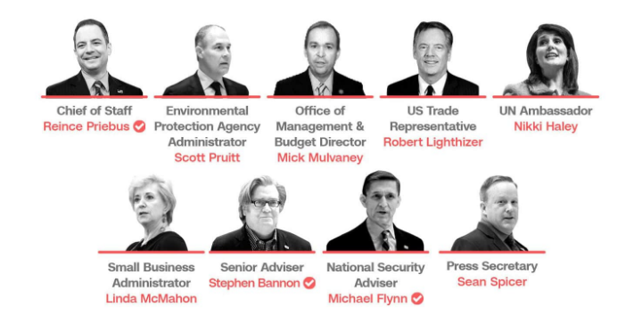
Gender and health in developing countries

Slide 22
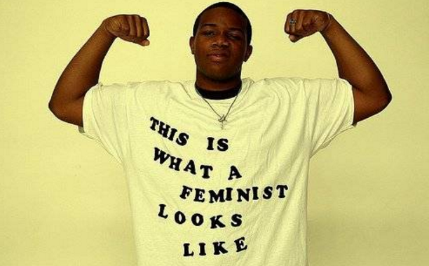
Gender and health in developing countries

