Slide 1
Humanitarian Response in Syria: Within the Syrian borders: A challenge of epic proportions

Slide 2
Not discussing: Turkey – 2.7 million 3.4% host pop Lebanon – 1.07 million 25% host pop Jordan – 637k 7% host pop Iraq 245k 0.7% host pop Greece EU

Slide 3
Syria: Total pop – 22.85 million Refugees – 5 million: 22% IDP’s – 6.5 million: 28% People in need of assistance – 13.5 million: 60%

Slide 4
The Bible never saw numbers on the move such as we see now Incomprehensible numbers Challenge of epic proportions

Slide 5
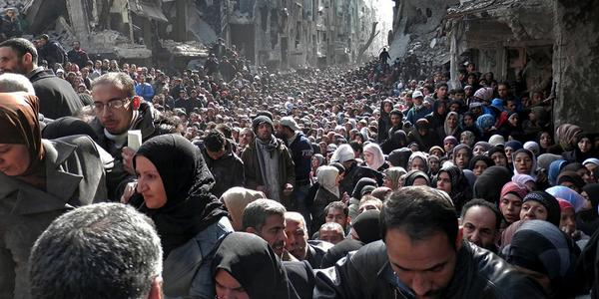

Slide 6
Supply Chain & Logistics Challenges Faced

Slide 7
Access Issues: Borders crossings Government Interaction Roads – Damaged Infrastructure Air - Minimal Roadblocks – Checkpoints Fluid Situation – Rapid Changes

Slide 8
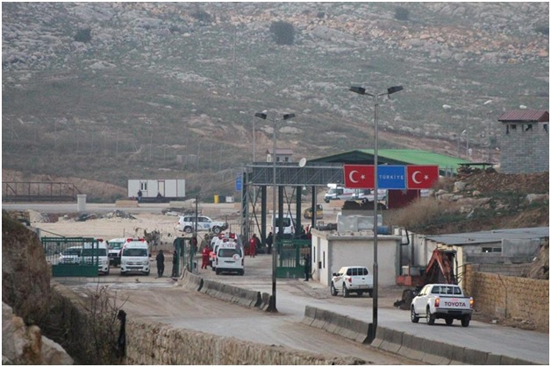

Slide 9
Infrastructure Roads Bridges Electricity/Lighting Water Sanitation Solid Waste - Sewage

Slide 10
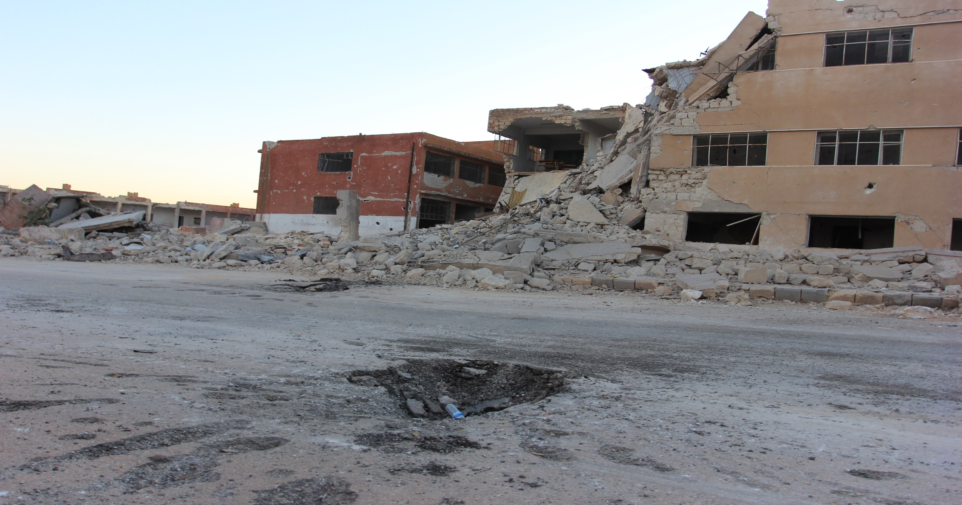

Slide 11
Staff Duty of Care Health & Safety Turnover of staff Short term contracts Leave on short notice, if any

Slide 12
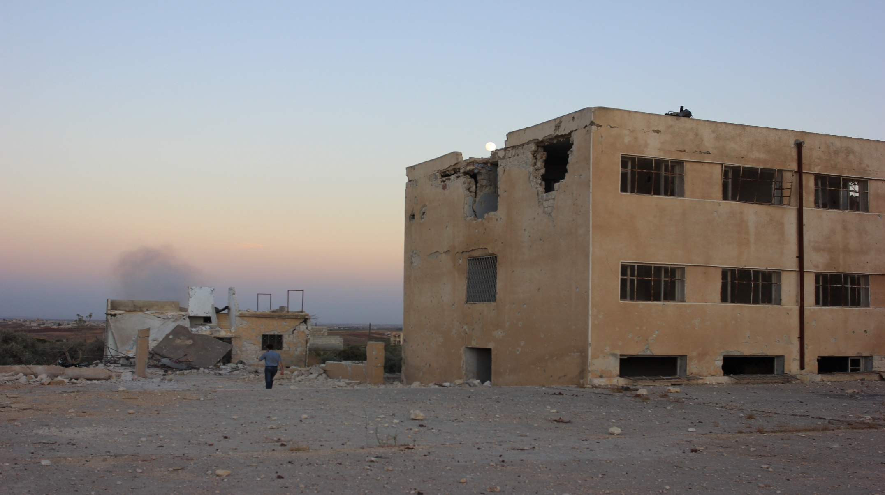

Slide 13
Key areas of logistics response Fuel - Ethics Flour – Quality/Testing Food Kits – Quantities/Analysis NFI - Variable Shelter – Differing Needs WASH – Complete breakdown Procurement – Suppliers/Payments

Slide 14
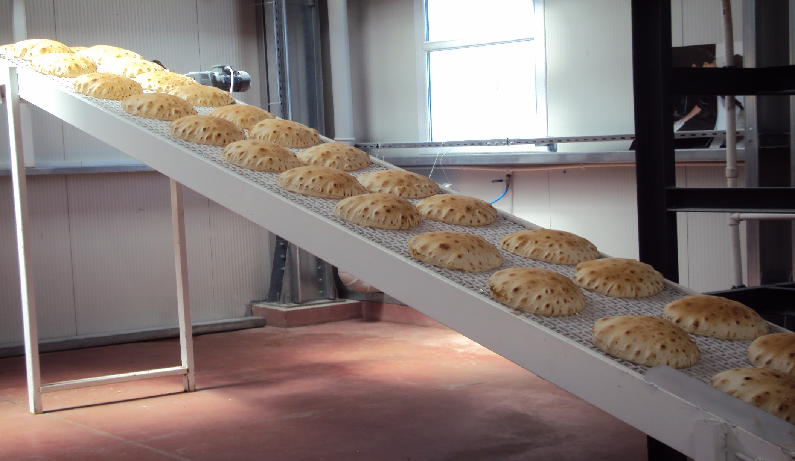

Slide 15
Daily logistics Issues Vehicle Management IT Infrastructure Warehousing Security of goods Large Projects Supply Chain Management

Slide 16
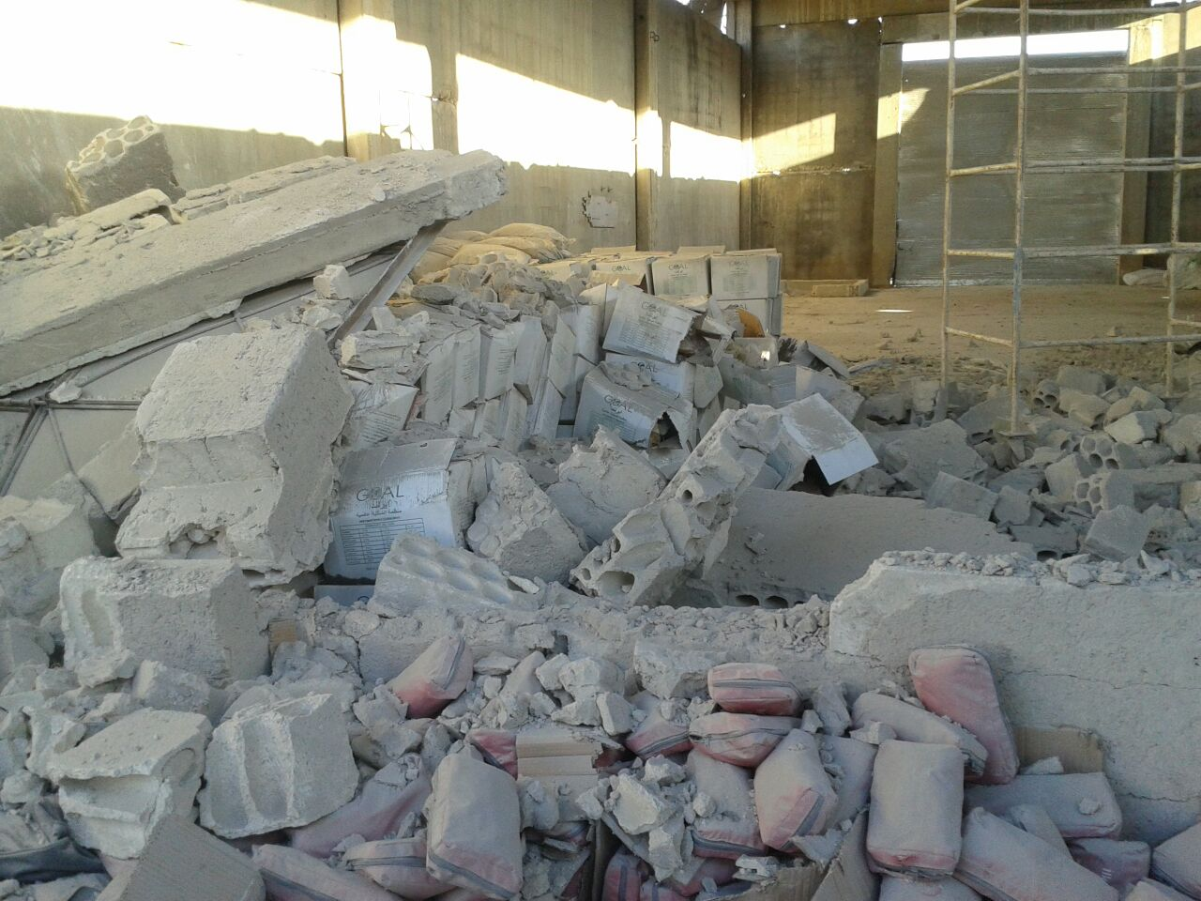

Slide 17
NGO logistics expertise Many set up as direct response Minimal expertise, if any No training ‘First thing that’s cut’ Little concept of forward planning ‘Chickens will come home to roost’

Slide 18
