Slide 1
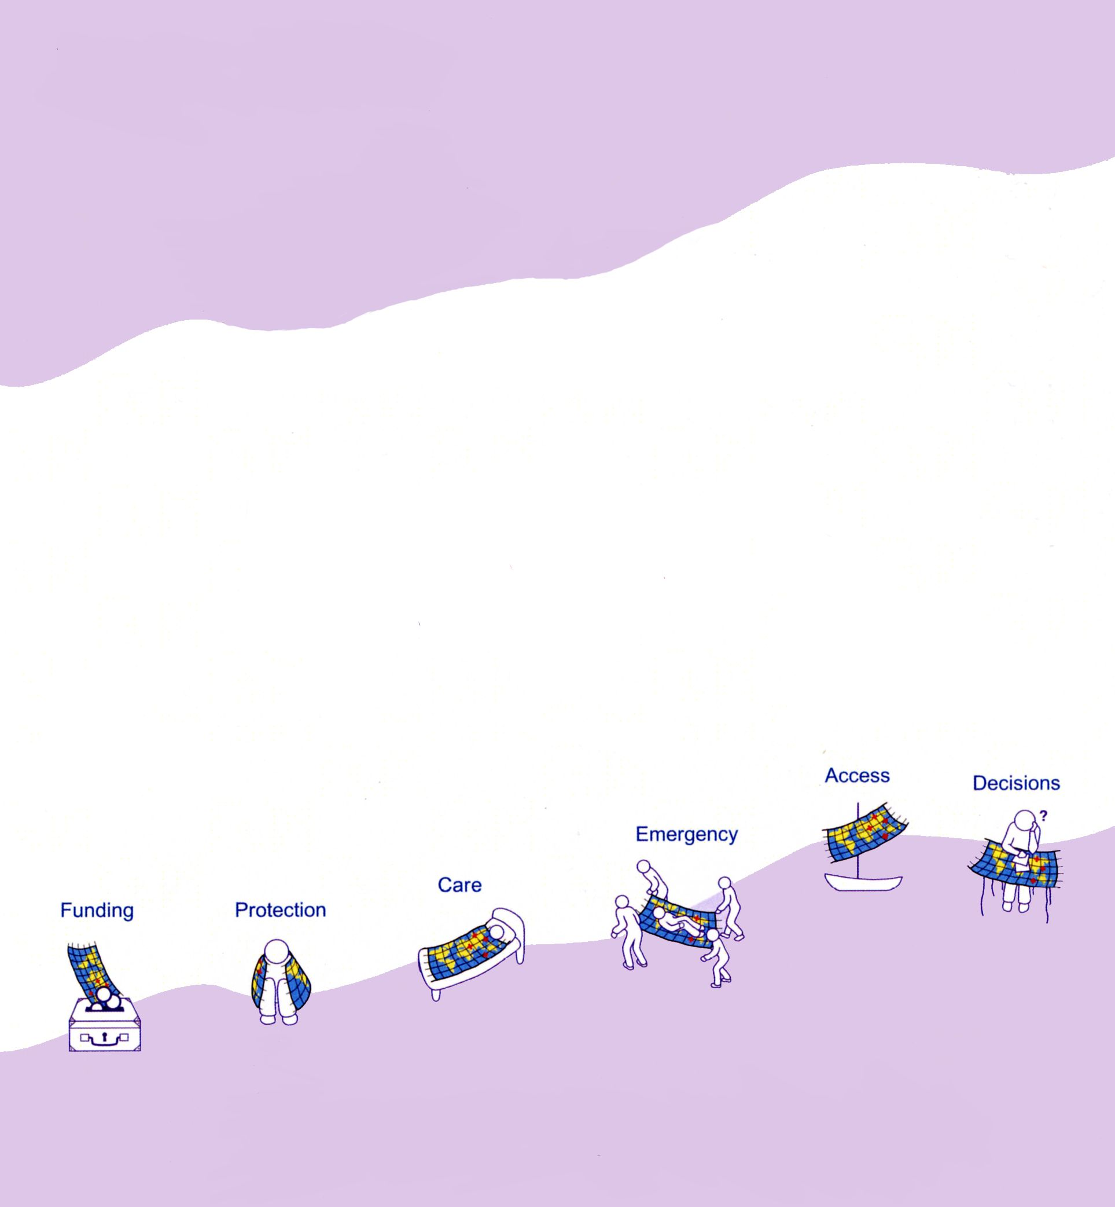
Centre for Health Geoinformatics
www.chg.ie
GIS to support Health in Poor Countries
Jan Rigby
[Department of Geography & Centre for Health Geoinformatics]
How can geographic information best support effective decision making in the health arena?

Slide 2
Geographical Information Systems
GIS: a system technology to describe, explain, predict and plan for patterns and processes at geographical scales
How can geographic information best support effective decision making in the health arena?

Slide 3
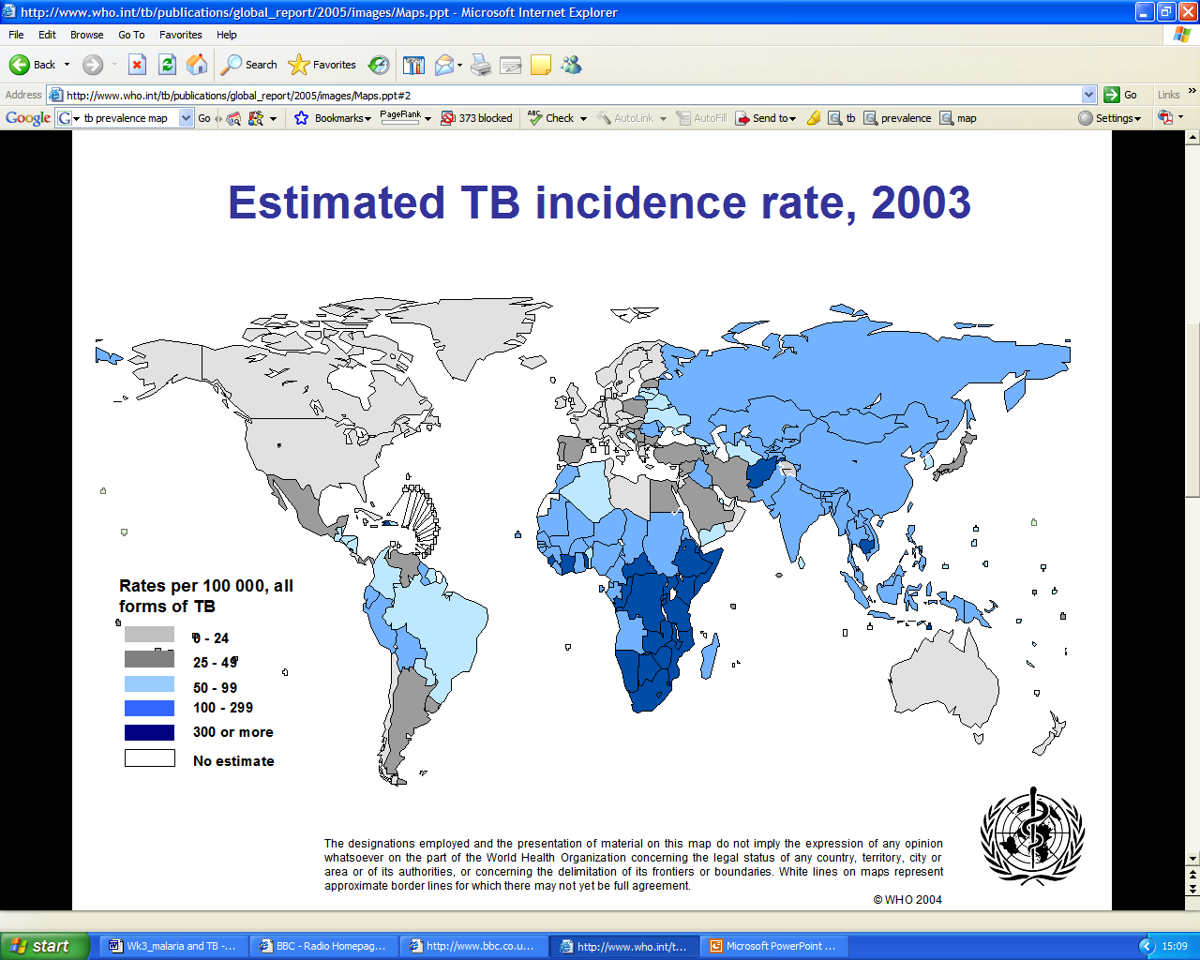

Slide 4
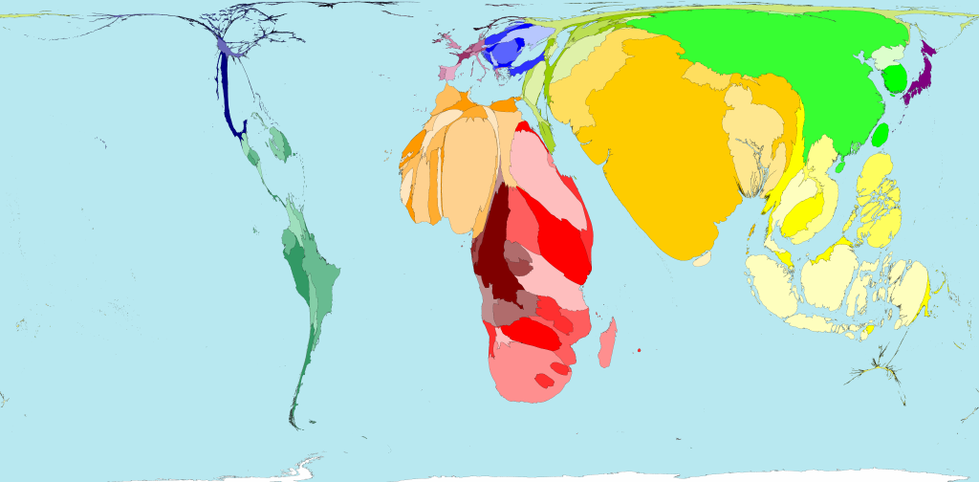
Cartogram of tuberculosis cases
Source: www.worldmapper.org,

Slide 5
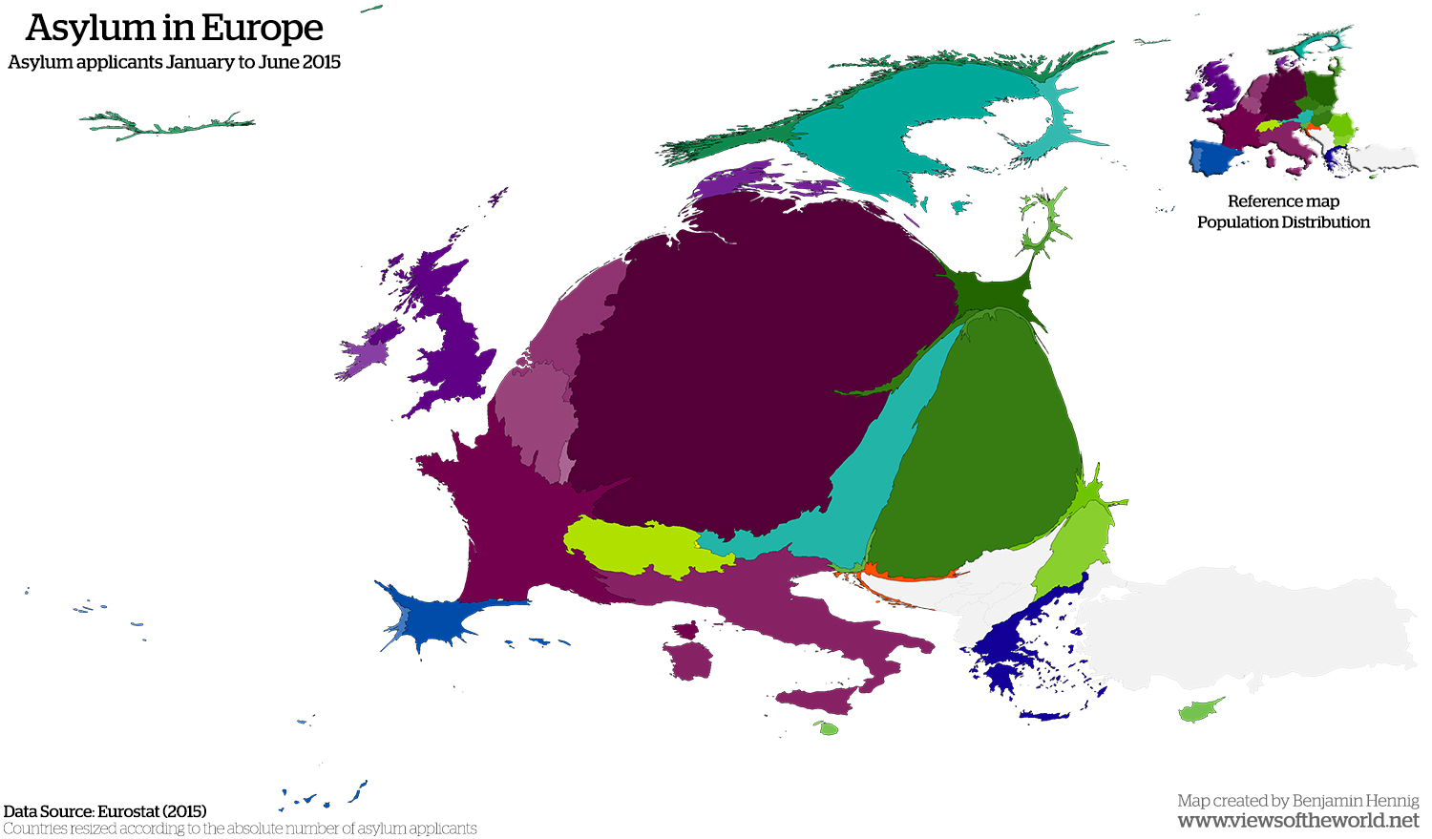

Slide 6
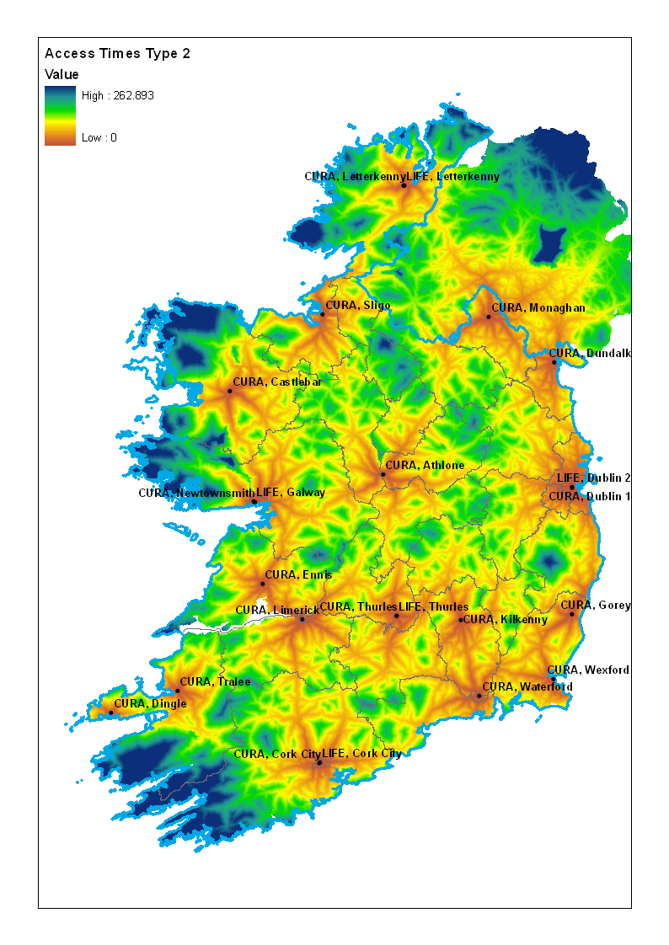
Ireland: access to service locations by travel time

Slide 8
Context
When training health researchers in GIS skills in poor countries, there is an enormous problem in sustaining the expertise that is being developed. We can fall back on the usual culprits: people, data and technology. A major barrier in the technology phase has been software. We tend to train using software we know is robust, and that software is often a commercial project which is unaffordable to those we have trained.

Slide 9


Develop sustainable training in GIS for health researchers in poor countries
Minimal cost to those being trained
Basic analysis – capturing and mapping point data, mapping area data
Ongoing support
GIS Health Research Open Source

Slide 10



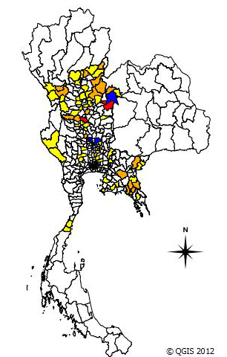
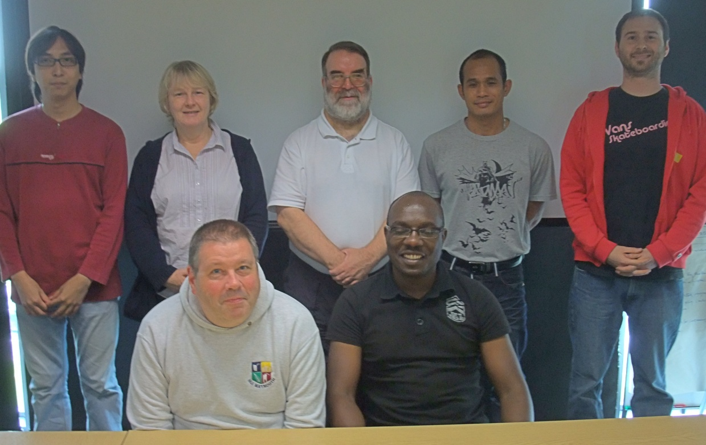
Leptospirosis Thailand 2011
GIS Health Research Open Source

