Slide 1
Mixed Messages? Exploring issues of representation in the Irish development NGO sector.
Lydia Kelly
DSA Ireland Annual Conference 2016: “Beyond Aid? Innovative Models for Social Justice”

Slide 2
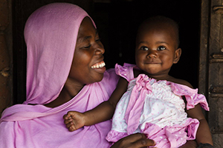
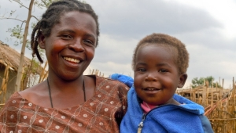
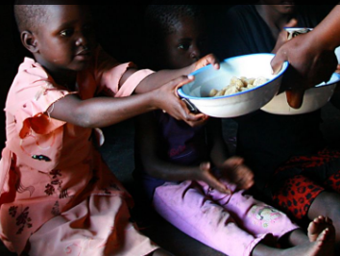
Ethical issues and representation
Prevalence of neo-colonial representations and problematic relationships of power:
Dominance of images children and mothers
Feminisation of poverty (absence of men)
Africanisation of poverty
Deliberate positivism
Reinforcing the relationships of strong/giver/superior and weak/receiver/inferior between the Global North and the Global South
(Lissner,1997), (Dogra, 2012/2008), (Liddchi, 1999)

Slide 3
Ambivalence and representation
The development NGO sector is currently facing a crisis of legitimacy, and even with attempts at self-regulation NGOs have also been criticised for their use of ethically questionable representations. Despite such criticism and in the context of growing scrutiny, NGOs continue to use methods of representation that conflict with their agendas and undermine their claim to ethical justification.

Slide 4
Aims of the project
There has been research into the public perceptions of development practise in Ireland (Dillon, 2015) (Kenny and O’ Malley, 2002) as well as representations used by NGOs (Murphy, 2014).
This project aimed to undertake a qualitative study of the perspective of development professionals on issues of ethics in representations in an Irish context in order to further understanding and broaden the discussion.
The data collected from in-depth interviews with Irish development professionals working in roles relating to the “representational field” form the basis of the findings.

Slide 5
Findings
There were 6 main findings from the research
1. Contradictory perceptions of the public as both expectant of certain types of representation, but also capable of more nuanced messages
2. Conflict within NGOs between agendas of fundraising and campaigns/development education
3. Legacy of the white saviour discourse as a useful model to appeal to the public
4. Ambiguity
5. Inclusion of structural causes of poverty into the conversation
6. Question of the “right to represent”

Slide 6
Findings
Current situation
Tools to achieve change
New directions/change
Competing Paradigms
Self-reflexivity and reflective professional practice
Broaden/shift conversation to include structural issues
Tensions
Ambiguity
Notes:
The usefulness of the White saviour discourse exacerbates the conflict between the competing paradigms, creating tensions which leads to ambiguity, both within the NGOS, for the development professionals and in the representations they produce. This research suggests that incorporating a discussion on structural justice issues could act as a tool towards addressing this and achieving more

Slide 7
Recommendations
The research identifies two areas and opportunities for growth
Comprehensive development education both by and within NGOS in order to facilitate more nuanced discussion of complex issues
Self-Reflexivity spaces for development professionals to reflect on their roles as ‘representers’ and to consider the long-term consequences of the representations they produce

