Slide 1
Setting the Scene : Research Funding Opportunities for International Development
22nd September 2015

Slide 2
National Sources of research funding
Minimal
Irish Aid – New call soon???
Irish Research Council – mainly fellowships, some small grants and projects awards.
No opportunities from other Irish funding agencies – advocate for more grant schemes in this area?

Slide 3
International Research Funding Sources
European funding
Programmes from other relevant DGs
Notes:
The Irish Research Council funds both postgraduate and postdoctoral fellowships.
There are Three types of Post Doc schemes.
1) The GOI 1 year fellowship is to allow researchers to prepare a doctoral dissertation for publication
through a variety of high quality published outputs e.g. monographs, peer-reviewed articles, edited volumes
2) The GOI 2 year fellowship is to allow researchers to develop either a new research project or a
research project that demonstrates a significant development of the subject of the doctorate through a variety of appropriate outputs.

Slide 4
EU Directorates-General
34 DGs
Many run funding calls and tenders
Most relevant for development research:
DG Research & Innovation (Horizon 2020, EDCTP)
DG International Cooperation and Development (EuropeAid)
Other possible DGs Climate Action, Justice & Consumers
Notes:
The Irish Research Council funds both postgraduate and postdoctoral fellowships.
There are Three types of Post Doc schemes.
1) The GOI 1 year fellowship is to allow researchers to prepare a doctoral dissertation for publication
through a variety of high quality published outputs e.g. monographs, peer-reviewed articles, edited volumes
2) The GOI 2 year fellowship is to allow researchers to develop either a new research project or a
research project that demonstrates a significant development of the subject of the doctorate through a variety of appropriate outputs.

Slide 5
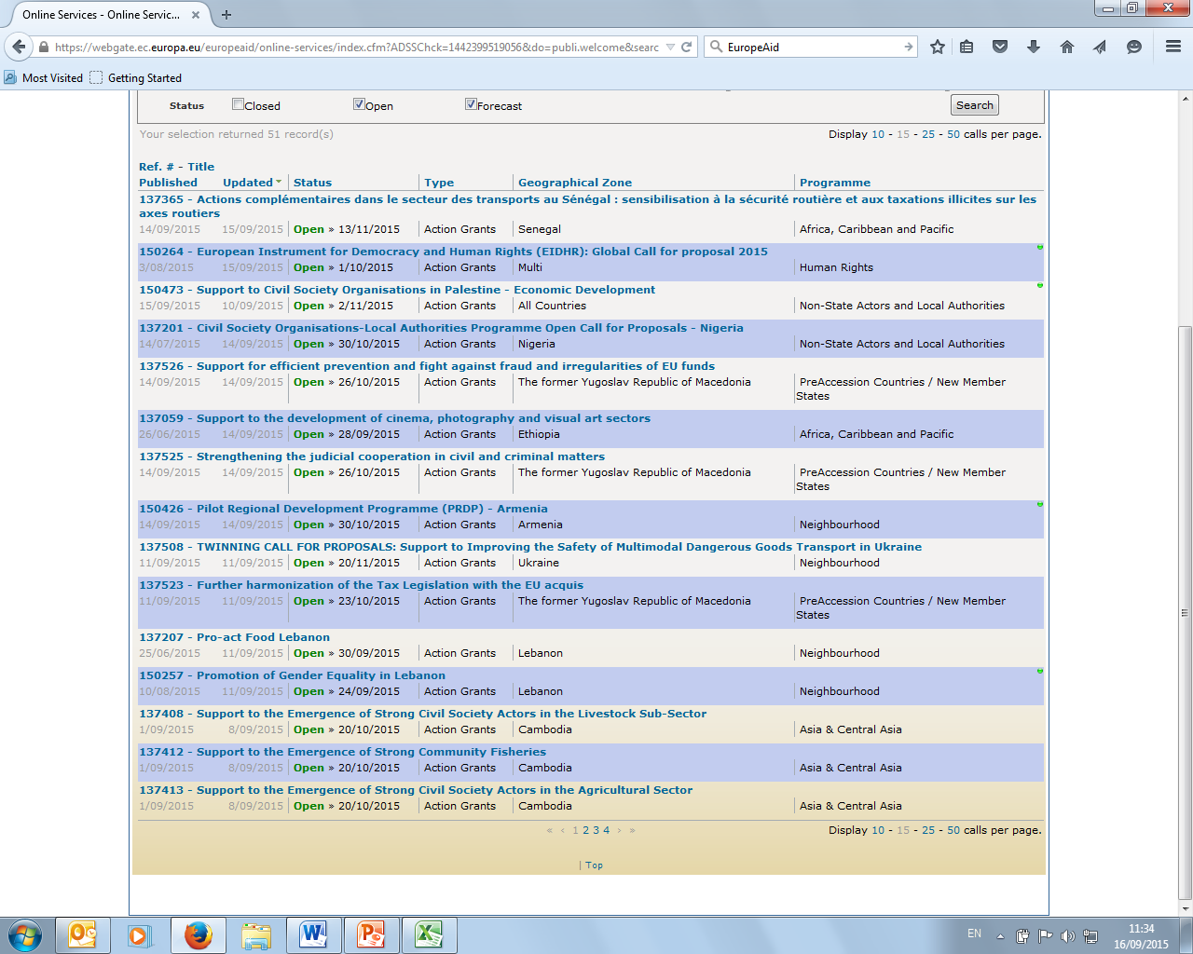
European Funding: EuropeAid
Notes:
The Irish Research Council funds both postgraduate and postdoctoral fellowships.
There are Three types of Post Doc schemes.
1) The GOI 1 year fellowship is to allow researchers to prepare a doctoral dissertation for publication
through a variety of high quality published outputs e.g. monographs, peer-reviewed articles, edited volumes
2) The GOI 2 year fellowship is to allow researchers to develop either a new research project or a
research project that demonstrates a significant development of the subject of the doctorate through a variety of appropriate outputs.

Slide 6
Other funding sources
UK funding
ESRC/DFID
Wellcome Trust
US funding
NIH
USAID
Miscellaneous others

Slide 7
Grant opportunities

Slide 8
The ‘Others’

Slide 9
Put yourself out there!
Most grants require a consortium
Consortiums are normally formed from personal contacts – start meeting and greeting!
Participation in networking events locally and in Europe (you apply for travel grants to cover it)
Foster range of contacts including academic & non-academics

